Slide 1

END OF LIFE TYRES MANAGEMENT:
an Italian perspective
The Tire-Cologne, 29 May 2018
Notes:
Prima slide – logo/ brand azienda, nome relatore e un claim del proprio report non finanziario;

Slide 2
Ecopneus’ mission
  To satisfy all stakeholders’ legitimate expectations, with full compliance of the ethical rules
First recycling, then energy recovery
To reduce (cancel) the consumers’ eco-contribution

Slide 3
ELT collection since the beginning
1.563.662 tons/ELTs
colleted by Ecopneus
from 2011 to 2017*
16.423
tons
managed in
Terra dei Fuochi
64.644 tons
from old
stockpiles
*Estimated quantity- 2017
More than 102.000 tons
over the legal target
Currently 72 % of the replacement market

Slide 4
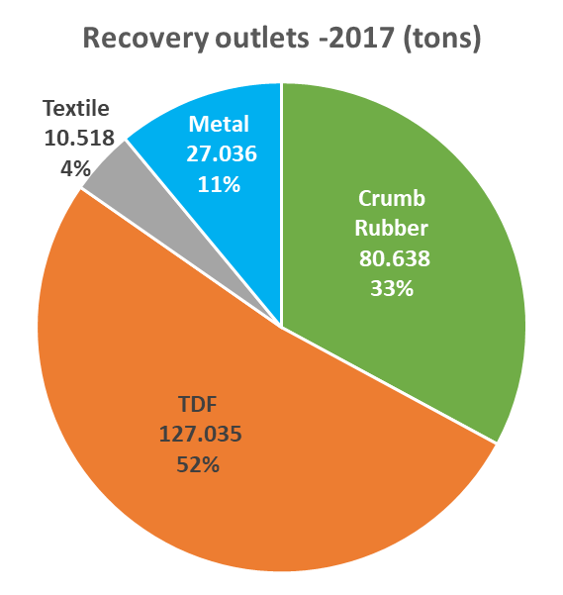
Flows
In 2017, flows have been directed to:
Granulation for 118.000 t/a (48%)
Shredding or treatment as whole for 127.000 t/a (52%)
About 56% of the material was
recycled into new
products/materials

Slide 5
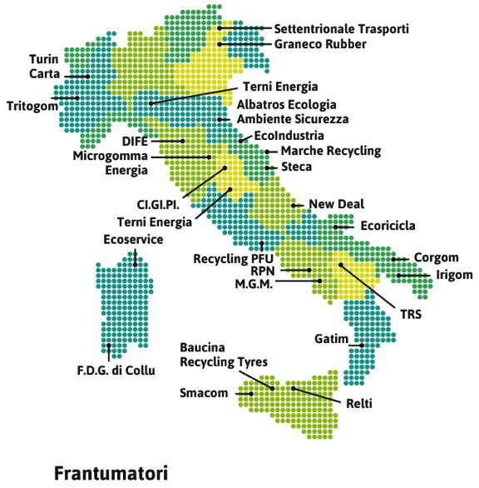
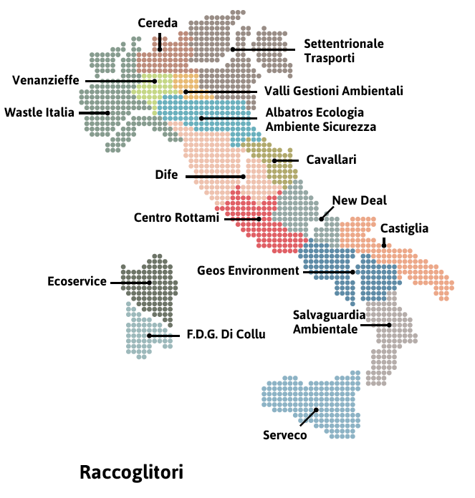
Ecopneus’ service providers
150 companies – 700 FTE
Shredders and Grinders
Collectors

Slide 6
Tracking and surveillance
IT systems:
ELTIS
SAP
Buiness Intelligence
App LND
Close monitoring:
2,5 managers
TUV engineers
contracted «inspectors»

Slide 7

Priorities in R&D

Slide 8
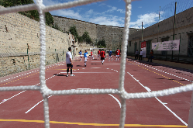

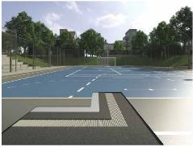
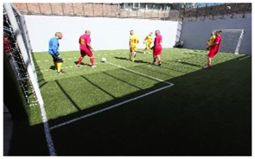
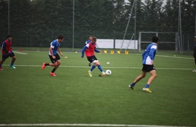
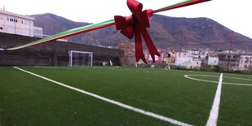
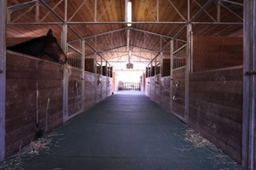
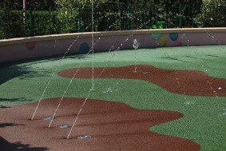
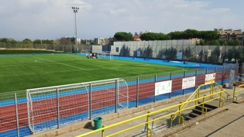
Sport surfaces
Napoli
Medolla (MO)
Prato
Siena
Atalanta (BG)
Gragnano (NA)
Todi (PG)
Leolandia (BG)
Roma

Slide 9
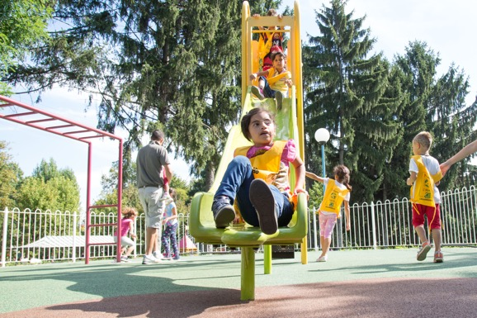
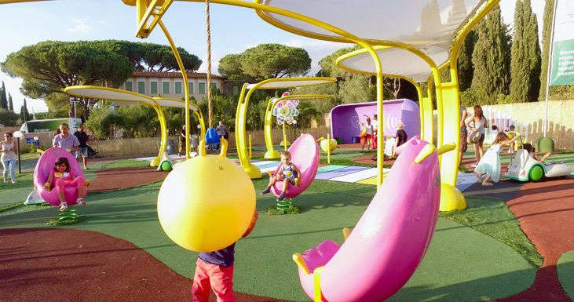
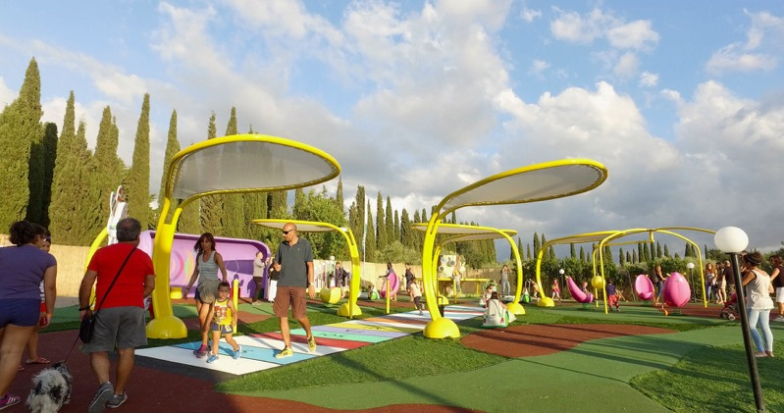
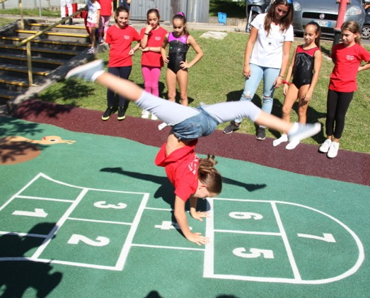
Playgrounds

Slide 10
Horses

Slide 11
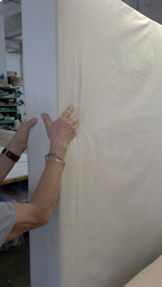
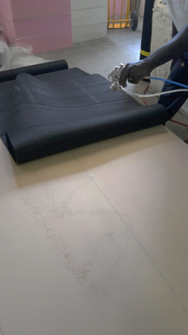
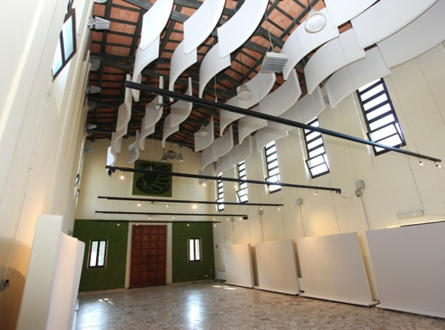
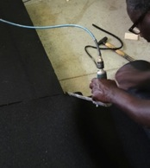
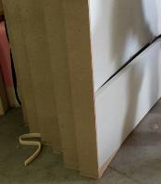
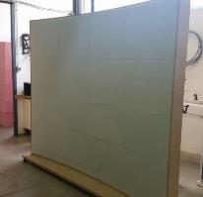
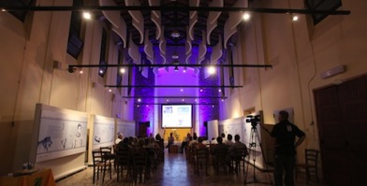
Acoustic and vibration

Slide 12
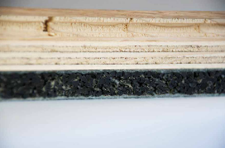
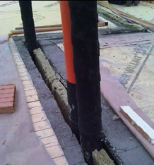
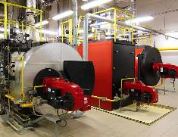

Buildings
Impact-noise deadening, antivibration joints, pipes acoustic liners, etc
Underfloor soundproofing mats
Industrial anti-vibration mats
Acoustic insulation
of walls

Slide 13
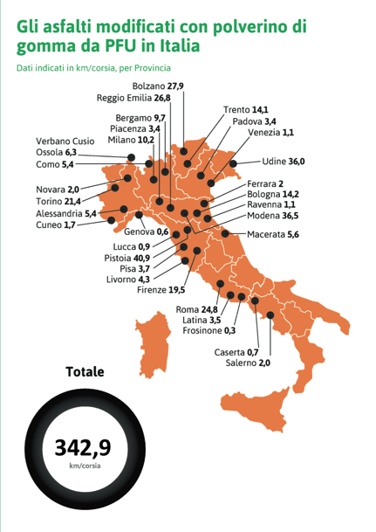
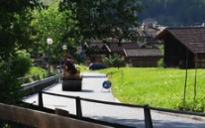
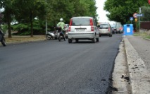
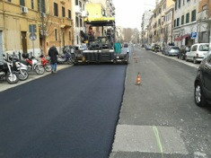
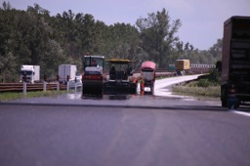
Rubber modified asphalt
A few examples:
Transacqua (TN)
Via Pistoiese - Firenze
Roma, via Torpignattara
Autostrada del Brennero
370
km

Slide 14


















Comunication
Web
Reports
Fairs/Events
Special projects
Press office and ADV
Educational

Slide 15

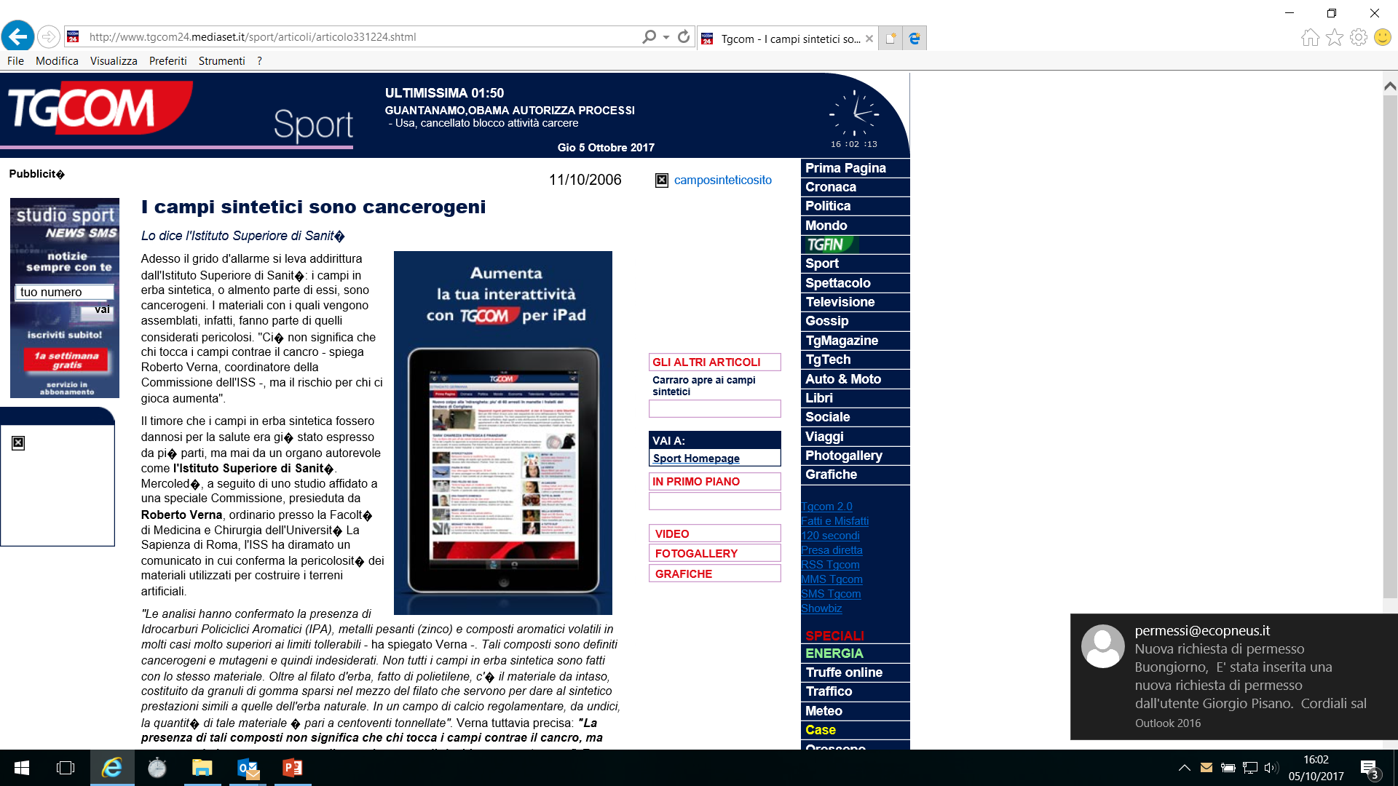
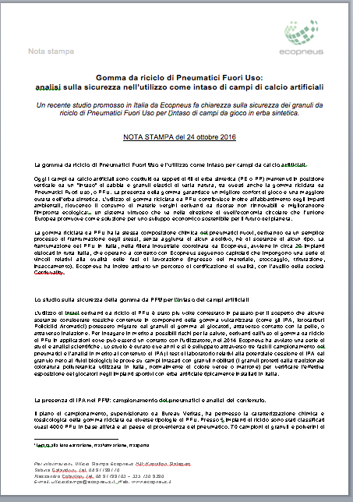




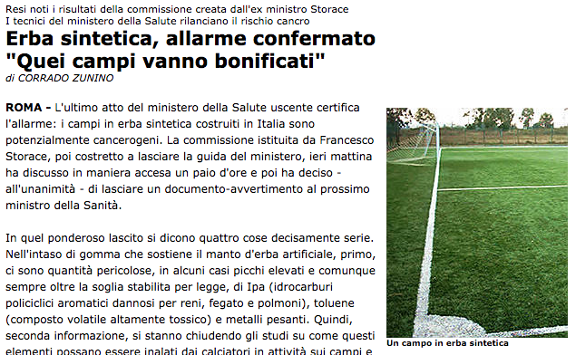

A relevant result
2006
2017

Slide 16
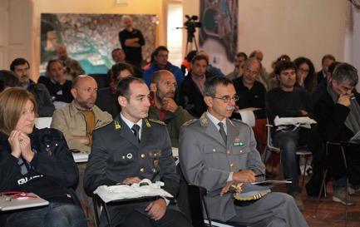

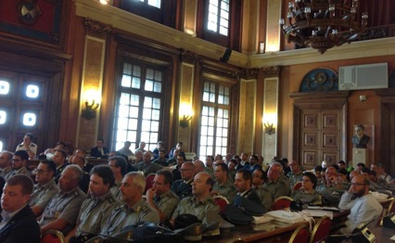
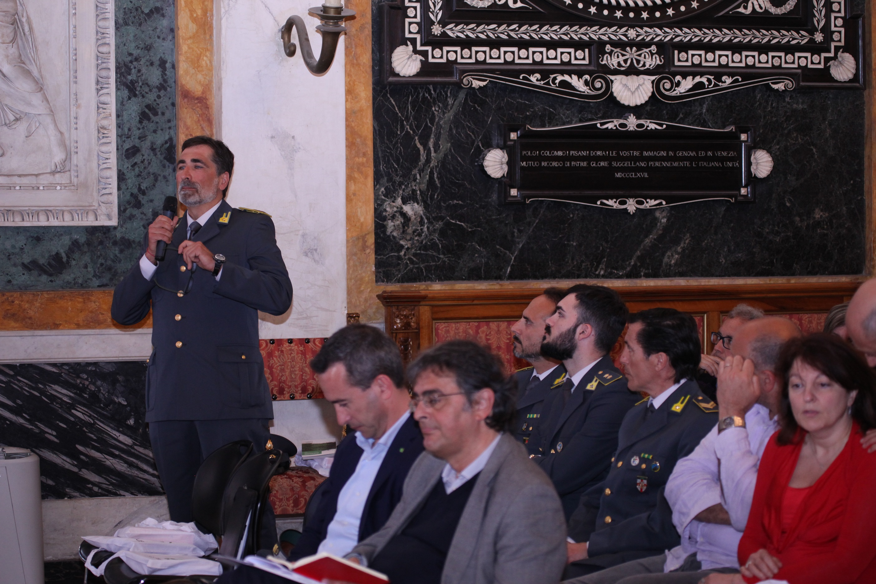

Education

Slide 17








Education – 2

Slide 18
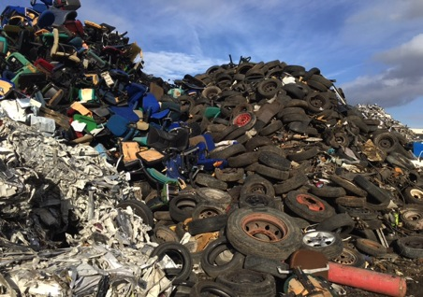
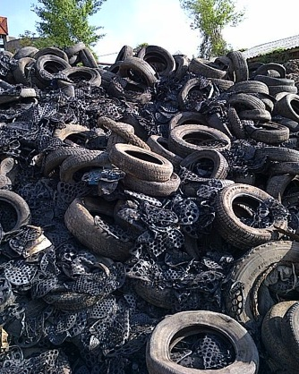
Yesterday, at the entrance

Slide 19
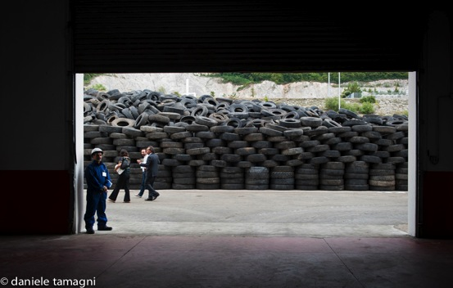
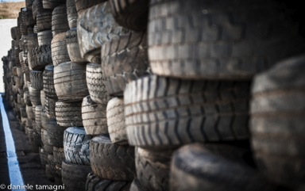
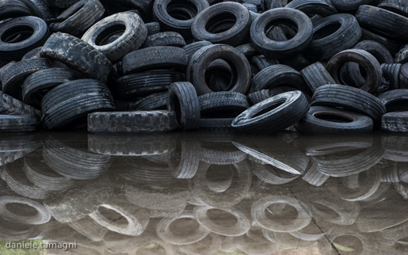
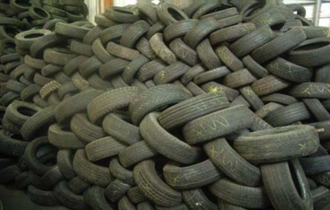
Today

Slide 20
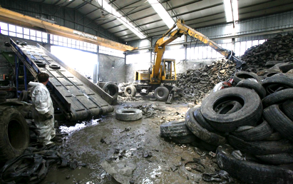
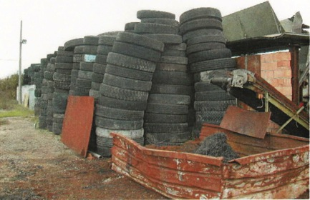
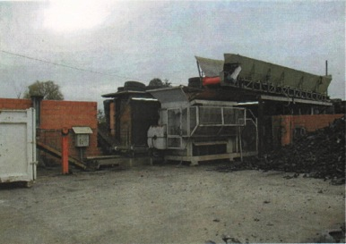
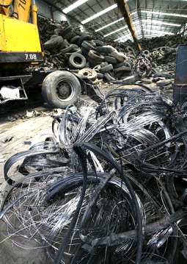
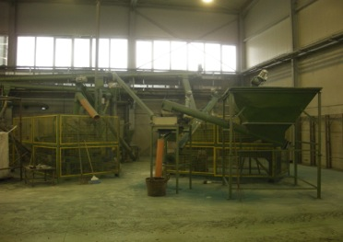
Yesterday, inside the granulation sites

Slide 21
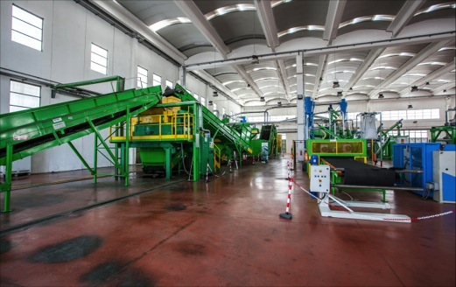
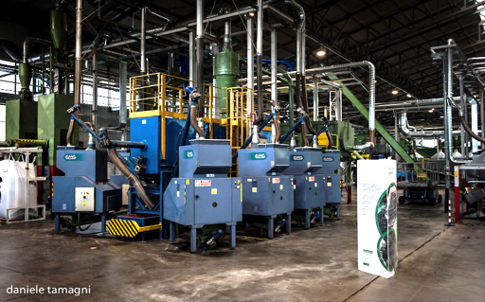
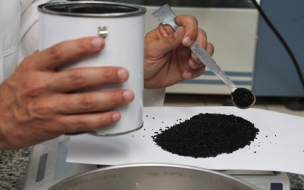


Today

Slide 22




Yesterday deliveries

Slide 23




Today

Slide 24
THANK YOU FOR YOUR ATTENTION
Daniele Fornai
d.fornai@ecopneus.it
+393459107364
Notes:
Vi ringrazio per l’attenzione.

