Slide 1
Tyres are a Global Issue
Ewan Scott – Editor of Tyre and Rubber Recycling

Slide 2
There is no country in the world without a waste tyre problem

Slide 3
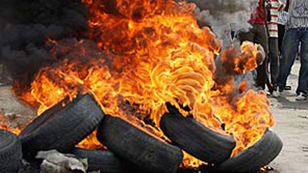
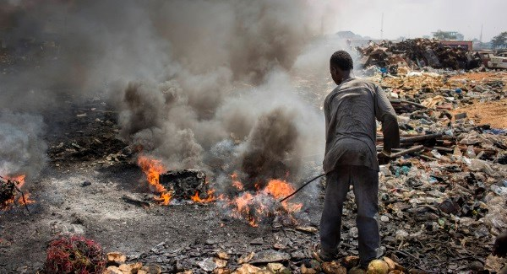
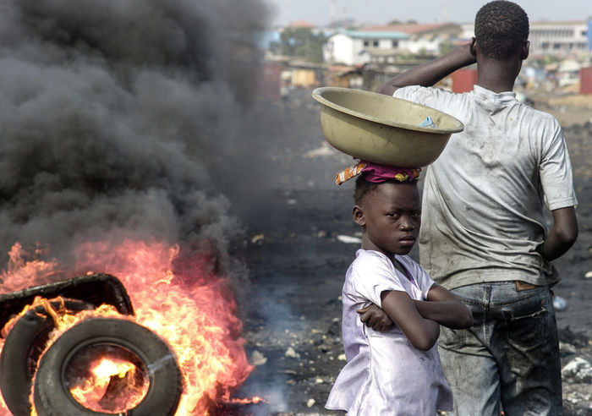

Slide 4
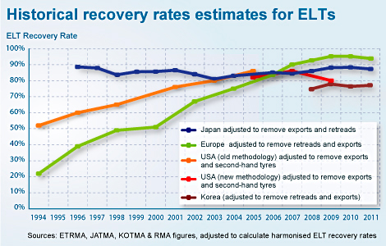

Slide 5
Top Five US Tyre Recyclers
Liberty Tire Services 123 million units Crumb rubber, mulch, TDF
Lakin General, 31 million units Die-cut products, civil engineering, TDF
CRM 25 million units Asphalt rubber, synthetic turf, moulded products
Lakin Tire 19.4 million units TDF, crumb rubber, civil engineering
Emanuel Tire Co. 12.1 million TDF, horse arena and playground cover material

Slide 6
Lack of feedstock security
Reluctance to use recycled materials
Lack of domestic markets
Undeclared tyre trade
Not in My Back Yard
Organised criminal activity
Exports – Legal and Illegal
Confusion over EoW Status
Unfair competition

Slide 7
Floor Tiles and Mats
Rail Ties
Street Furniture
Sports surfaces
Wood substitute
Rubberised Asphalt
Tram and Rail insulation
Steel reinforcement for concrete
Water Filtration
Laminates
Rubber Aggregate
Irrigation Pipes
rCB
Insulation
Mouldings
Oil recovery
Building Bloacks

Slide 8
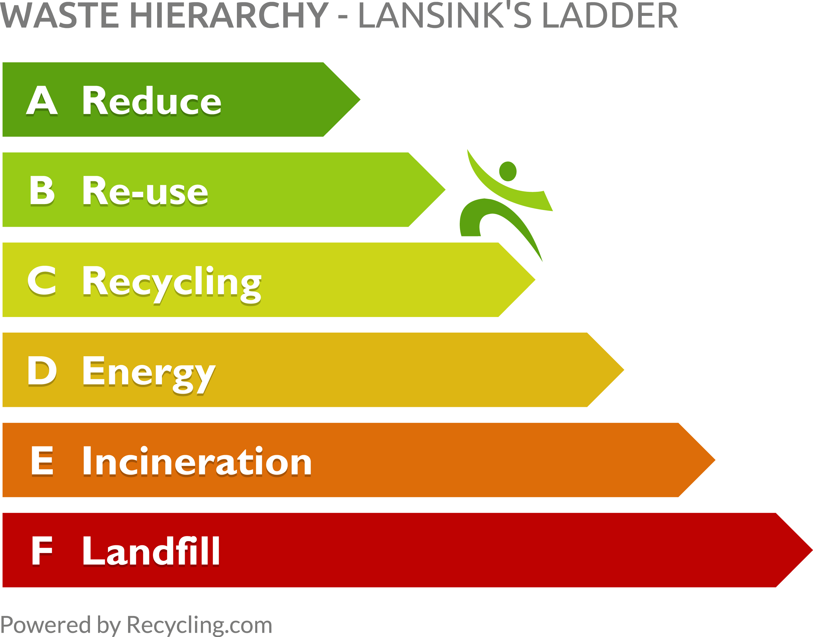

Slide 9
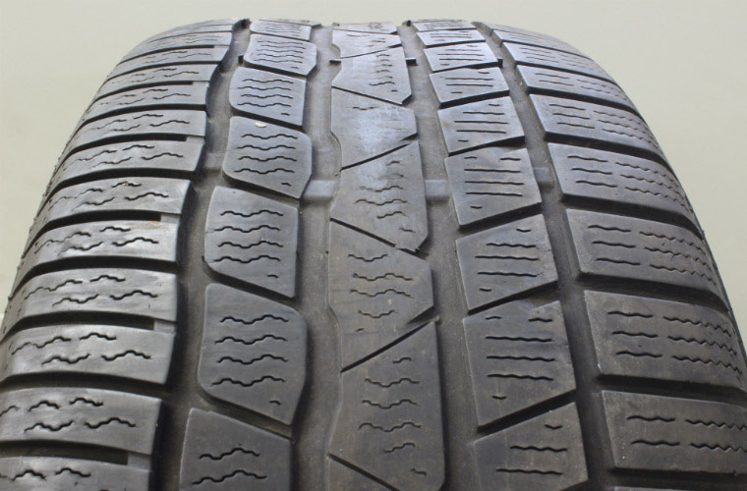

Slide 10
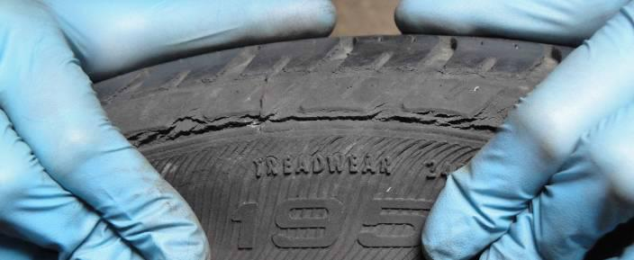

Slide 11
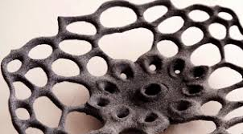
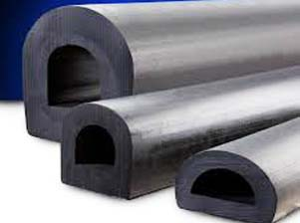
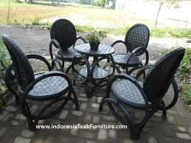
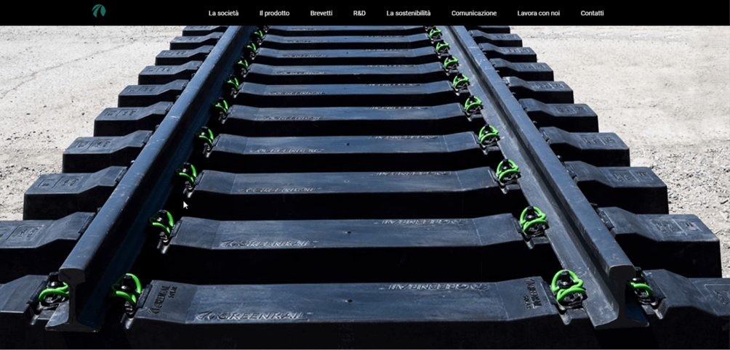
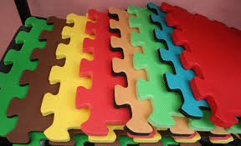
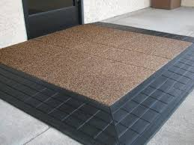
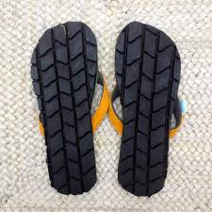
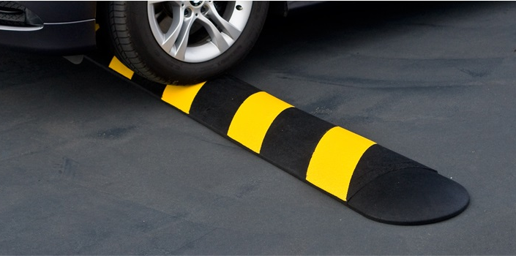
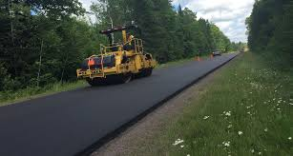
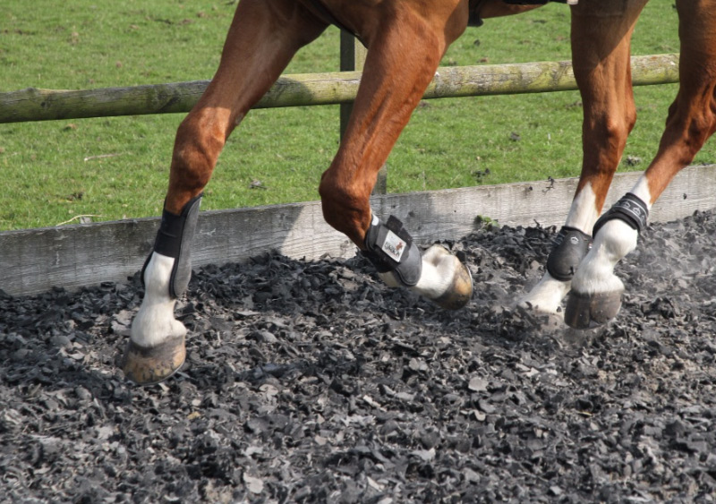
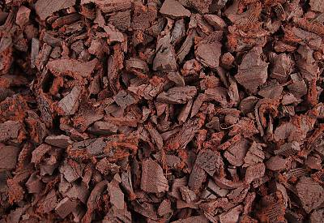
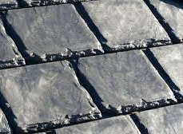
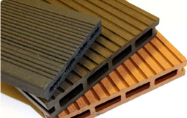
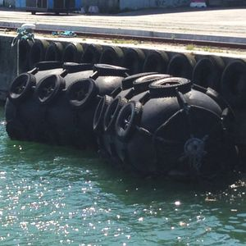
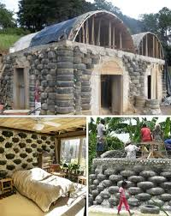
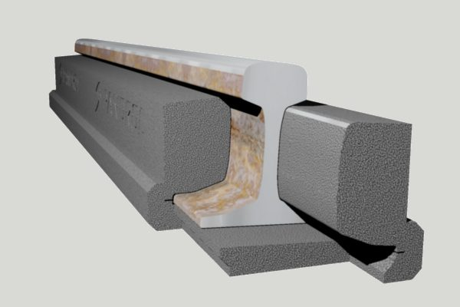
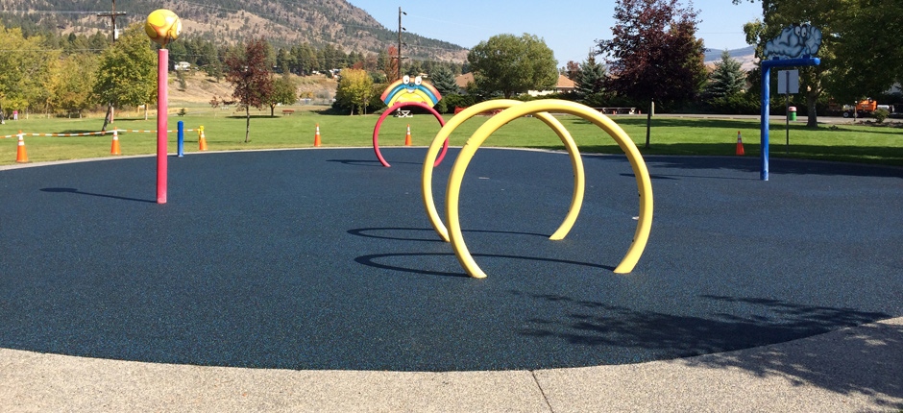
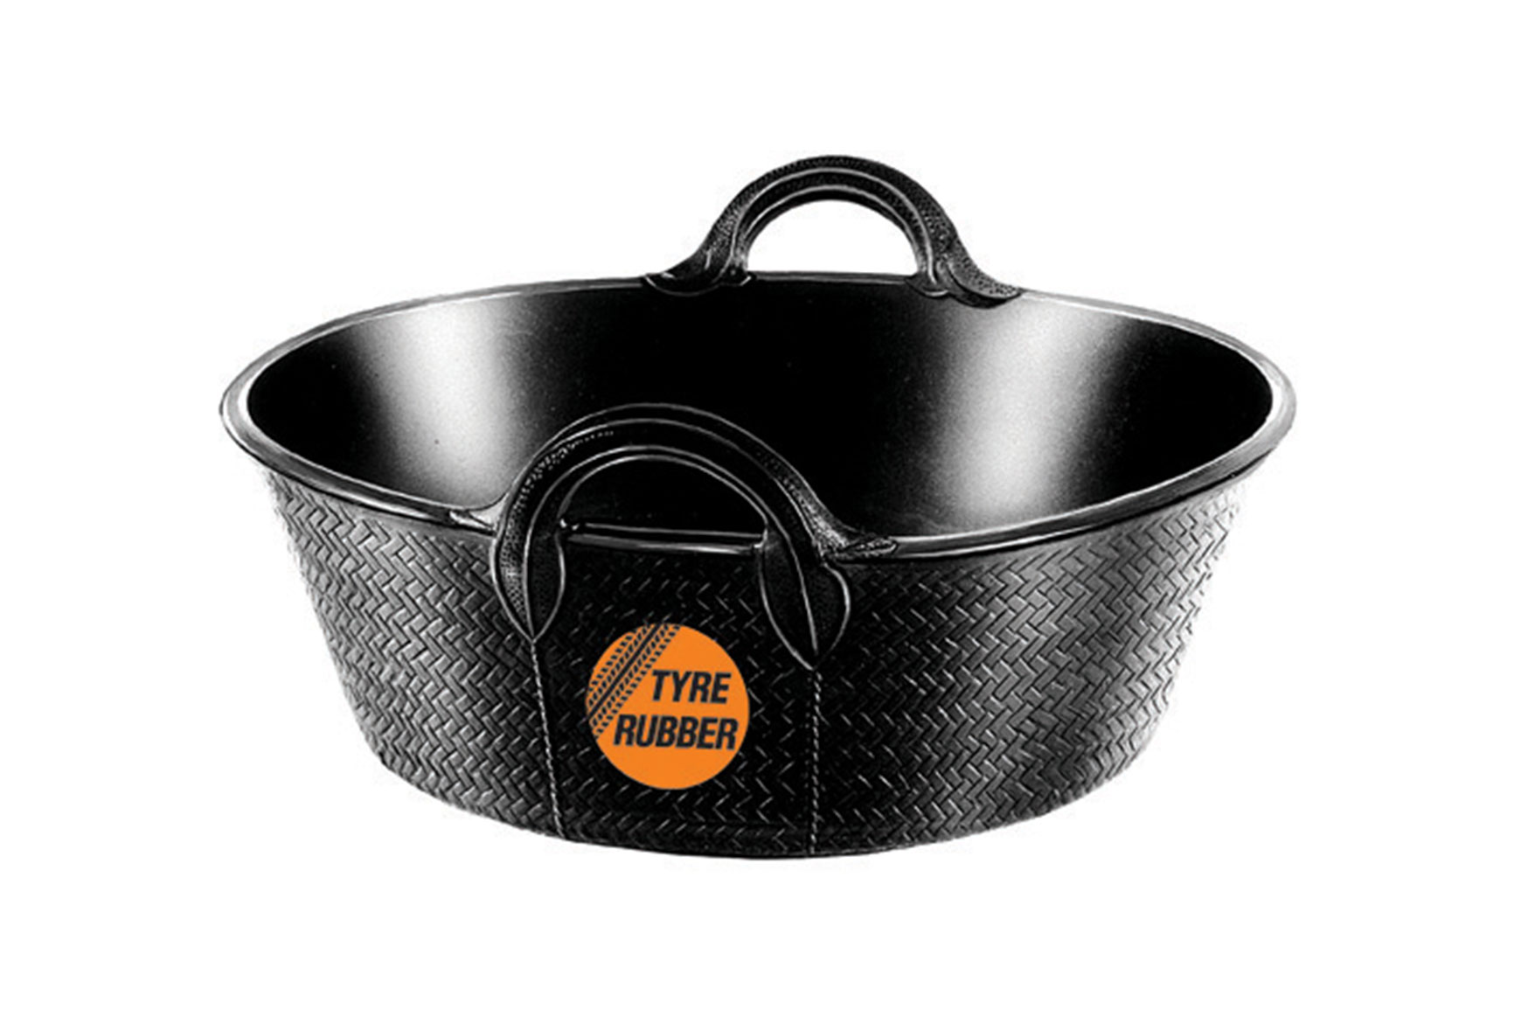
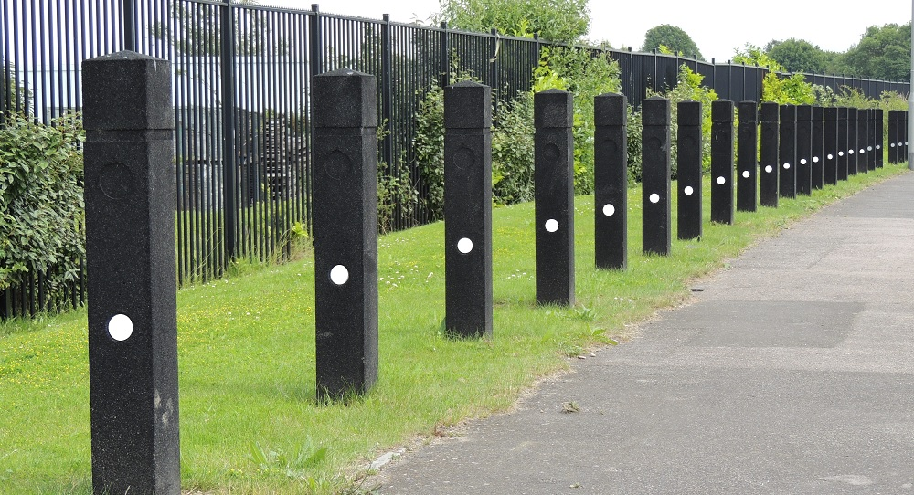
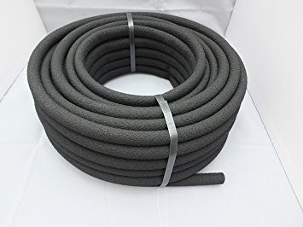
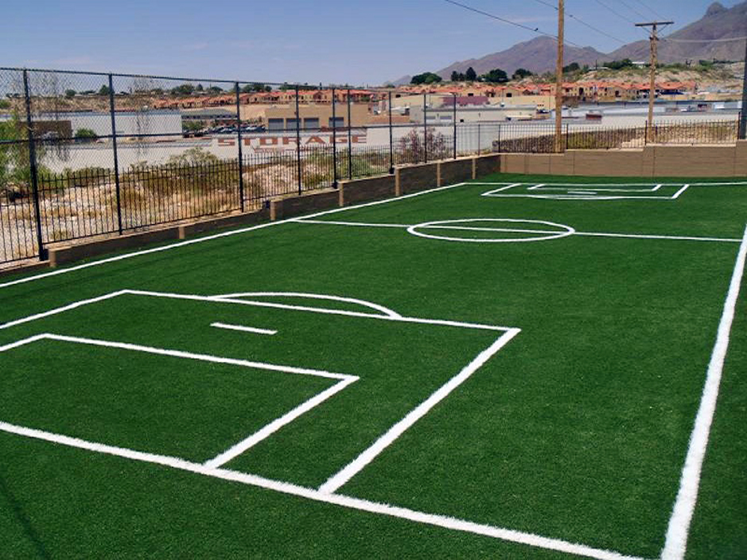
Recycle

Slide 12
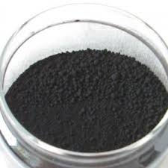
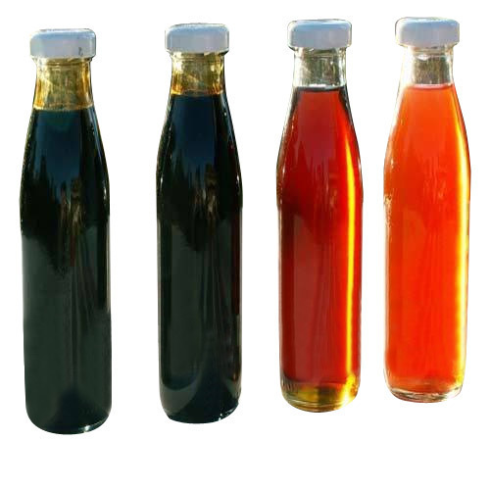
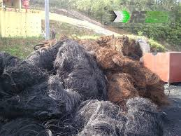
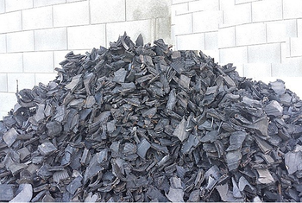
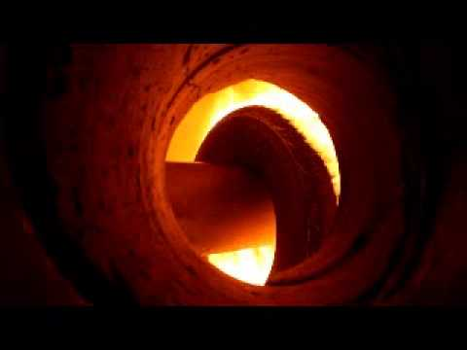
Recover

Slide 13
Disposal by Landfill
ETRMA Figures show 134,000 tons still going to Landfill (or unknown)
78,000 tons of that figure is estimated to be from Turkey
24,000 tons is estimated to be from the UK (according to the UTWG)*
Many Countries show zero to Landfill
* Unknown is probably a better description of their fate

Slide 14
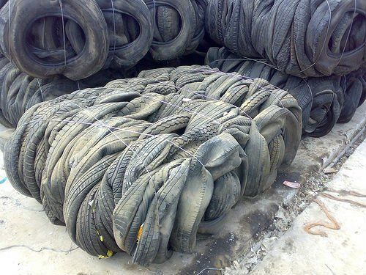
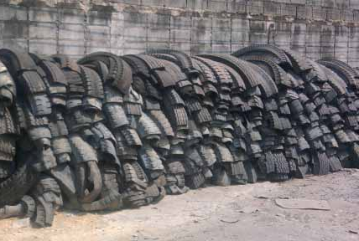
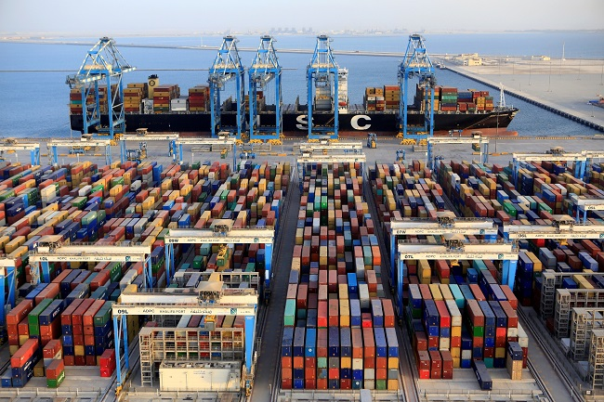
Disposal by Export

Slide 15
The treatment and disposal of hazardous waste should take place at the closest possible location to its point of origin in order to minimise the risks involved in its transport. According to a similar principle, any community should recycle or dispose of the waste it creates, inside its own territory.

Slide 16
Closing Doors
China – official ban on imports of ELT
Vietnam – only temporary imports permitted
Malaysia – considering a ban on waste tyre imports
India – preparing EPR scheme, anticipates a domestic surplus…
Legally banned in Nigeria, Ghana and other states (though borders are porous)

Slide 17
Tyres are a global issue but the solutions need to be local
We need to harness the resources of waste tyres and maximise the benefits
We need to build strong recycling infrastructure and ethos
We need to ensure that the public buy into recycling
We need to do better – individually, nationally and globally

