Slide 1
an overview of the European Tyre Recycling Market
Tyre Recycling Forum
29 May 2018 - Köln
Jean-Pierre TAVERNE EU Coordinator End of Life Tyres & Director Circular Economy

Slide 2
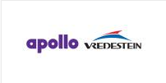
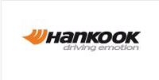
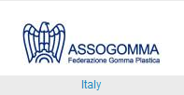
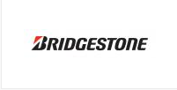
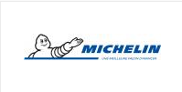
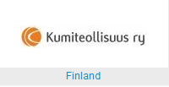
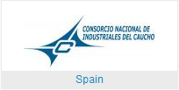
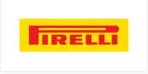
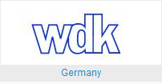
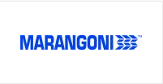
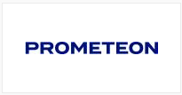
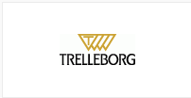
ETRMA MEMBERS
2

Slide 3
EU Landfill Directive (1999/31/EC)
National EPR regulation – basis for EPR schemes
3
EU Landfill ban for ELTs (Dir. 1999/31/EC) – whole (since 2003) & shredded ELTs (since 2006)
ELT-specific National EPR regulation (see examples below)
Decreto-Lei n.º 111/2001, de 6 de Abril, estabelece os princípios e as normas aplicáveis à gestão de pneus e pneus usados. Download
Decreto-Lei n.º 43/2004, de 2 de Março, clarifica algumas das normas do Decreto-Lei n.º 111/2001. Download
https://lovdata.no/dokument/SF/forskrift/2004-06-01-930/KAPITTEL_5#KAPITTEL_5
….
Ministerial Decree no. 82 of 11th April 2011
Article 228 of L.D. no. 152/06, as amended
Ministerial Decree of March 7th, 2012 no.44
https://www.aliapur.fr/fr/reglementation/articles-du-code
In total, 23 out of 28 EU Member States with EPR legislation for ELTs in 2018

Slide 4
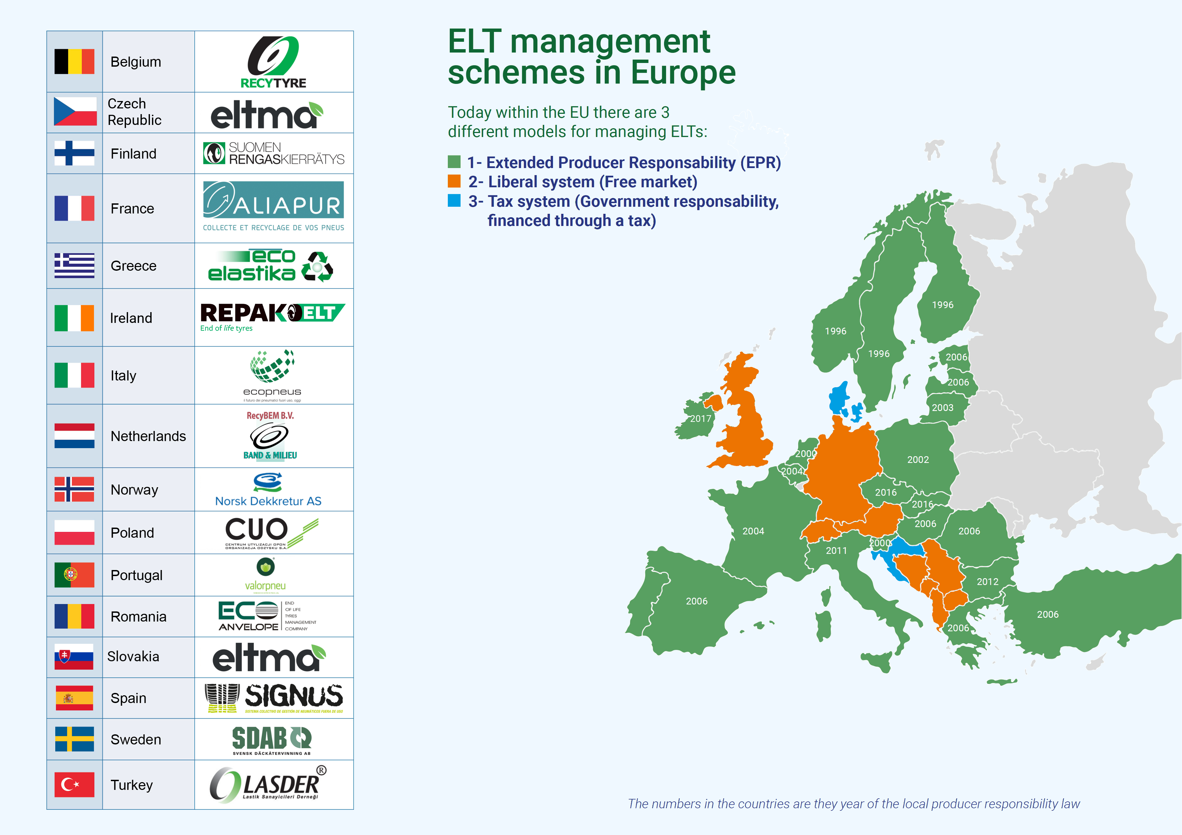
Main ELT management companies
ELT Management
Producer Responsibility Model 65% - Free market Model 33% - Tax Model 2% (2018)
(of UT arisings in EU28+CH+NO+SR+Turkey)
Notes:
3 new EPR countries:
- 2016 – SK & CZ Republic - 2017 – Ireland (limited scope – PC tyre & motorcycles) - discussions kicked off in 2018 at UK level (exploratory phase)

Slide 5
Used Tyres Arisings in Europe
Evolution of Tyre Recovery Performance in Europe
5
Total: 3.93 Mio. t Used Tyres
+ 1.67% vs. 2015

Slide 6
ETRMA 2016 ELT Management Figures
6
Rounded figures
ETRMA methodology: Incorporation in cement manufacturing of 25% (by weight) inorganic content (Fe, Si, ..) of ELTs as contribution to recycling and allocation of the remainder as energy recovery
Notes:
Présentation d’images sans Titres

Slide 7
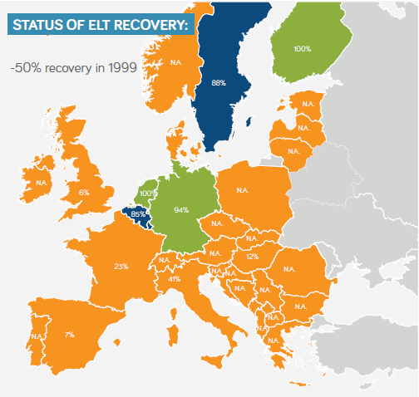
Evolution of ELT recovery in Europe
Evolution of Tyre Recovery Performance in Europe
7
Source: ETRMA
Source: ETRMA

Slide 8
8
ETRMA methodology: Incorporation in cement manufacturing of 25% (by weight) inorganic content (Fe, Si, ..) of ELTs as contribution to recycling and allocation of the remainder as energy recovery

Slide 9
Evolution of EU ELT Arisings (kt)
9
Notes:
Présentation d’images sans Titres

Slide 10
10
1.39 Mt of ELTs sent to cement kilns, district heating, power plants
ELTs sent to energy recovery slightly increased (+2%)
Top 5 countries: UK, DE, FR, IT, Poland
No credit for recycling
LUX: no data
Notes:
Présentation d’images sans Titres

Slide 11
11
AT, NO, ROM > 50% of UT arisings
LUX: no data
Notes:
Présentation d’images sans Titres

Slide 12
12
1.4 Mt of ELTs were sent to granulation in 2016
ELT granulation continued being strong (+9.3% vs. 2015)
LUX: no data
Notes:
Présentation d’images sans Titres

Slide 13
13
LUX: no data
Notes:
Présentation d’images sans Titres

Slide 14
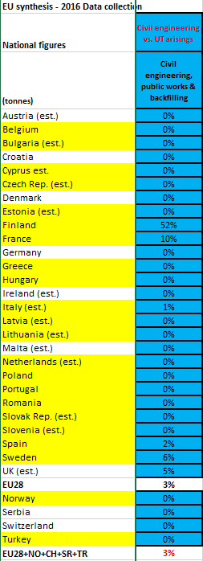
Use of ELTs in civil engineering applications – Trends
14
Top 4 countries: SF, FR, SE & UK
Civil engineering uses of whole or shredded ELTs shrunk by 3% as did the reuse of tyres as blasting mats and dock fenders (-15% vs. 2015).
Uses restricted in some countries
Notes:
Restrictions of use (whole & shreds)
SF / prohibits use of the ELTs in landfill internal structures as from 1/1/2016 (Decree on Landfills 331/2013)
IT / use of whole or shredded tyres for road embankments is forbidden + other restrictions
DE / total ban of civil engineering in land sites
BE / forbidden in drainage basins
TR / backfilling is prohibited
UK / use of tyre bales in civil engineering projects and landfill infrastructure works is strictly regulated (RPS 085)
Elsewhere
No known restriction

Slide 15
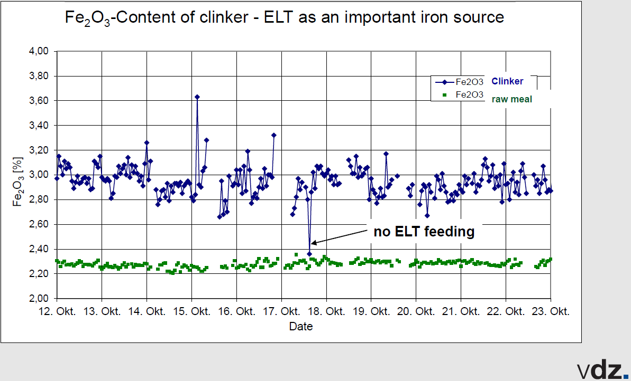
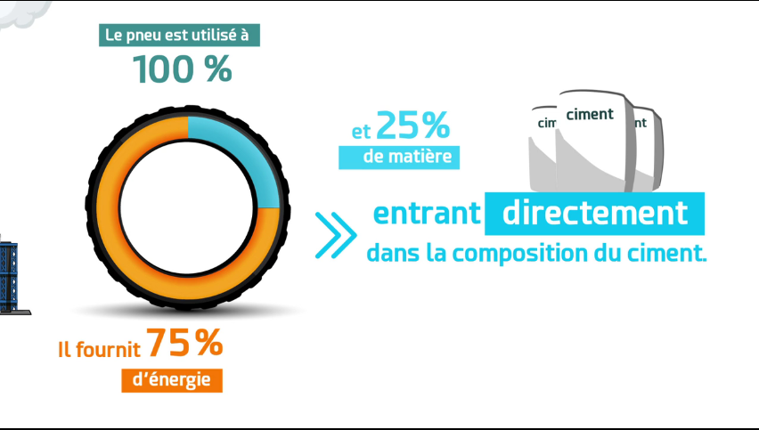
ETRMA 2016 ELT Management Figures
15
ETRMA methodology: Incorporation in cement manufacturing of 25% (by weight) inorganic content (Fe, Si, ..) of ELTs as contribution to recycling and allocation of the remainder as energy recovery
Notes:
Présentation d’images sans Titres

Slide 16
ELT Granulation Market Trends
16
High dependency on 2 main markets:
Consolidation from 4 ELT management companies

Slide 17
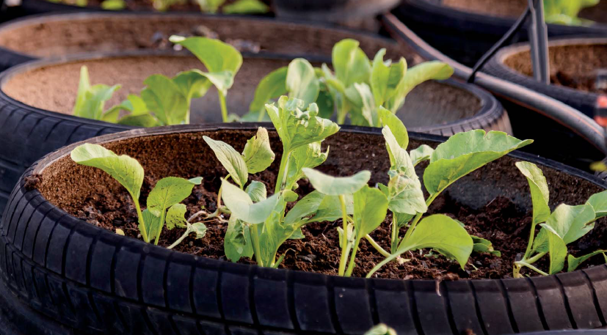
Tyre is a source of resources
17
We Transform Waste into a Resource

Slide 18
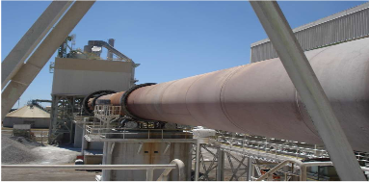
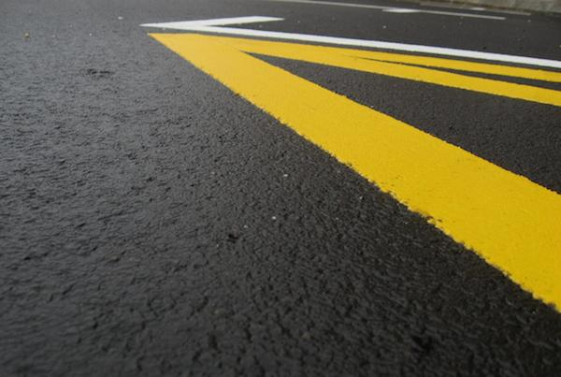
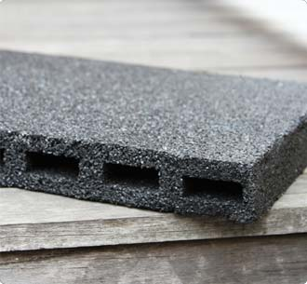
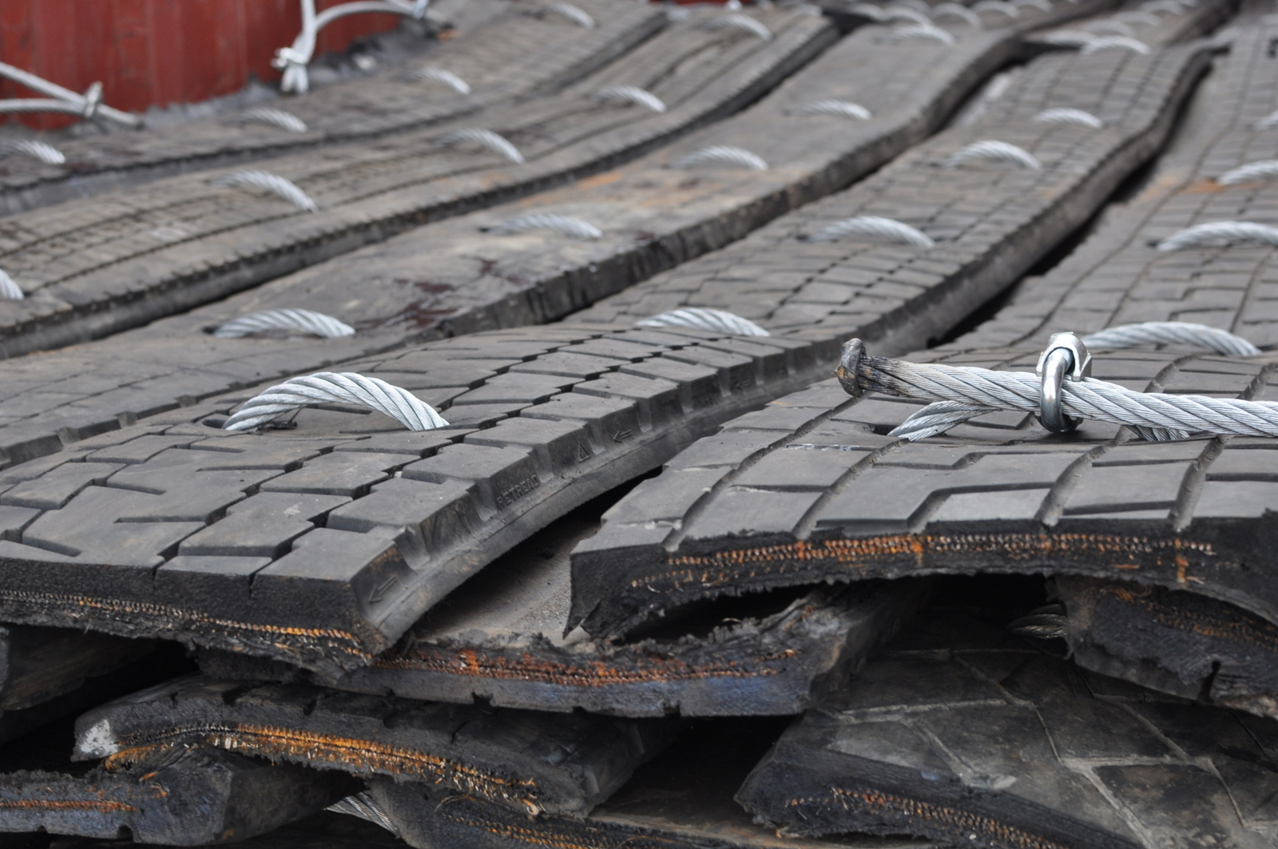
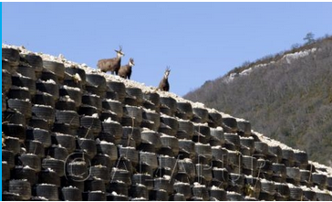
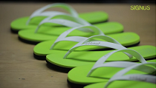
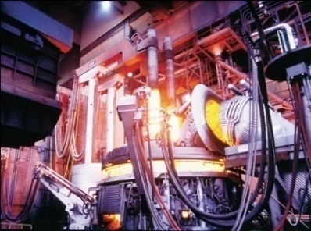
Applications of ELT-derived products
18
- ELTs have a multitude of applications using rubber properties and composition (elasticity, draining, mechanical, shock attenuation, noise-reducing, biomass and C content, …)
- ELT-derived products substitute conventional fuels and raw materials
Material substitution & biomass containing alternative fuel – Cement industry
Asphalt rubber (noise & crack mitigation)
Sub-ballast application – Railway tracks (Anti vibration)
Children playgrounds (Shock absorption)
Synthetic turf / Rubber Infill (Elasticity, All seasons)
Acoustic mats (Noise insulation)
Blasting mats (Civil engineering)
Moulded objects
Retaining Walls (Flexibility, Resistance)
Equestrian Floors (Dust & horse injuries reduction)
Shoe Soles
C substitution in steel industry
Notes:
Présentation d’images sans Titres

Slide 19
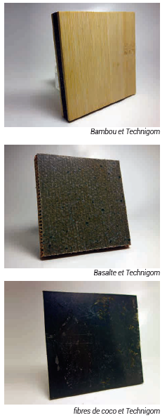
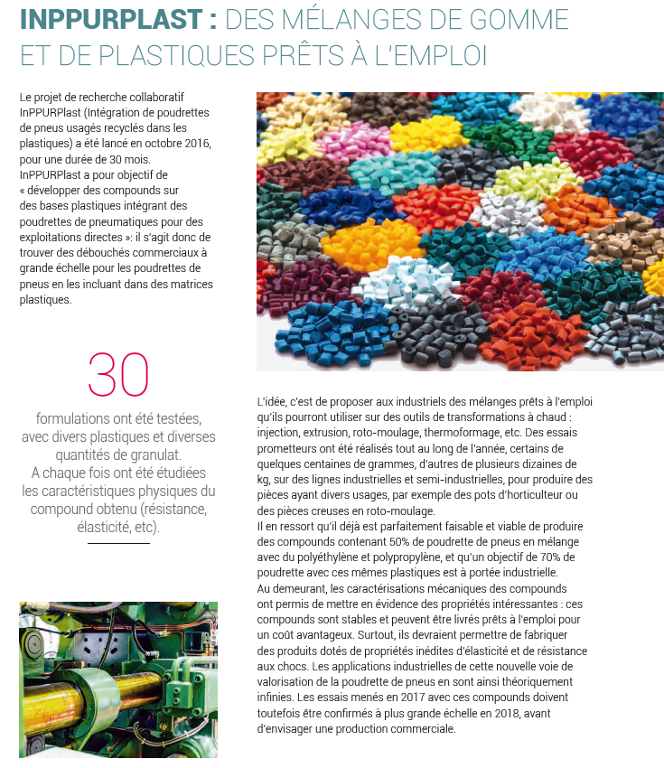
Role of R&D & new challenges
19
Bio-composites
TPE – Thermoplastic Elastomers
Notes:
Présentation d’images sans Titres

Slide 20
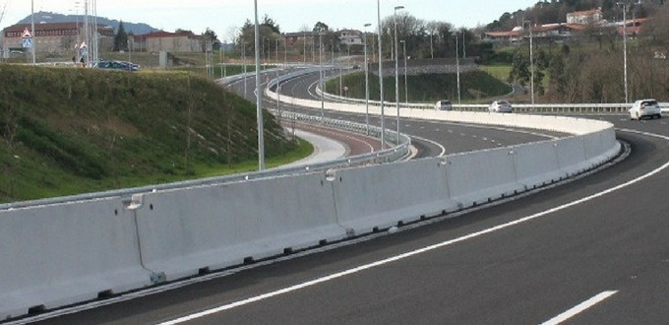
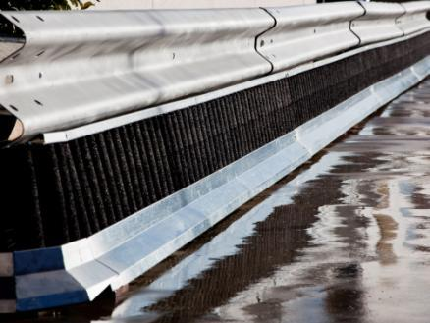
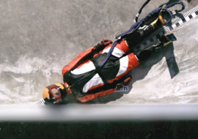
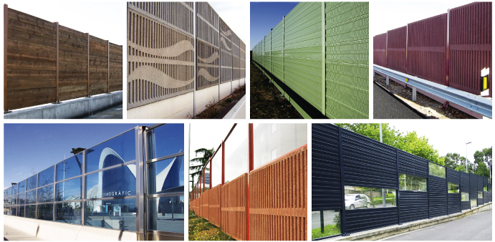
Role of R&D & new challenges
20
Protection systems for motorbikers
New Jersey Safety Barriers
Acoustic walls
Modification of bituminous mixtures with ELT powder
TPE
Notes:
Présentation d’images sans Titres

Slide 21
Role of national authorities
Spanish PEMAR (2016-2022) – State Framework Waste Management Plan
21
Promotion of the use of materials derived from ELTs
Encourage the use of ELT powder (PNFU) in the manufacture of bituminous mixtures for road pavements. For this purpose, the “ELT rubber use manual for bituminous mixtures", edited by CEDEX on behalf of MAGRAMA (Spanish MoE), as well as the specific highway legislation prepared by the Ministry of Public Works, are available as guidance instruments for the applicable technology.
Specifically, the establishment of minimum percentages of use of this material in public works will be promoted through the introduction of criteria that foresee this, for example, through the Green Public Procurement
Notes:
Présentation d’images sans Titres

Slide 22
Role of national authorities
Spanish PEMAR (2016-2022) – State Framework Waste Management Plan
22
Establish a Sectoral Framework Agreement to promote the measures included in these guidelines. Among other measures, the Agreement will promote the incorporation of minimum percentages of use of recycled material from ELTs in public works.
The opportunity to promote the application of the end of waste criteria to the materials such as the granulated or rubber powder from the treatment of ELTs for specific uses
R&D: The Public Administrations will continue supporting the R&D Projects, mainly oriented to the promotion of studies of technological innovation that make viable the recycling treatments, as well as projects oriented to promote the prevention, and the search for new markets and commercial uses of these recycled materials
Notes:
Présentation d’images sans Titres

Slide 23
Conclusions…
23
What is the key to implement a Circular Economy?
Commitment, Collaboration & Awareness from all stakeholders
Tools promoting the use of those materials (for ex. GPP)
Transmission of knowledge & diffusion
R&D – new applications

