Slide 1

rCB,
What is it really?
30th May 2018

Slide 2

What is Carbon Black?

Slide 3
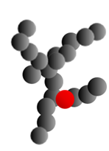

Carbon Black Classification
Example = N330
Normal or Slow Cure
Indicates primary particle size
Arbitrarily assigned

Slide 4
What is rCB?

Slide 5
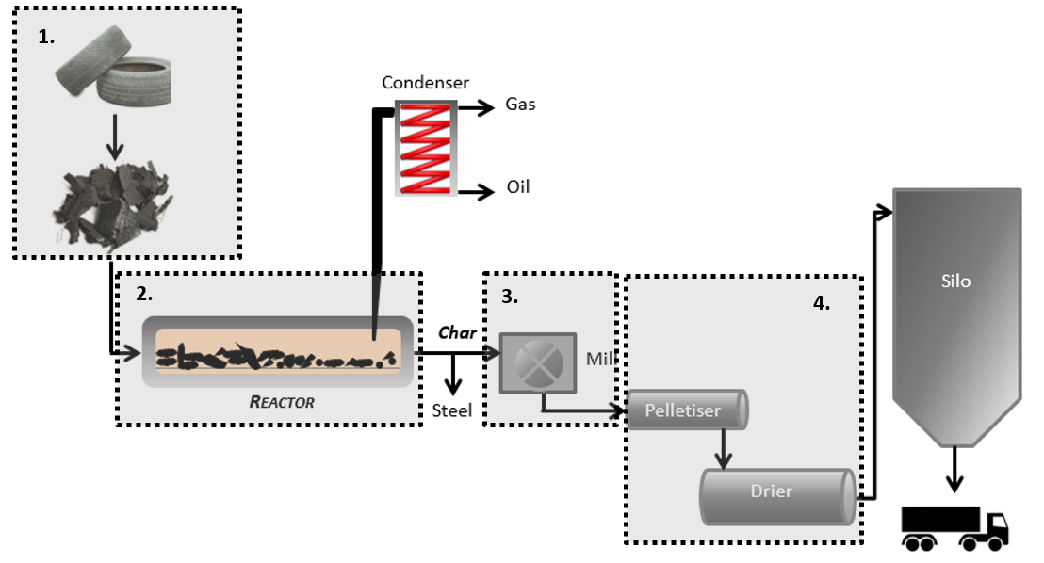
rCB Production – Pyrolysis
Feedstock preparation
Pyrolysis
Particle size reduction
Pelletisation
Simplified version!

Slide 6
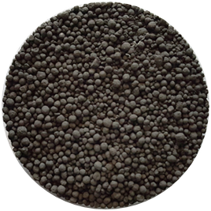
rCB Composition
*Volatiles: Controlled by Stages 1 & 2
*Carbon: Controlled by Stages 1 & 2
Ash: Controlled by Stage 1
rCB

Slide 7





rCB Production – Feedstock (Stage 1)

Slide 8
rCB Production – Pyrolysis (Stage 2)
Notes:
Formation of carbonaceous residue
Target very low volatiles content & certainly no residual polymer

Slide 9
rCB Production – Polishing (Stage 3)

Slide 10
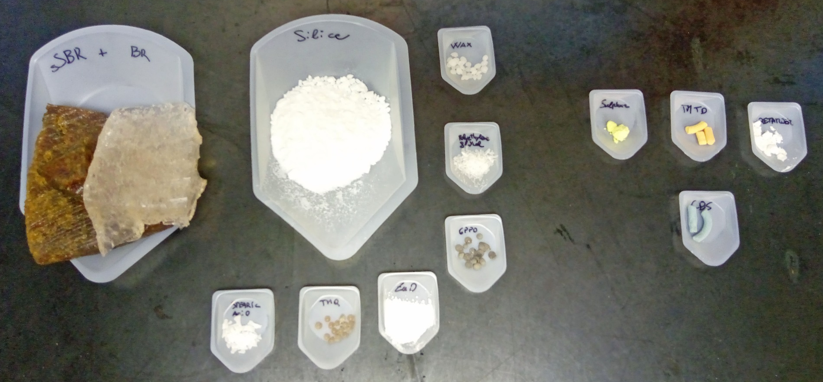
White Compound Pyrolysis
Model tread formulation prepared without the inclusion of carbon black
Shredded <5mm
Pyrolysed at 550°C

Slide 11
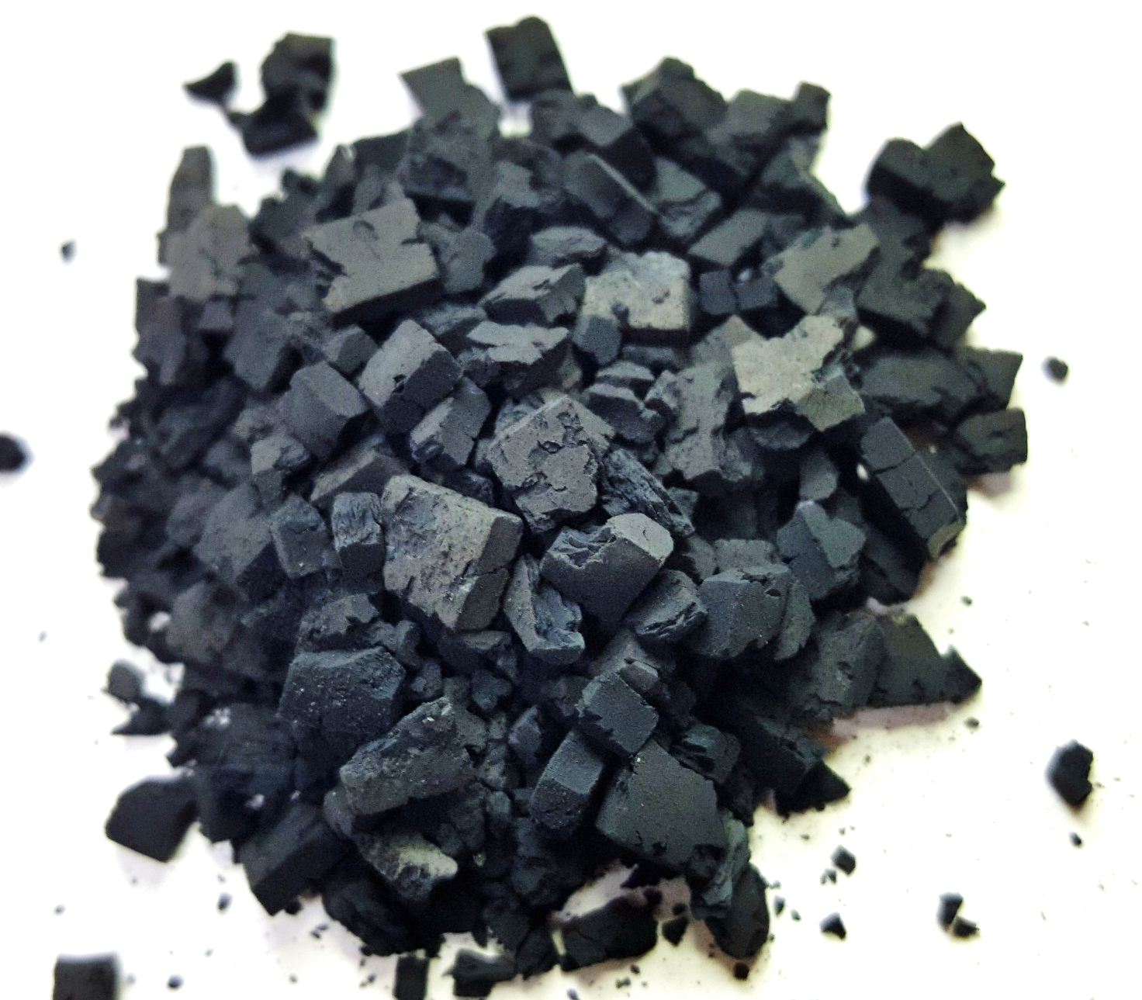
White Compound Pyrolysis
4.2% Carbon from polymer decomposition

Slide 12
rCB Colloidal Properties

Slide 13
rCB Colloidal Properties
*rCB Performance
Window
We’ve all seen this chart!
This is very misleading.
*typical rCB
Notes:
By definition, grades have narrow particle size and aggregate size distribution

Slide 14
rCB – How does it compare to its constituents?
Blend 1: Contains N234/ N330/ N375/ N326/ N550/ N660/ N683/ N772 at ratios expected in a tyre feedstock.
Blend 2: Carbon black blend + 13% silica + 5% zinc oxide (close match to Euro rCB)
Notes:
Based solely on the colloidal characteristics of the samples, we would expect the in-rubber performance of the rCB and blend 2 to fall between that of N326→N330, with blend 1 being slightly less reinforcing.

Slide 15
ASTM D3192 – Relative IRB8 (N330)
Blend 1, 2 & rCB Predicted
Less
reinforcing
Same trends for hardness, tensile strength….
Drop in predicted performance due to vastly broadened aggregate size distribution
Trend verified in ASTM D3191 (SBR)
Notes:
blend 1, which contains carbon blacks only, the reduction in reinforcing potential must be an artefact of the very wide aggregate size distribution. It is also interesting to note that the rCB sample was more reinforcing than the compositionally similar blend 2

Slide 16
rCB Colloidal Properties
This is wrong
*typical rCB
Notes:
By definition, grades have narrow particle size and aggregate size distribution

Slide 17
rCB Colloidal Properties
rCB
This is more representative!
Notes:
By definition, grades have narrow particle size and aggregate size distribution
We must find a better test to represent this as part of ASTM D36

Slide 18
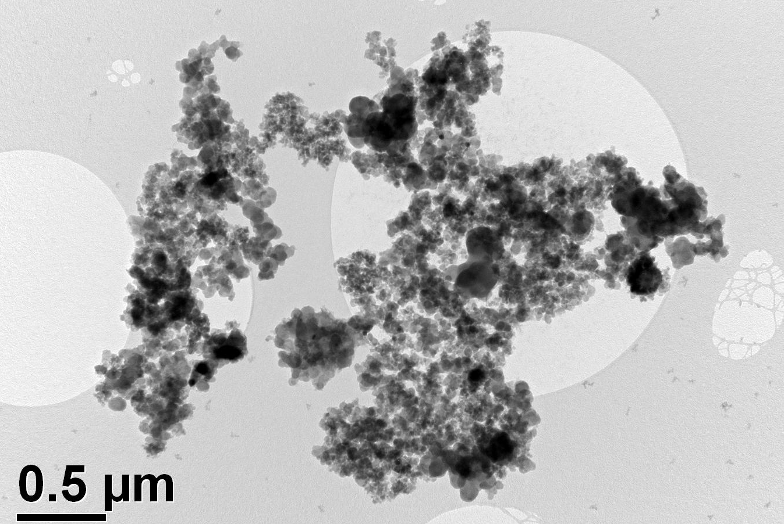
rCB Colloidal Properties
Notes:
Demonstration of broad particle and aggregate size distribution

Slide 19
Conclusion = rCB Actually Outperforms Raw Constituents

Slide 20


Slide 21

Thank You!
Questions?
Chris Norris PhD, MSc, BSc (Hons)
chris.norris@artis.uk.com
01225 896505
www.sustainable-materials-group.com
www.artis.uk.com

