Slide 1
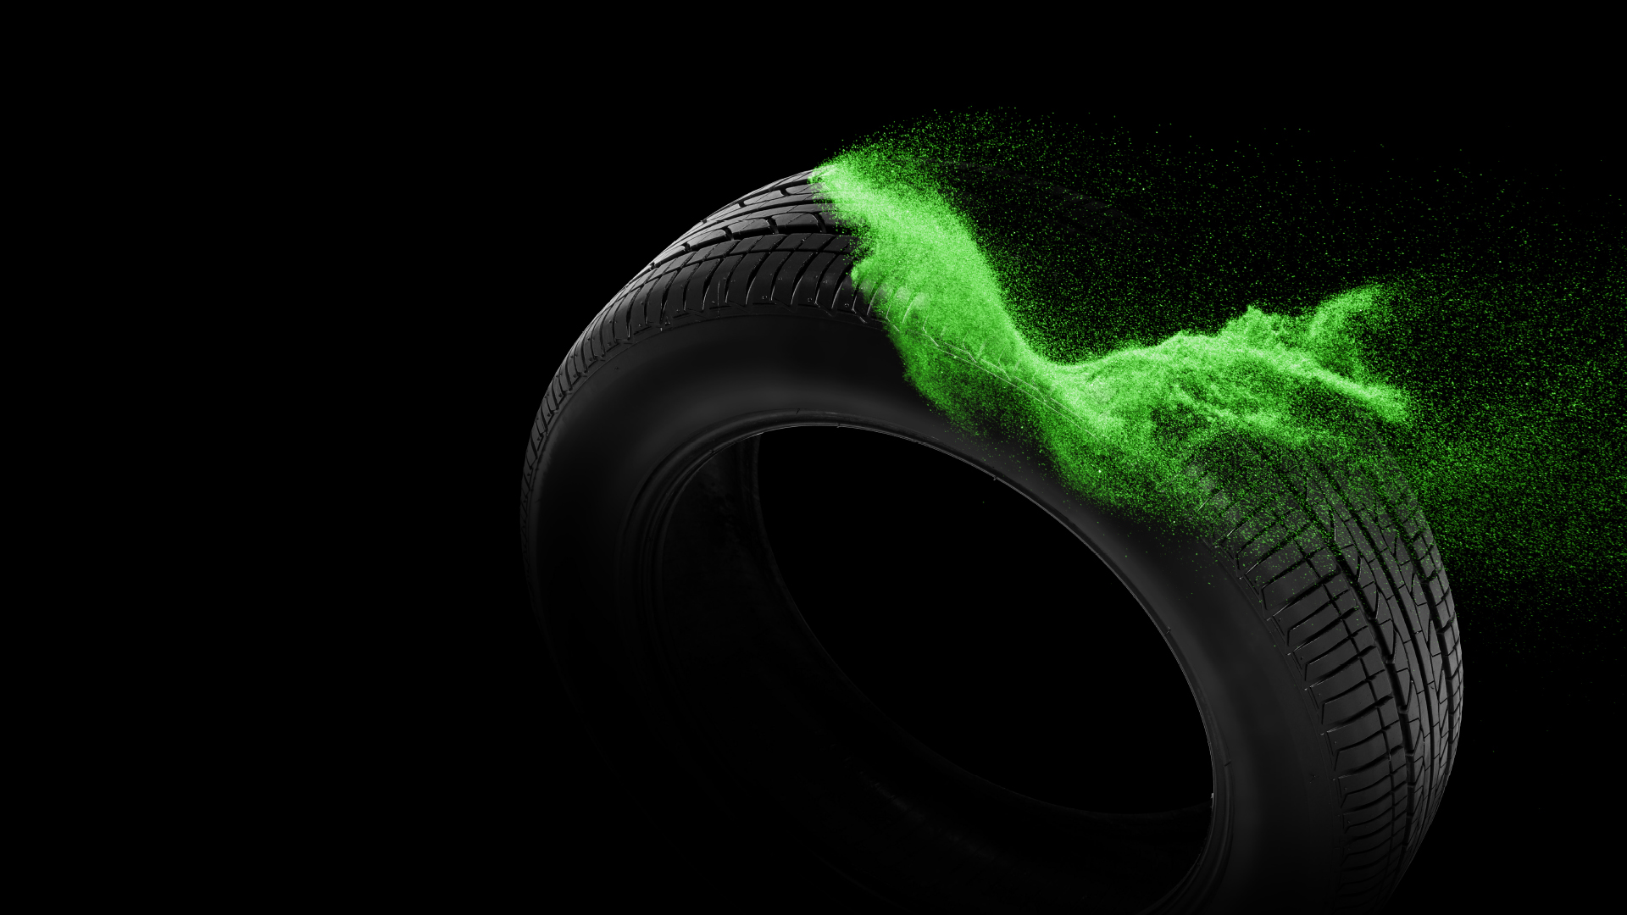
TURNING TRASH
INTO CASH
CHANGING THE APPROACH TO TYRE
RECYCLING
Sonia Megert, COO, Tyre Recycling Solutions SA
© Tyre Recycling Solutions SA

Slide 2
PEOPLE SEE
WASTE
WE SEE
OPPORTUNITY
Material recovery less than 50% of ELT recovery
50% of material recovery route under threat
Conversion into value-added products
Development of regional downstream industry
© Tyre Recycling Solutions SA

Slide 3
© Tyre Recycling Solutions SA

Slide 4
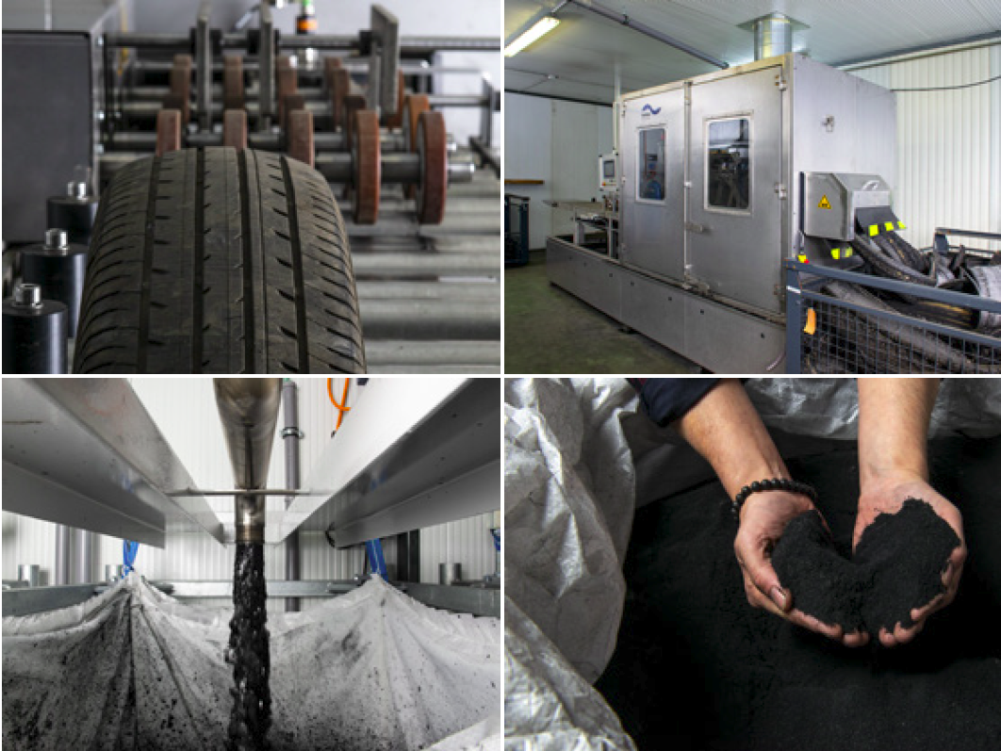
THE TECHNICAL CHALLENGE
RUBBER POWDER CHARACTERISTCS
WHICH RECYCLING TECHNOLOGY?
SPEAKING THE CUSTOMER LANGUAGE
QUALITY AND CONSISTENCY
© Tyre Recycling Solutions SA

Slide 5
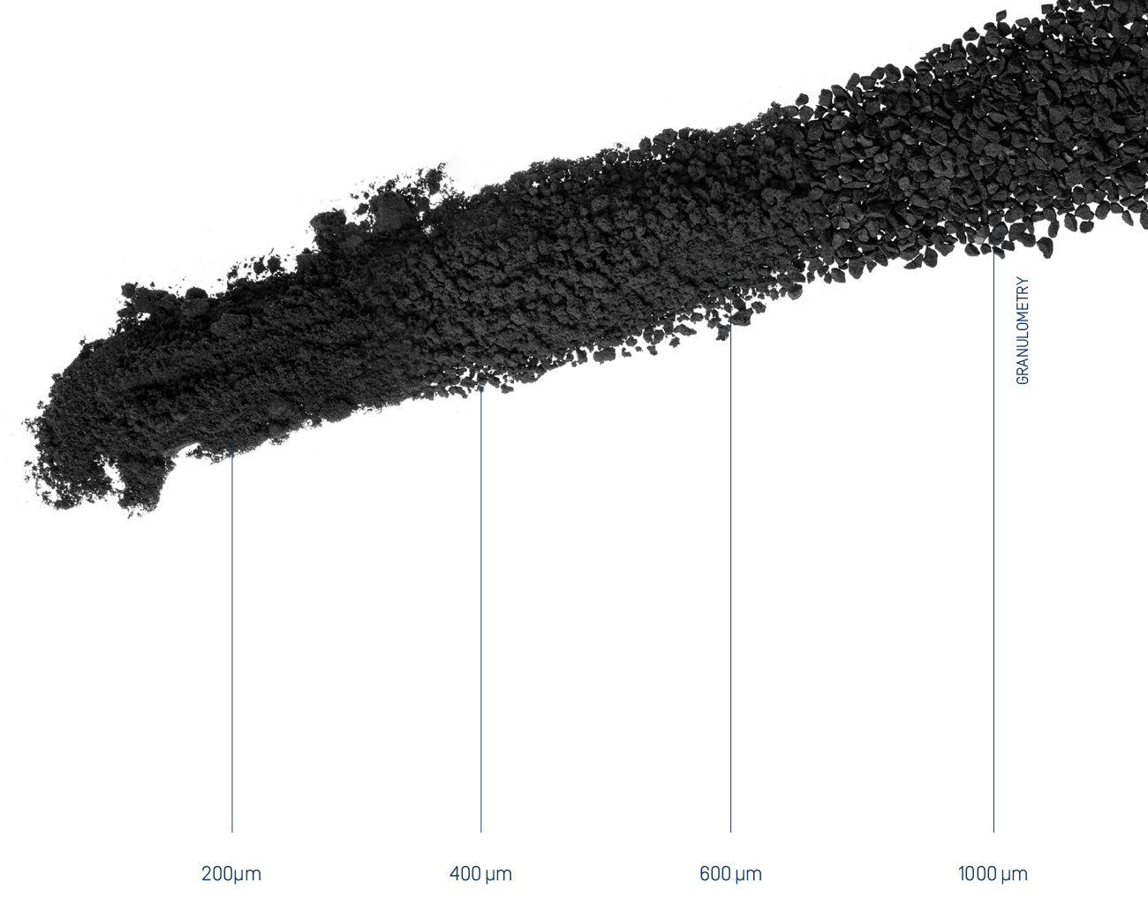
THE RIGHT PRODUCT FOR THE MARKET
Powder properties impacted by:
Material selection
Grinding technology
Granulometry
Powder surface treatment
“The right powder” is the best fit between technical and commercial requirements
© Tyre Recycling Solutions SA

Slide 6
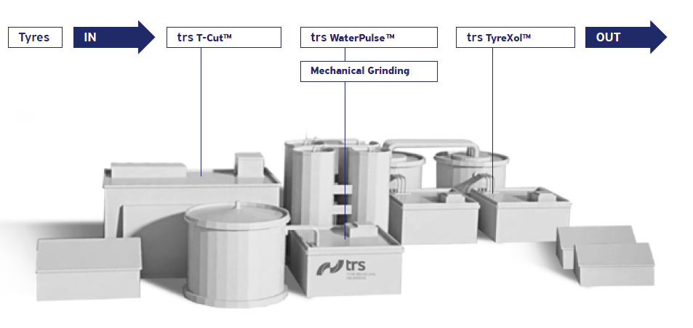
WHICH TECHNOLOGY IN THE TYRE RECYCLING FACTORY?
Pyrolysis
Cryogenic Grinding
Equipment choice dictated by end-market applications and regional dynamics
Extensive market feasibility study required prior to setting-up a new plant
© Tyre Recycling Solutions SA

Slide 7
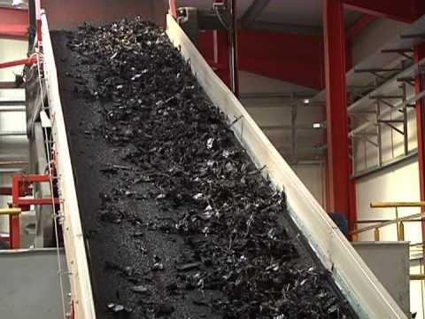
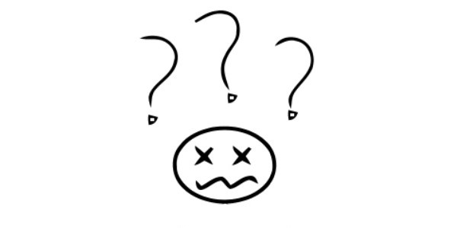
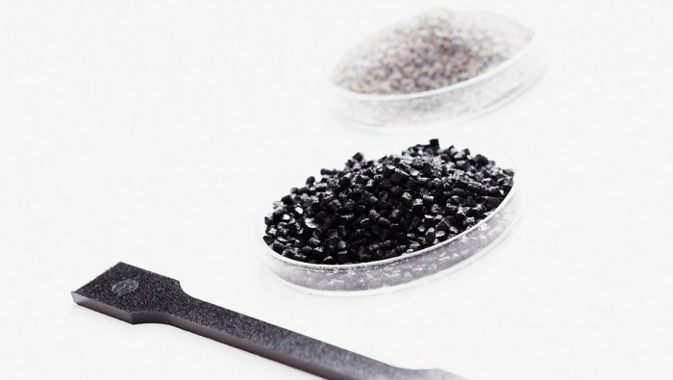
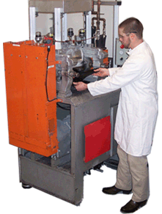
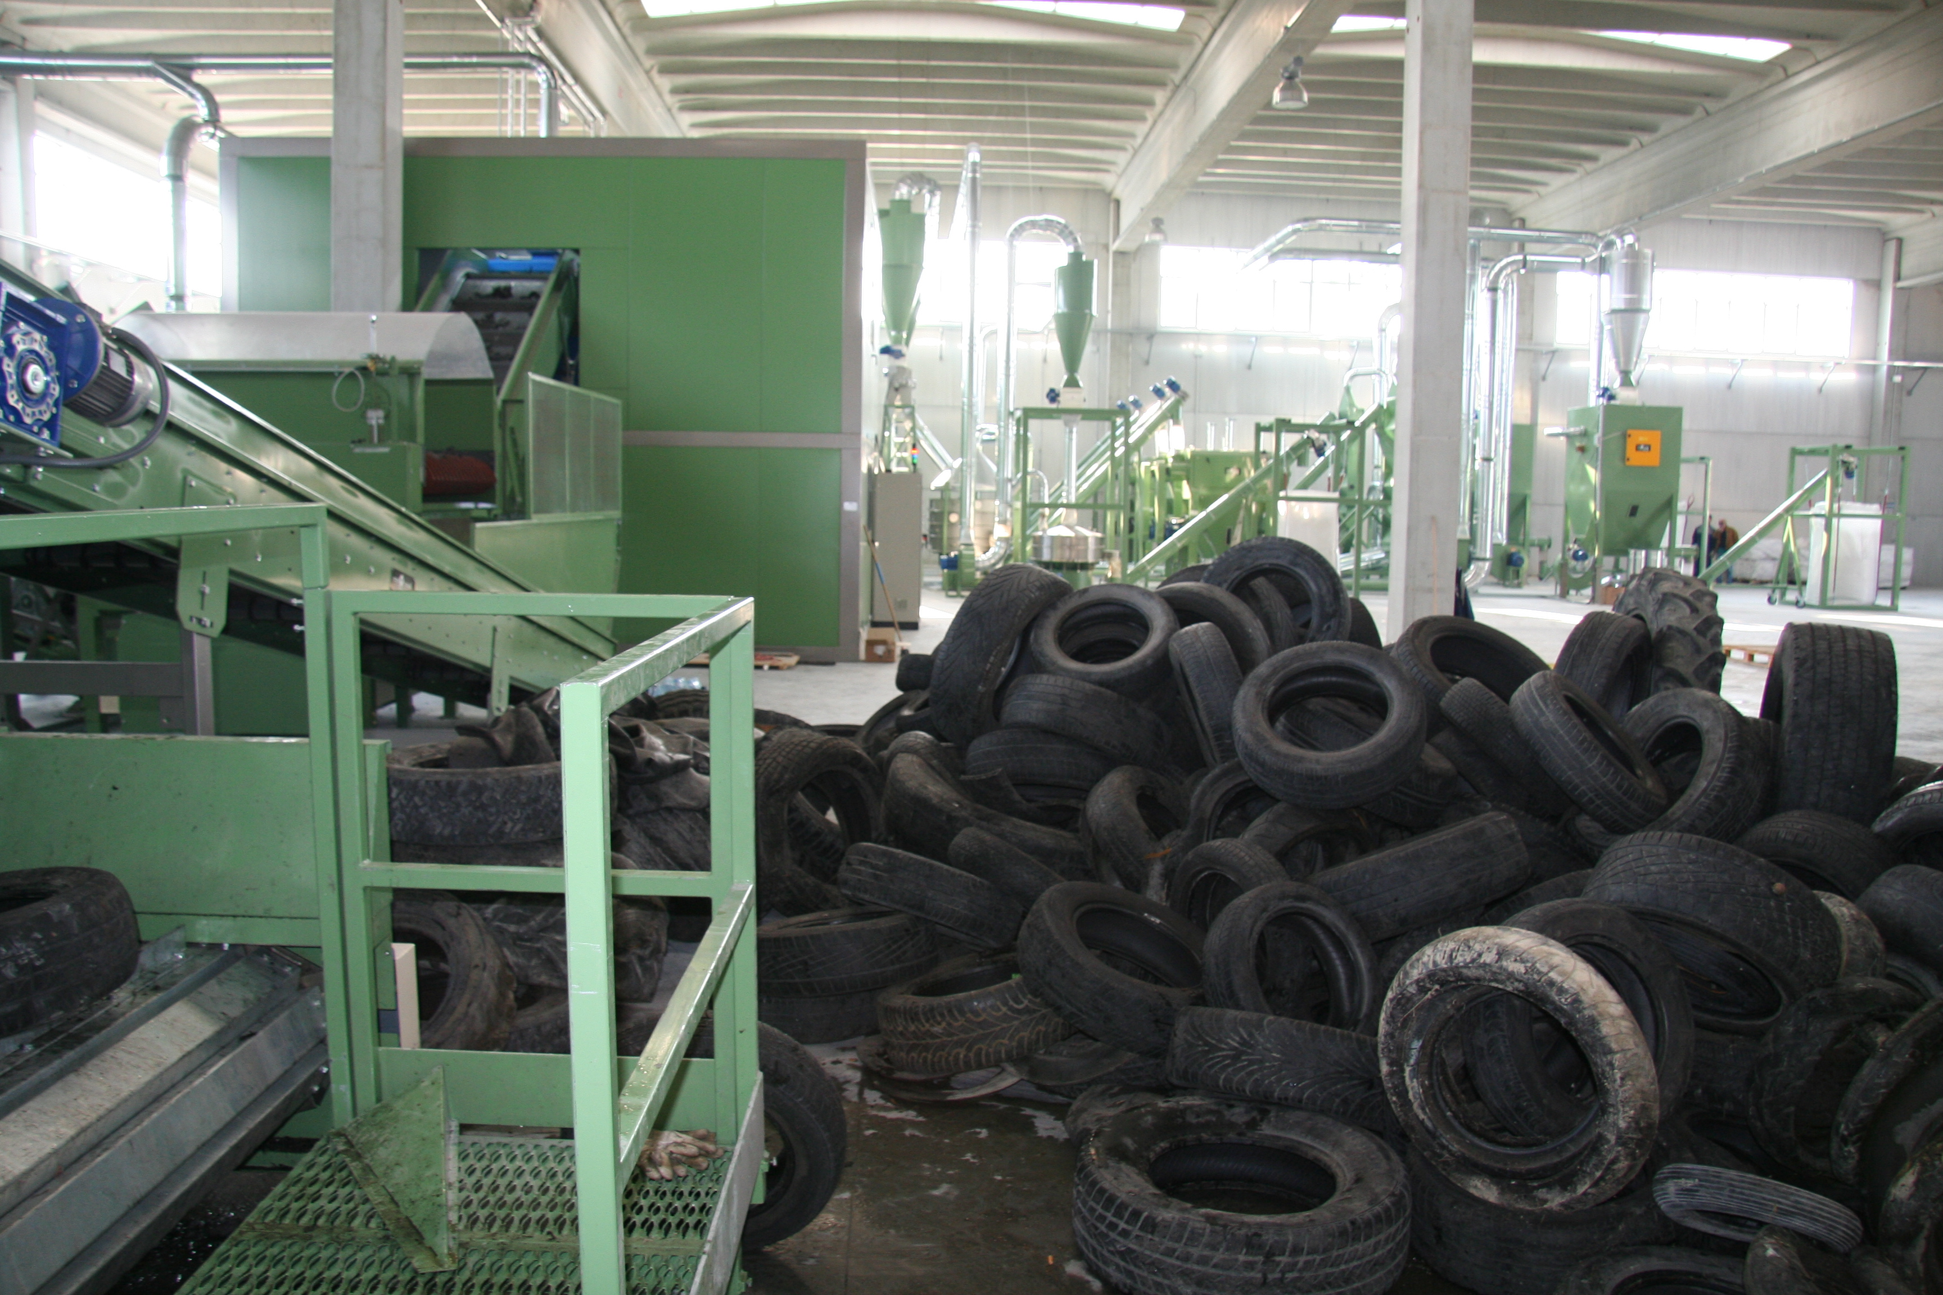
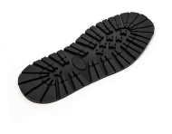
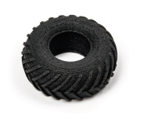
GREAT WORK STARTS BY UNDERSTANDING EACH OTHER
PRODUCT MANUFACTURERS
TYRE RECYCLERS
© Tyre Recycling Solutions SA

Slide 8
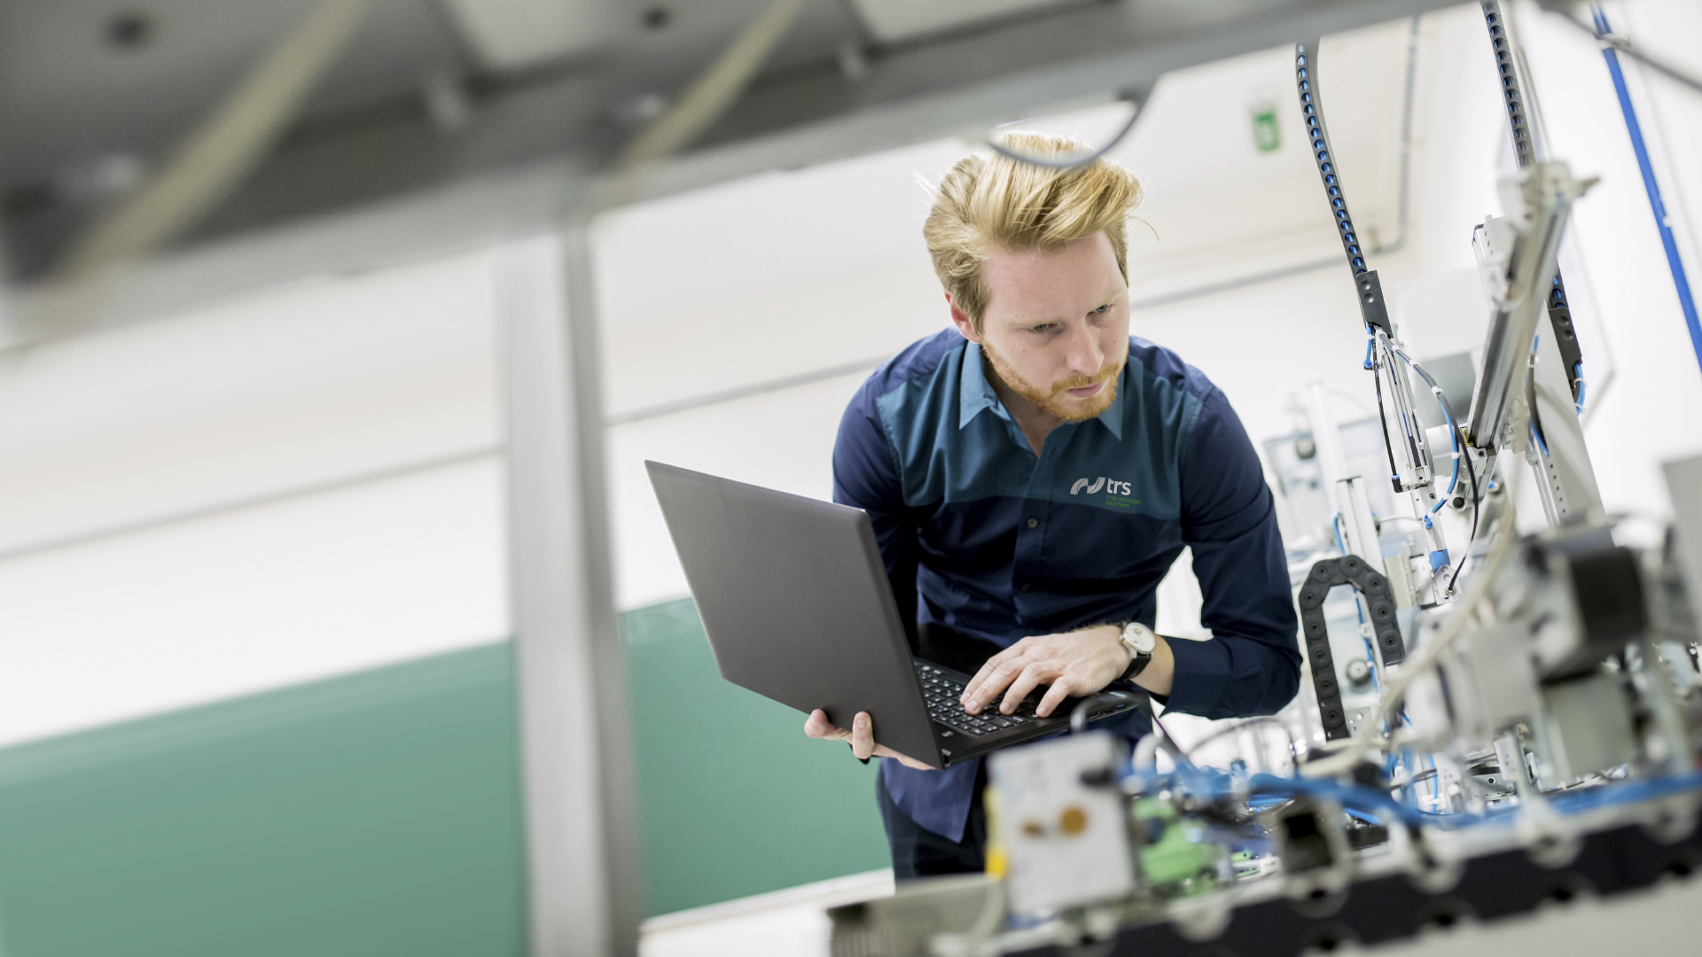
WANTED!
SOLUTION PROVIDER
Improve the functional properties of matrices through tailored compounding solutions
Modify or even upgrade materials such as rubbers, polyurethanes, plastics, thermoplastic elastomers, bitumen and concrete
Create a new breed of eco-tech materials
© Tyre Recycling Solutions SA

Slide 9
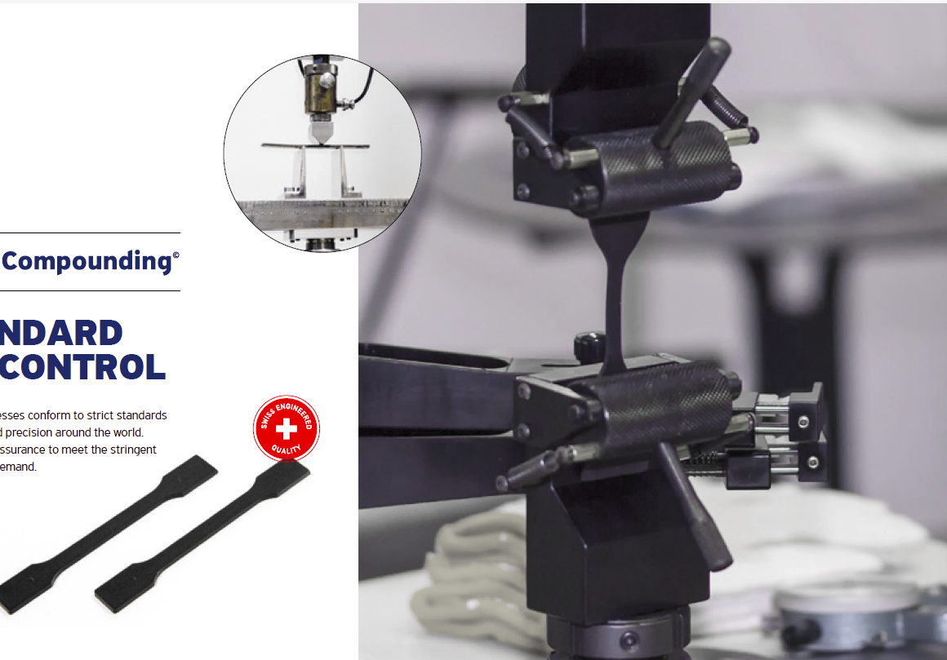
9
HIGH STANDARD QUALITY CONTROL
Products and production processes conform to strict quality standards
Meeting customers quality requirements
© Tyre Recycling Solutions SA

Slide 10
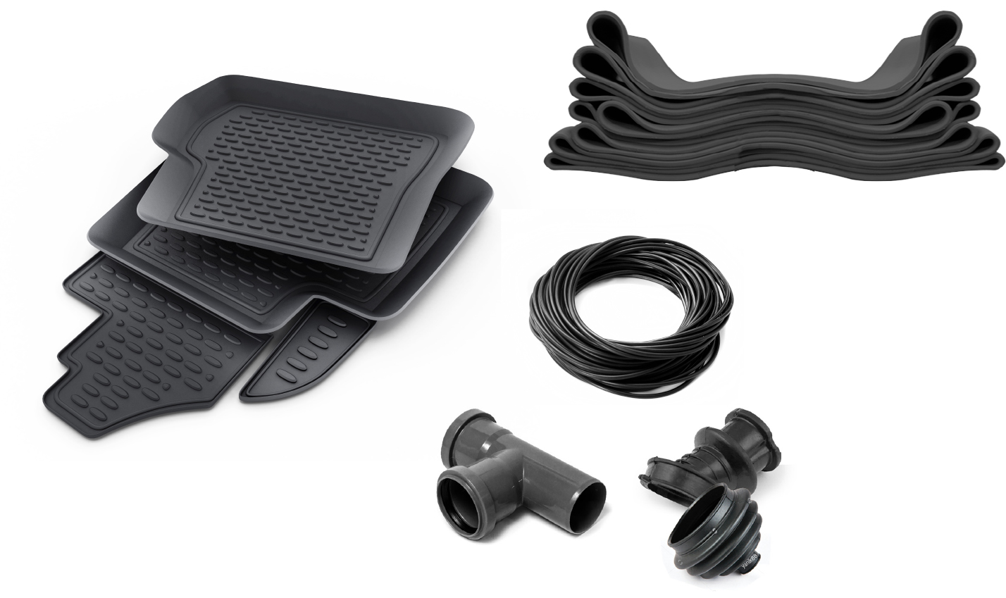
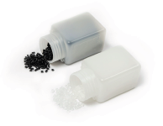
PERFORMING MATERIALS
New materials can be manufactured across a wide range of industries – provided following criteria are met:
The “right” powder characteristics
An adapted production technology
Innovative compounding solutions
High standard quality control
© Tyre Recycling Solutions SA

Slide 11
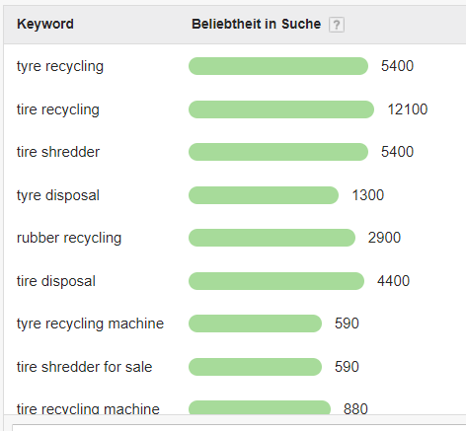
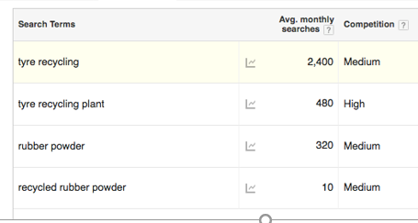
CIRCULAR ECONOMY MARKETING CHALLENGE N°1
How to grab the product manufacturers attention?
© Tyre Recycling Solutions SA

Slide 12
CIRCULAR ECONOMY MARKETING CHALLENGE N°2
Improve success rate and qualification time
323
3
18 MONTHS
323 Deals initiated – 3 wins
1% Deal Conversion rate
© Tyre Recycling Solutions SA

Slide 13
© Tyre Recycling Solutions SA

Slide 14
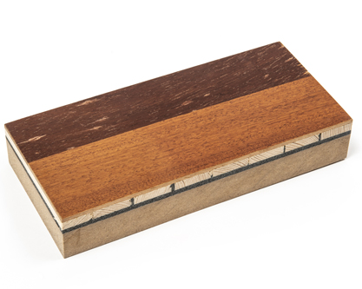
CASE STUDY
PARQUET FLOORING
ADHESIVE
A soft 2-components PU adhesive:
Containing 30% rubber powder
Demonstrate capabilities to integrate recycled, post-consumer constituents in high-end polyurethane systems
Impart sound absorbing properties to parquet flooring
Formulation designed for parquet prefabrication in factory
Can be adapted to be laid on site on other surfaces (e.g. concrete)
Adhesive layer
© Tyre Recycling Solutions SA

Slide 15
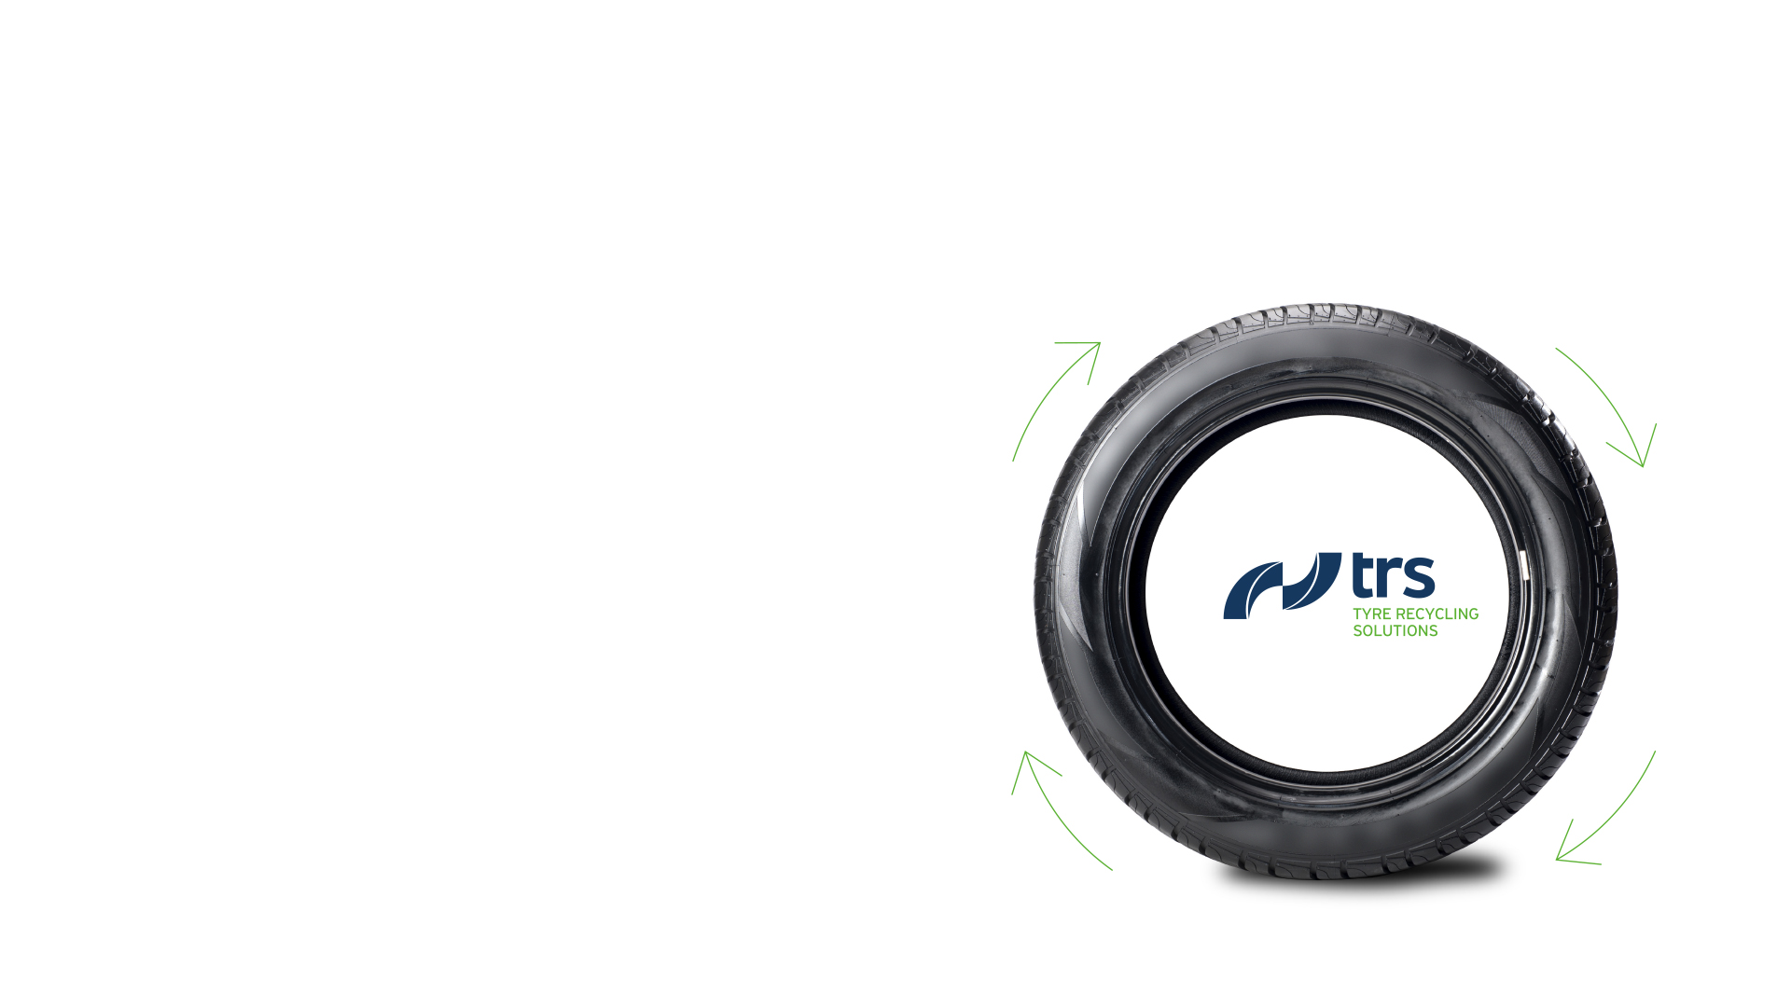
PARTNERSHIP WITH PUBLIC AND PRIVATE STAKEHOLDERS
GOODS MANUFACTURERS
GOVERNMENTS
Drive the tyre recycling value chain, in partnership with public and private stakeholders, towards a profitable and sustainable circular economy.
RAW MATERIAL PRODUCERS & COMPOUNDERS
TYRE RECYCLERS
© Tyre Recycling Solutions SA

Slide 16
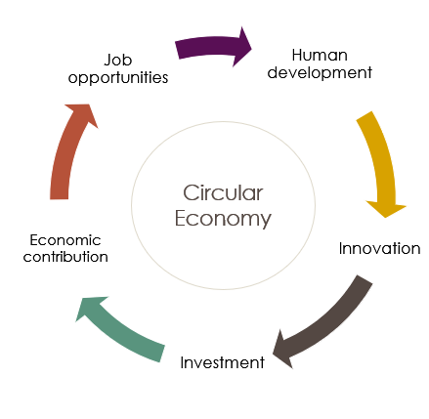
DEVELOPING DOWNSTREAM INDUSTRY
Localization strategies in selected regions (e.g. Middle-East, Africa, Latin America)
Other market opportunities
China ban on imports
India carbon black shortage
EU Circular Package
…
© Tyre Recycling Solutions SA

Slide 17
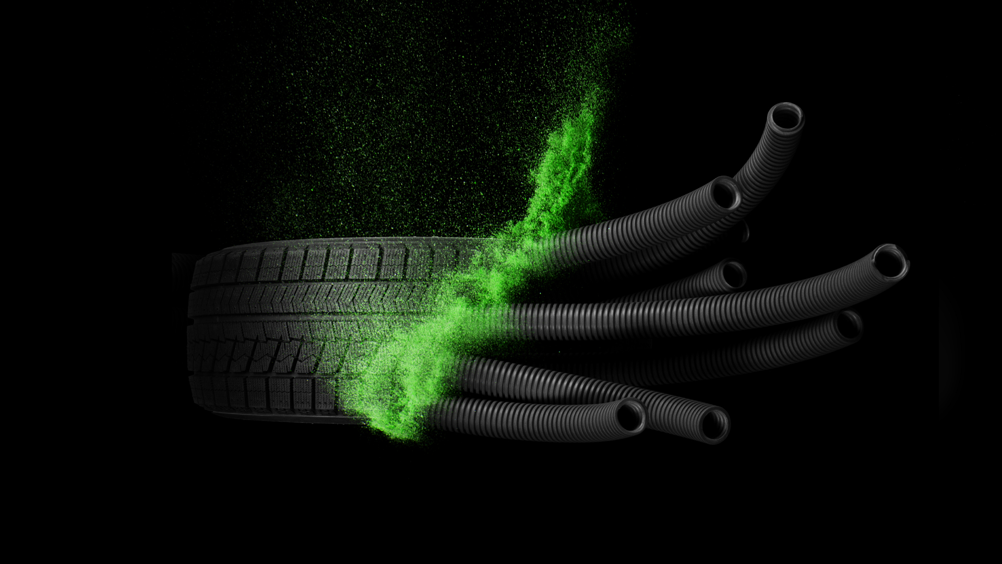
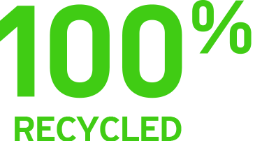
© Tyre Recycling Solutions SA

