Slide 1

Crumb Rubber Infill:
a never-ending story
The Tire-Cologne, 30 May 2018

Slide 2







Ecopneus
Since 2011 – ELT management under an Extended Producer Responsibility scheme
Management of 250.000 tonnes ELT/y
Non for Profit
(New) Business Development
Notes:
Over the past 20 years a large number of papers and scientific reports have been published worldwide by public and private institutes trying to address the growing concern for the use of recycled rubber in artificial turf and playgrounds.
Beside confirming the presence of Poly Aromatic Hydrocarbons (PAH) in rubber, all these studies converged in determining acceptable levels of the incremental carcinogenic risk.
Notwithstanding that, every now and then new doubts and conserns rise to the attention of the media (and decision makers), that denounce the «potential risks» for the athletes and children and/or ask for deep analysis of the issue.

Slide 3
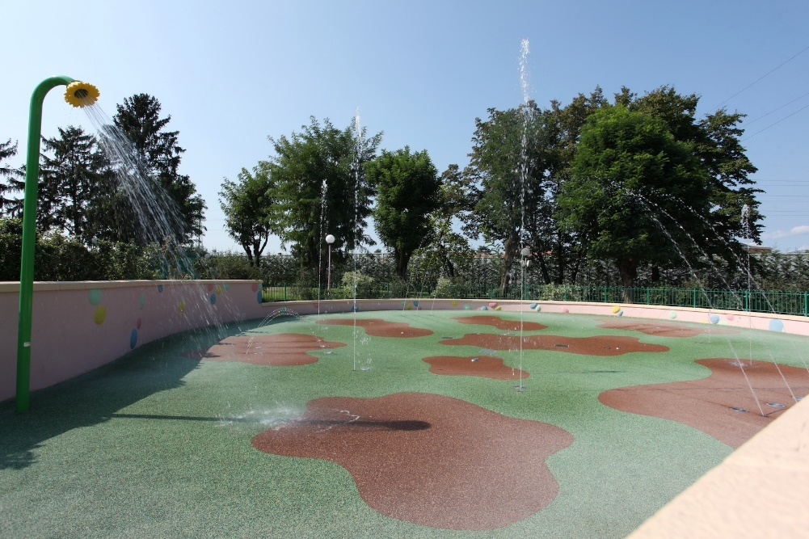
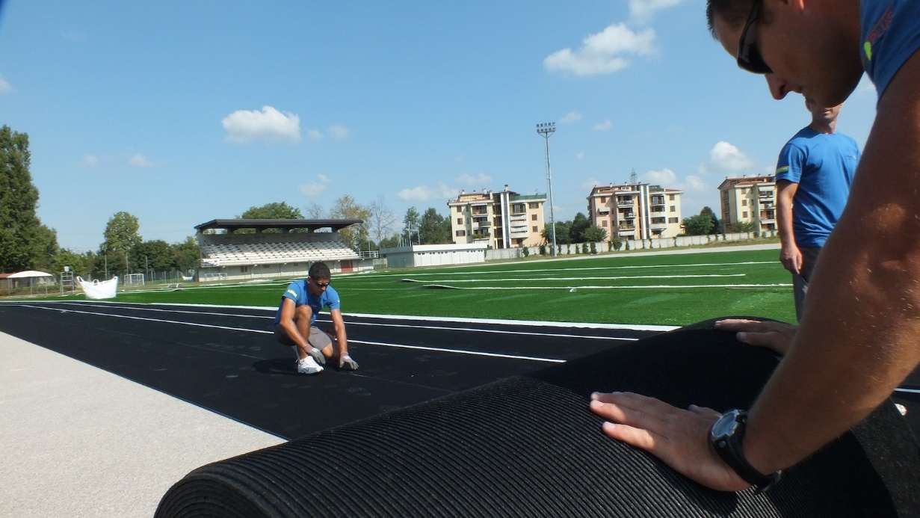
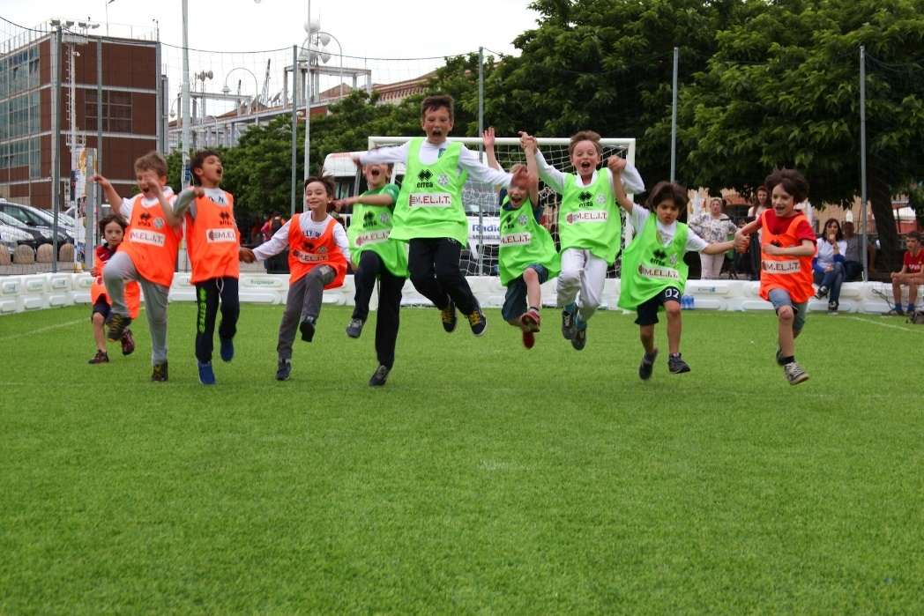
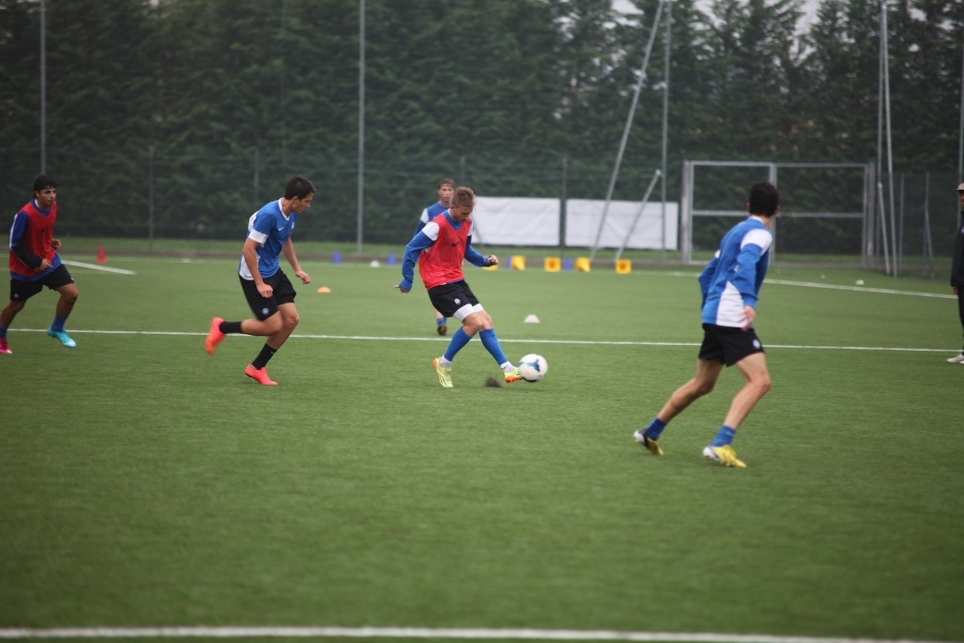
Besides managing End of Life Tyres..
Notes:
Over the past 20 years a large number of papers and scientific reports have been published worldwide by public and private institutes trying to address the growing concern for the use of recycled rubber in artificial turf and playgrounds.
Beside confirming the presence of Poly Aromatic Hydrocarbons (PAH) in rubber, all these studies converged in determining acceptable levels of the incremental carcinogenic risk.
Notwithstanding that, every now and then new doubts and conserns rise to the attention of the media (and decision makers), that denounce the «potential risks» for the athletes and children and/or ask for deep analysis of the issue.

Slide 4

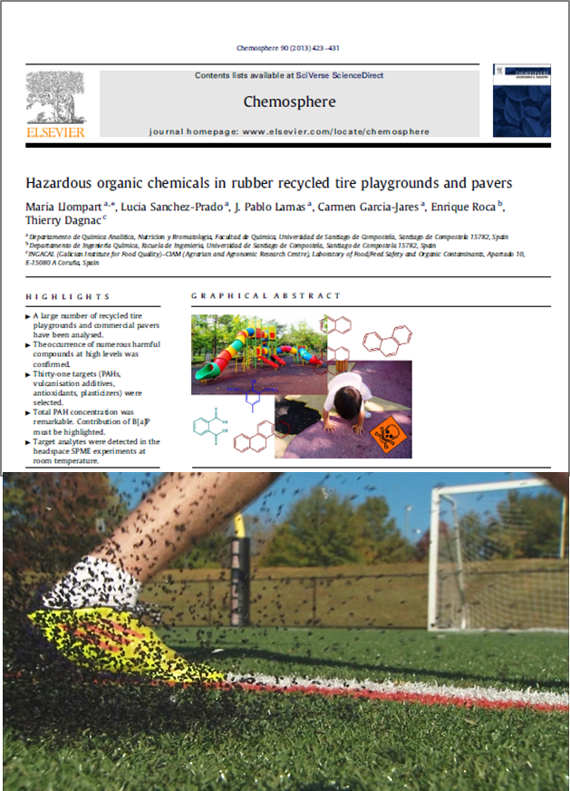
A different perception of safety
VS
Notes:
Over the past 20 years a large number of papers and scientific reports have been published worldwide by public and private institutes trying to address the growing concern for the use of recycled rubber in artificial turf and playgrounds.
Beside confirming the presence of Poly Aromatic Hydrocarbons (PAH) in rubber, all these studies converged in determining acceptable levels of the incremental carcinogenic risk.
Notwithstanding that, every now and then new doubts and conserns rise to the attention of the media (and decision makers), that denounce the «potential risks» for the athletes and children and/or ask for deep analysis of the issue.

Slide 5

A long story.. since 2000
Env. & Human Healt Inc. 2007
Milone & MacBroom 2008
CT Dept. Public Heatlh 2010
Ginsberg et al. 2011
Joost et al. 2009
ECHA 2017
Plesser et a. 2004
Norwegian Inst. Public Health 2006
Beusoleil et al. 2009
Hofstra et al. 2007
Nilsson et al. 2008
Cardno Chemrisk 2013
Johns et al. 2008
Moretto et al. 2007
US EPA 2008, 2009
Menichini et al. 2011
Ruffino et al. 2013
Davoli et al. 2017
Kim et al. 2012
Broderick et al. 2007
Denly et al. 2008
Lim et al. 2009
Vetrano et al. 2009
Cal. IWMB 2007
Dept.Env.Health 2010
OEHHA 2017
Llompart et al. 2013
Chien et al. 2003
Ledoux et al. 2007
NJ Dept of Health 2008
Zhang et al. 2008
Pavilionis et al. 2013
More than 100 studies
No evidence of health risks
Notes:
Over the past 20 years a large number of papers and scientific reports have been published worldwide by public and private institutes trying to address the growing concern for the use of recycled rubber in artificial turf and playgrounds.
Beside confirming the presence of Poly Aromatic Hydrocarbons (PAH) in rubber, all these studies converged in determining acceptable levels of the incremental carcinogenic risk.
Notwithstanding that, every now and then new doubts and conserns rise to the attention of the media (and decision makers), that denounce the «potential risks» for the athletes and children and/or ask for deep analysis of the issue.

Slide 6

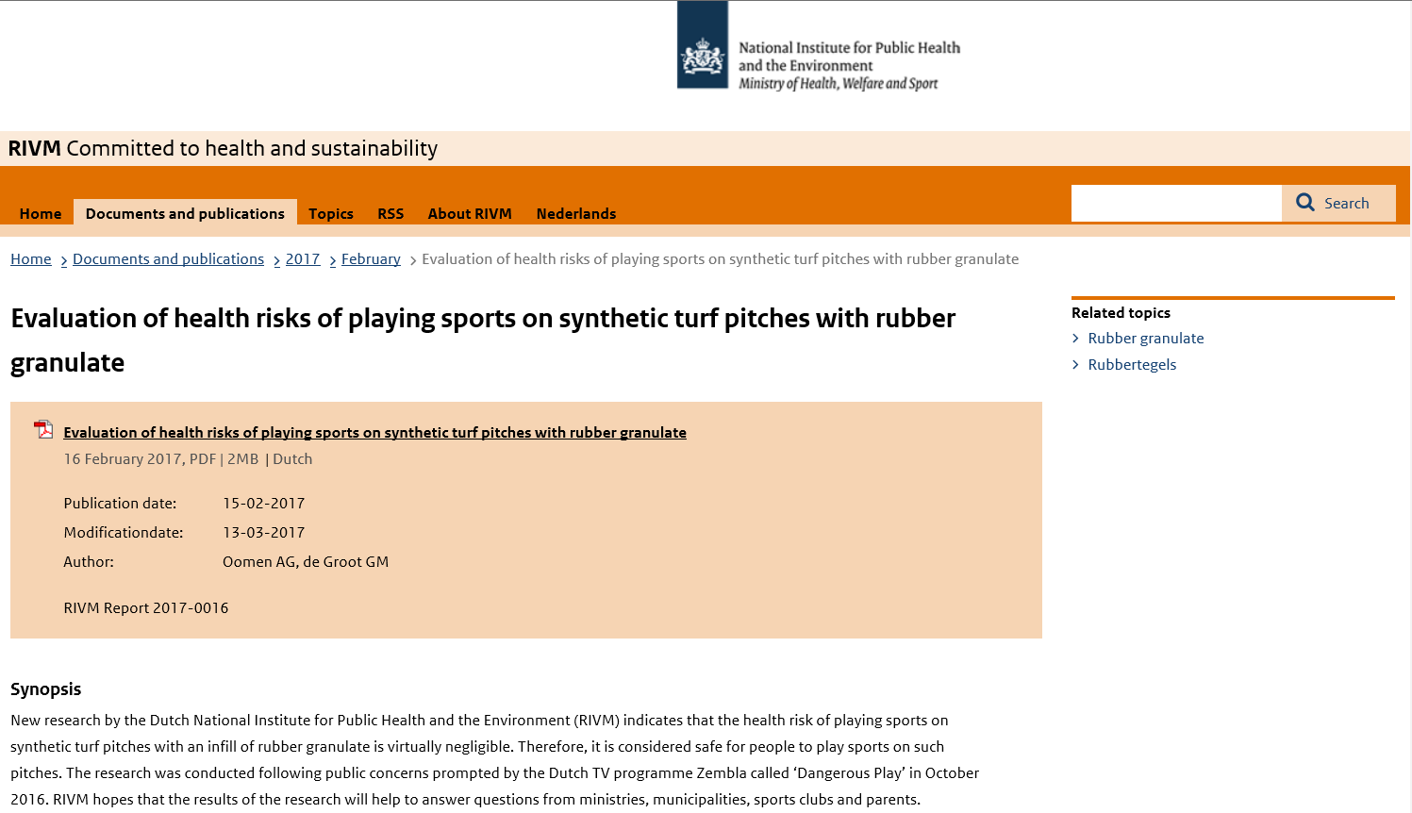
RIVM’s conclusions
«..the health risk of playing sports on synthetic turf pitches with an infill of rubber granulate is virtually negligible.»
Source: www.rivm.nl

Slide 7
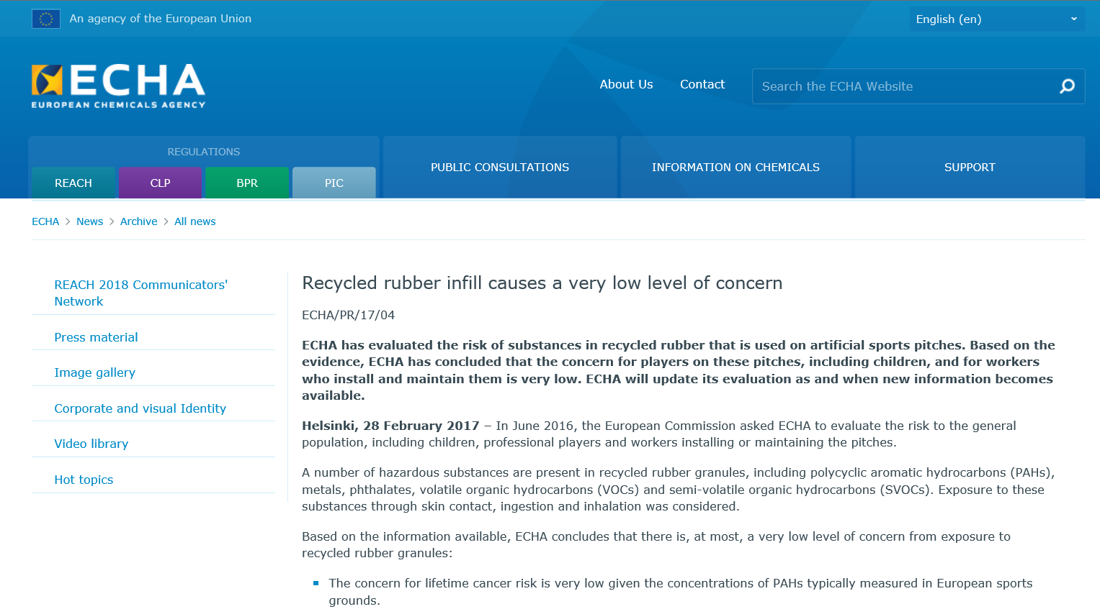
ECHA’s conclusions
Source: https://echa.europa.eu

Slide 8
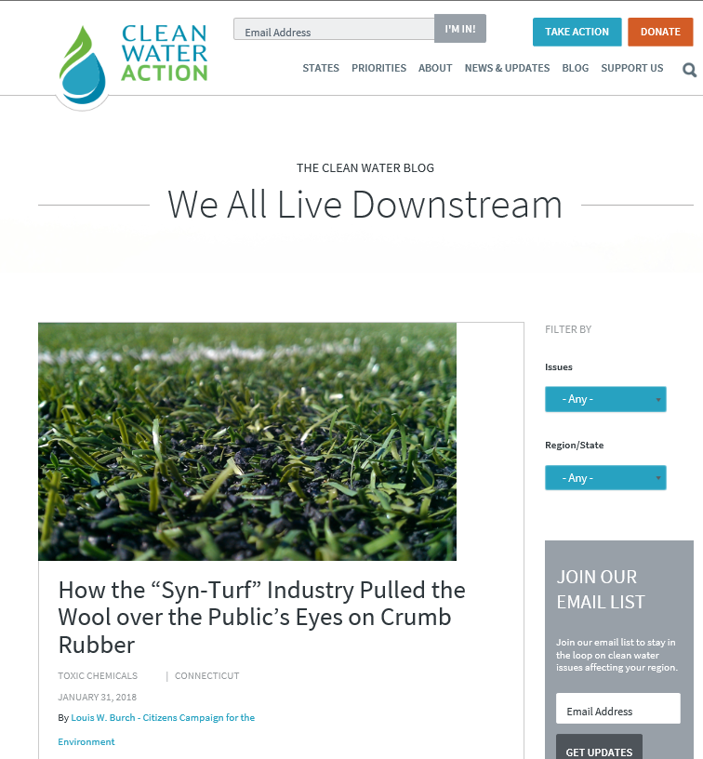
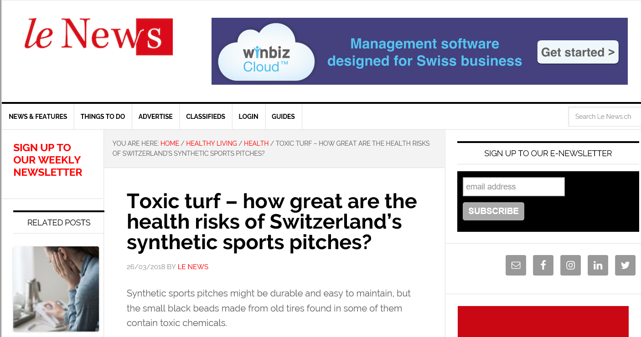
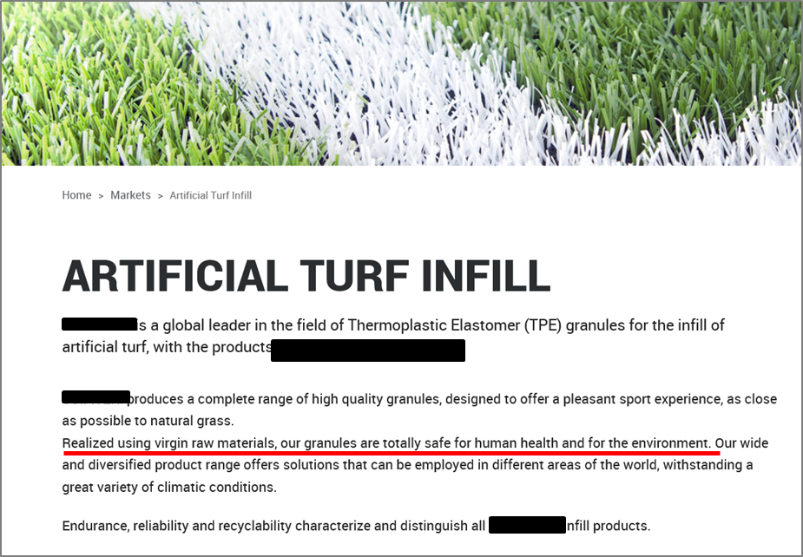
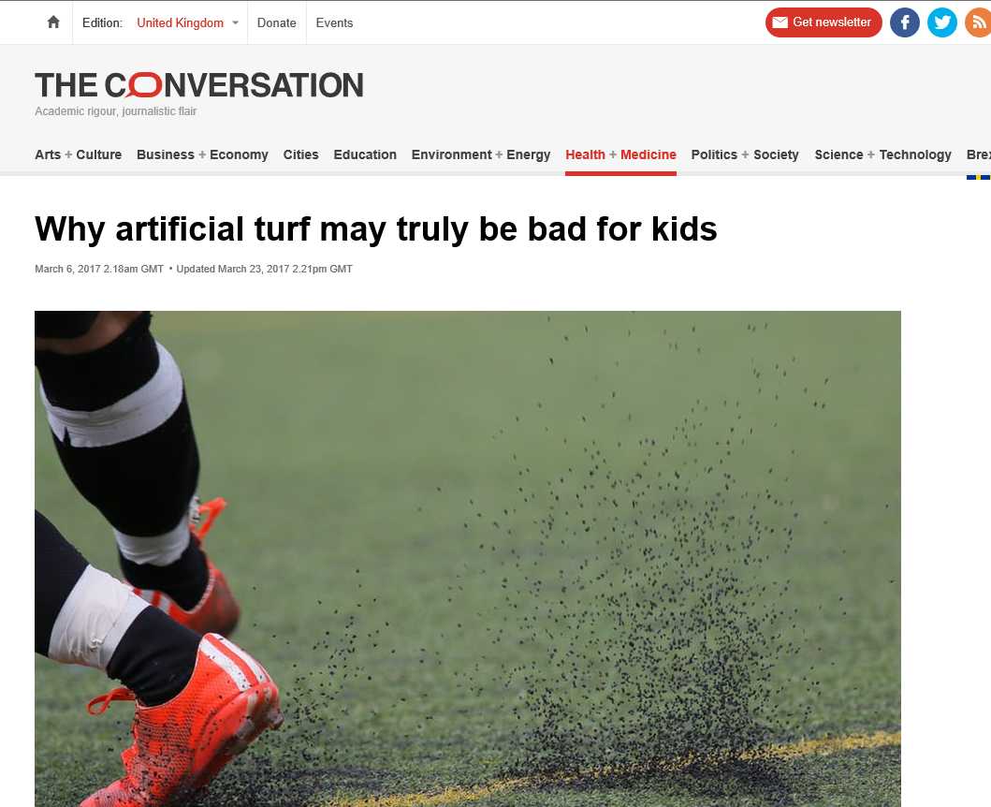
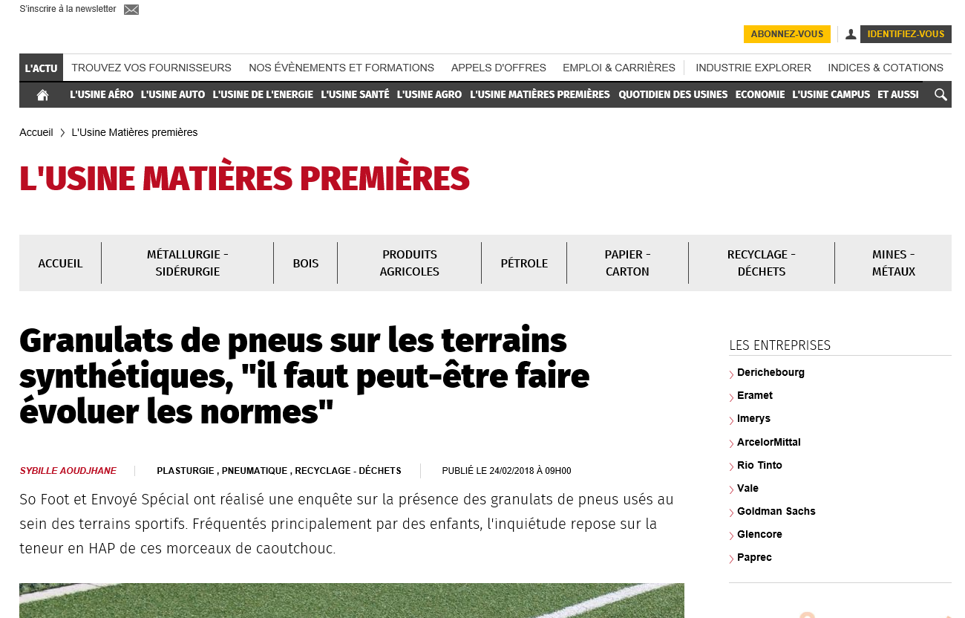
But..

Slide 9
Most relevant milestones
MAY 2010: GERMAN PROPOSAL FOR A RESTRICTION ON PAH IN ARTICLES (short-track procedure)
DEC 2013: COMMISSION REGULATION (EU) No 1272/2013 ON PAHs IN ARTICLES (entry into force on Dec. 2015)
NOV 2015: QUESTIONS ON THE INCLUSION OF RUBBER INFILL INTO THE SCOPE OF THE RESTRICTION
MAR 2016: THE CARACAL AND THE EC AGREED THAT INFILL MATERIALS ARE TO BE CONSIDERED AS «MIXTURES» (out of the scope of Reg. 1272/2013)

Slide 10
Ongoing
RIVM TO PREPARE A DOSSIER* XV FOR ECHA (by july 2018)
ECHA TO EVALUATE THE DOSSIER’S CONFORMITY, TO INTEGRATE IT WITH ADDITIONAL INFORMATION AND TO PREPARE AND ADOPT AN OPINION ( ca 21 months)
EC AND CARACAL, TO PREPARE A DICISION AND TO AMEND ANNEX XVII-ENTRY 50 BY INTRODUCING A NEW RESTRICTION ON PAH IN INFILL MATERIALS (by early 2020)
* It includes a Socio Economic Impacts assessment

Slide 11
PAH determination - EC M/556
CEN AND CENLEC TO DRAFT HARMONIZED STANDARDS FOR THE ANALYTICAL DETERMINATION OF THE INDIVIDUAL CONCENTRATIONS OF THE 8 CARCINOGENIC PAHS (by Dec. 2022)

Slide 12
Conclusions
Most of the public concerns on artificial turf –presumed- toxicity are emotionally driven
Based on the available scientific evidence, both the RIVM and the ECHA have confirmed that the health risks associated with the use of rubber infill in artificial turf fields are negligible
Nevertheless, as infill materials have been classified as «mixtures», other foreign materials might be used (not originated from ELTs) and high PAH content might be allowed by the current legislation
To prevent that, a new specific restriction is under preparation.

Slide 13
Thank you for your attention.
Daniele Fornai – Ecopneus
d.fornai@ecopneus.it
m. +39 3459107364

