Slide 1
Tire Pyrolysis: More than Technology
Global overview, applications & growth hacks
The Tire 2018, Cologne , Tyre Recycling Forum, Day 3, Stream 9 “Rubber Technology and Recycling”
Martin von Wolfersdorff, WOLFERSDORFF CONSULTING
♻️

Slide 2
Content
Intro
What is tire pyrolysis?
A global tire pyrolysis industry overview
Evolution of the tire pyrolysis industry – “From thermal to material valorisation”
Global industry landscape
Future tech: Microwave technology landscape
Beyond technology: Applications and growth hacks
Tire pyrolysis carbon, a composite material
An application map for tire pyrolysis carbon
3 growth hacks for tire pyrolysis

Slide 3
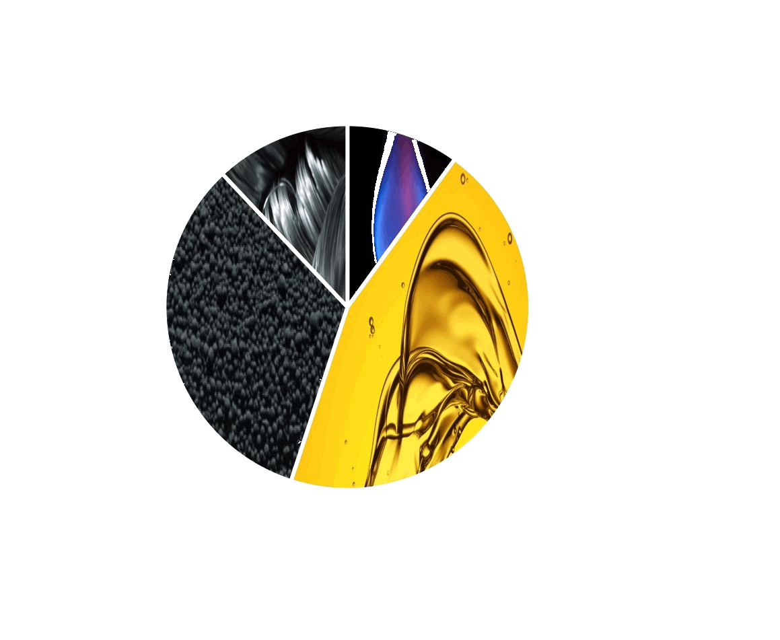
What is tire pyrolysis?
~10% Hydro-carbon gas
(onsite energy creation)
55%
Thermal valorisation
“Net positive energy process”
ELT pyrolysis treatment
(tires, shreds, granulate)
300°C – 1000°C
N₂ atmosphere
~45% Hydro-carbon oil
(on- or offsite energy)
45%
Material valorisation
~33% Carbon composite
(profit center)
~12% Steel

Slide 4
Evolution of the tire pyrolysis industry
“A journey from thermal to material valorisation”
2018 global virgin carbon black shortages
2017 US market volume growth
2016 ASTM D36 workgroup
2014 Bridgestone pyrolysis investment, Michelin project TREC
2010 Reactivation technologies
2000 Carbon valorisation
1990 Oil price & profit drop
N
1970 Oil crisis & alternative fuel
W
E
S

Slide 5
The industry landscape
Europe
91 operators (27 operating)
61 tech providers
EU 28, NO, CH, SRB, TR in 2016: 103 ktpa ELT treated
Leading: Pyrolyx (Germany), SES(Sweden)
Emerging: Tyrebirth (Italy), AlphaCarbone (F)
North America
41 operators (8 operating)
24 tech providers
Leading: Bolder (USA), Delta Energy (USA)
Emerging: New Black Technologies (USA)
Asia Pacific
35+ operators (16 operating)
20+ tech providers
Leading: Enrestec (Taiwan)
Emerging: Radhe Energy (India)
Central & South America
12 operators (4 operating)
Leading: Polimix Ambiental (Brazil)
Emerging: ecoTR (Chile), Kaltire (Chile)
Middle East Africa
21 operators (8 operating)
5 tech providers
Leading: OSHO (South Africa)
Emerging: Marami Energy (KSA)
Notes:
La région avec le nombre plus grand des entreprises actives est l’Europe. Ici la culture de recyclage et les possibilités des subventions sont le plus fort. La deuxième région est l’Amérique du Nord. Là-bas, le marché de noir de carbone est le plus prometteur, grâce à plusieurs nouvelles usines dans le secteur pneumatique. En Asie, il y a surtout des centaines d’usines de pyrolyse de basse technologie et sans valorisation des produits. Dans ma base, j’ai que noté les meilleurs parmi eux.

Slide 6
Future tech: Microwave technology landscape
Worldwide, 11+ tire pyrolysis companies develop microwave heating technology
Heating efficiency is high: Heating is 3D inside the feedstock and fast (~ minutes)
Good balance between oil and carbon quality
Preliminary in-rubber results of microwave processed rCBs are promising
First commercial plant in construction by Tyrebirth (Italy, batch for 30 entire tires)
New Black Technologies (USA), Rotawave (Scotland), Environmental Waste International (Canada) continuous processes

Slide 7
Tire pyrolysis carbon, a composite material
III
I
II
IV
Micro particle size
A
B
C
D
E
F
Structure
OH
surface groups
(if any)
Macro particle size
Composite of virgin carbon blacks (e.g. N330,
N660, N326) and inorganics from tyre feedstock:
e.g. ~80% C, ~10% SiO2, ~8% ZnS, ~2% S
Carbon surface heat history important
(surface energy and carbonaceous residues)
Colloidal properties (OAN; STSA) typically
not representative for rubber performance
“recovered CB”: Milled & pelletised
I: Graphitic planes (sp2)
II: Amorphous carbon (sp3)
III: Crystallite edges
IV: Slit shaped cavities
Source of pic A: Dr. Wilma Dierkes et al.: “Attribution of energy sites to CB microstructures”

Slide 8
An application map for pyrolysis carbons
High temperature
pyrolysis or batch
Σ8 PAHs 0.5 ppm (virgin carbon black ~1 ppm)
Low PAH applications & food contact
Milling,
classification,
blending,
pelletising
Filler or
pigment
Non-reinforcing (N772, N660, N550)
Pooling
Feedstock / process
Reinforcing applications
Global market¹⁾:
> 2 mtpa
Oxidation
Raw carbon
char
Colouring applications (masterbatch)
Coatings appl.
Low silica
Activated
carbon
Adsorbent applications (oil spill, soil)
Activation
Filter applications (e.g. Hg emission)
Combustible
Market²⁾: 300 ktpa
Cement kilns
or heating
Electrode
material
S impurity improves conductivity
Low silica,
graphitisation
Wolfersdorff Consulting top-down estimate based on Notch Consulting 2016 CB market data
Wolfersdorff Consulting top-down estimate based on Markets&Markets 2016 AC market data
Notes:
Dans ce diagramme, les principales applications du carbone recyclé sont indiqués, avec les conditions pour chaque application.

Slide 9
3 growth hacks for tire pyrolysis
① Scale:
Vertical integration (collection, tire, CB, refineries etc.)
Networks, pooling
Internationalisation, regionalisation
② Transparency:
Feedstock type & consistency
Technologies used
Company, products
③ Standardisation:
Test methods (ASTM D36)
Product categories (c.f. TiO₂ “R1”, “R2”)
Product specifications

Slide 10
Thank you!
Martin von Wolfersdorff
WOLFERSDORFF CONSULTING
Mail vonwolfersdorff@googlemail.com
Mobile +49 151 26874623
Skype martin.von.wolfersdorff
Web www.wolfersdorff.com

Slide 11
Appendix & weblinks
Follow-up reading and networking:
👉 Read about “The best tyre recycling process - does it exist?” - An article comparing tire recycling processses
👉 Join the "recovered carbon black / rCB” Linkedin group
👉 Connect with Martin on LinkedIn
👉 Browse and buy reports like the Global Top 40 Benchmarking report & regional market reports for rCB

