Slide 1


END OF WASTE CRITERIA FOR RECYCLED RUBBER FROM END-OF-LIFE TYRES.
A NECESSARY STEP
TO IMPULSE
CIRCULAR ECONOMY
Roberto Pérez Aparicio
Leticia Saiz Rodríguez

Slide 2
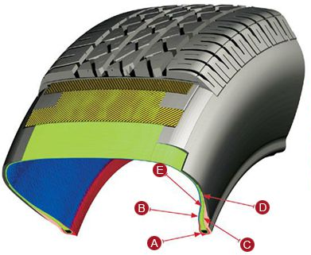
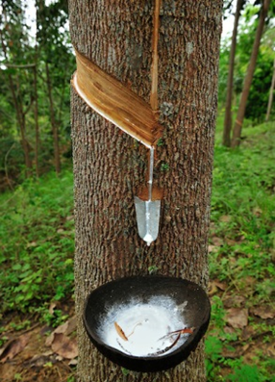

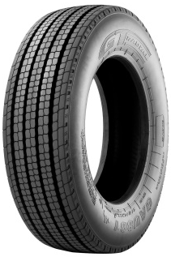
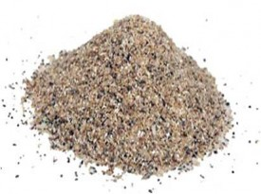
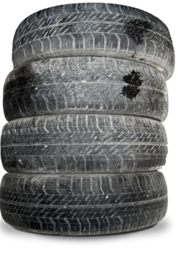


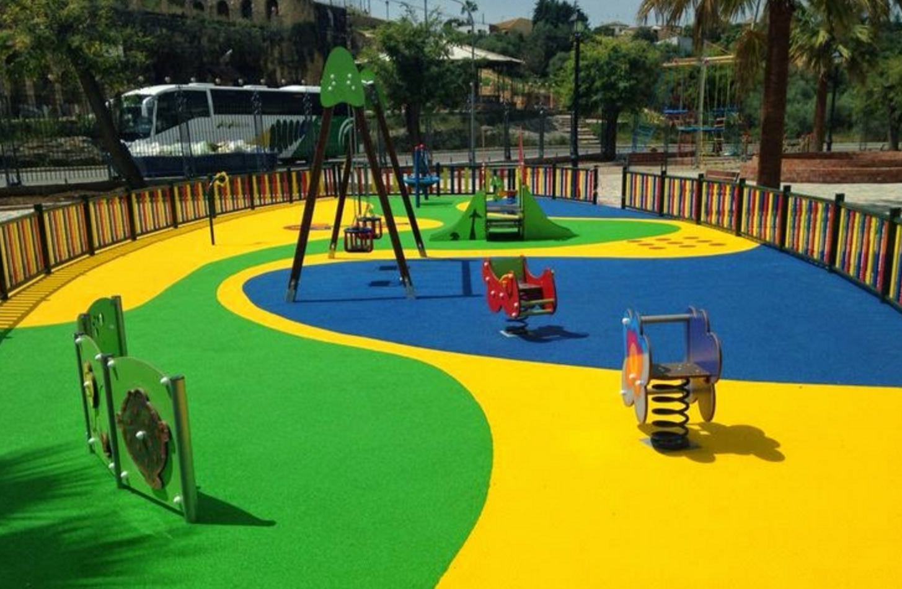
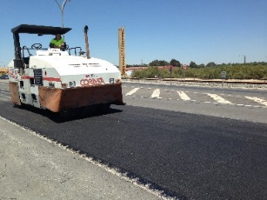
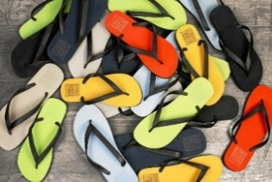
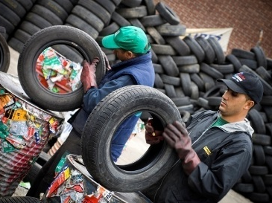
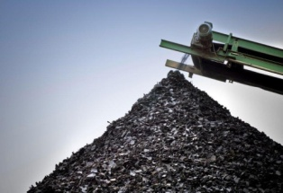
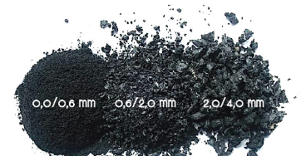
Circular economy
Design & Production
Raw Materials
End-of-life → Waste
New Applications
Turning waste into resources
Closing the loop
Recovery & Recycling

Slide 3




ELT materials - current situation
LEGAL
TECHNICAL
ENVIRONMENTAL, HUMAN HEALTH

Slide 4
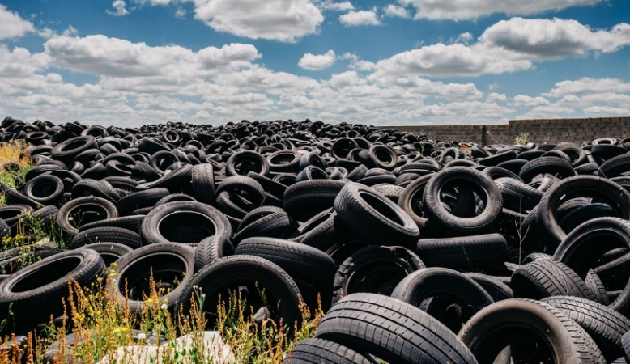


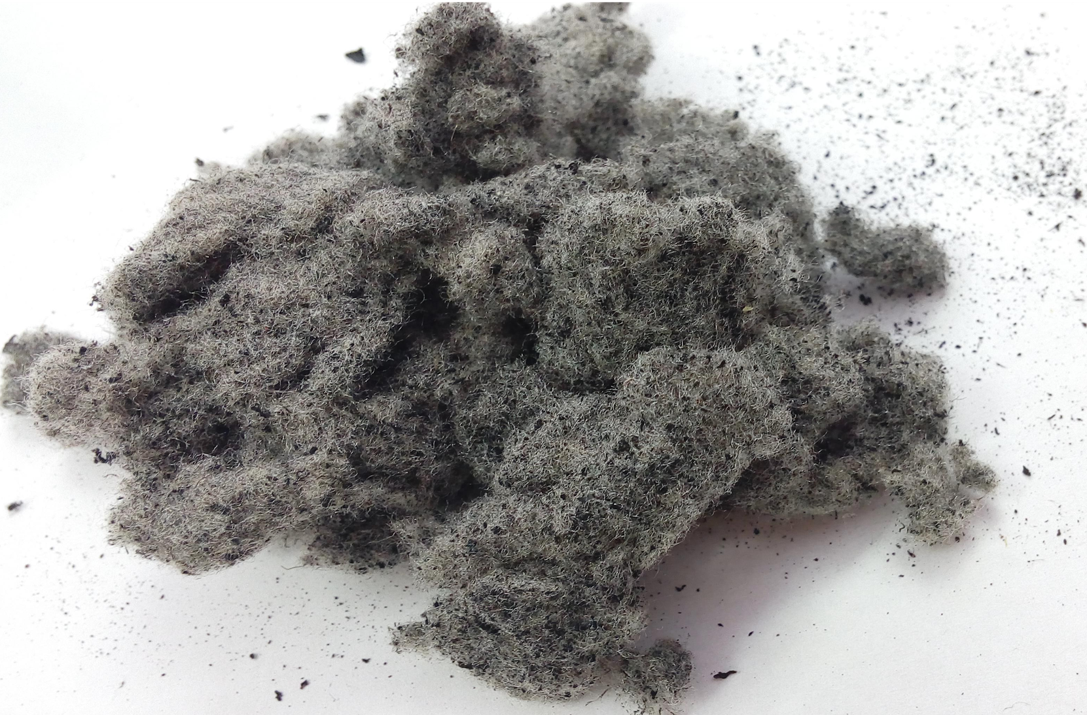

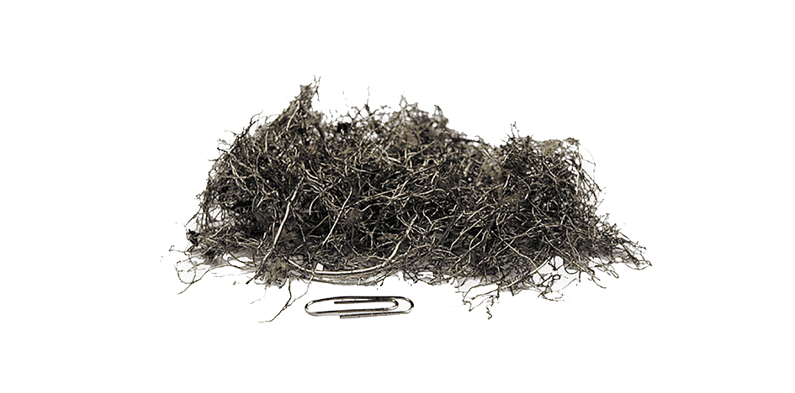
End-of-waste criteria
Specify when certain waste ceases to be waste
obtains a status of a product or a secondary raw material
Textile
Rubber
Steel

Slide 5
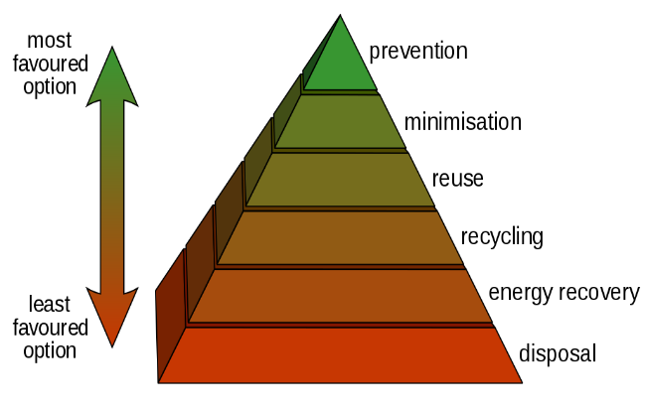


WHY IS IMPORTANT TO APPLY THE EOW CRITERIA?
Circular Economy
Waste Hierarchy: Recycling enhancement
Enhanced use
Easier administrative procedures
No uncertainties for REACH compliance
Non-hazardous wastes
Objectives and common criteria
Increased product confidence

Slide 6
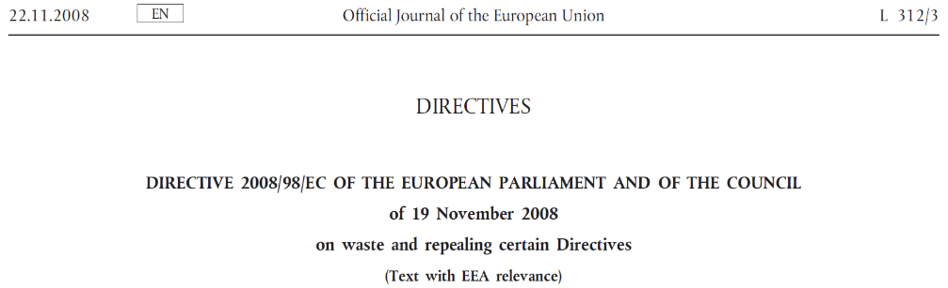

background
Directive 2008/98/EC on waste
Article 6. End-of-waste status
1. “Certain specified waste shall cease to be waste within the meaning of point (1) of Article 3 when it has undergone a recovery, including recycling, operation and complies with specific criteria to be developed in accordance with the legal conditions:
a) the substance or object is commonly used for specific purposes;
b) there is an existing market or demand for the substance or object;
c) the substance or object fulfils the technical requirements for the specific purposes and meets the existing legislation and standards applicable to products;
d) the use of the substance or object will not lead to overall adverse environmental or human health impacts.”
2. “End-of-waste specific criteria should be considered, among others, at least for aggregates, paper, glass, metal, tyres and textiles.”

Slide 7

State of eow criteria in eu
EoW approved
UK
The Netherlands
Portugal
EoW in process
Italy
France
Spain

Slide 8
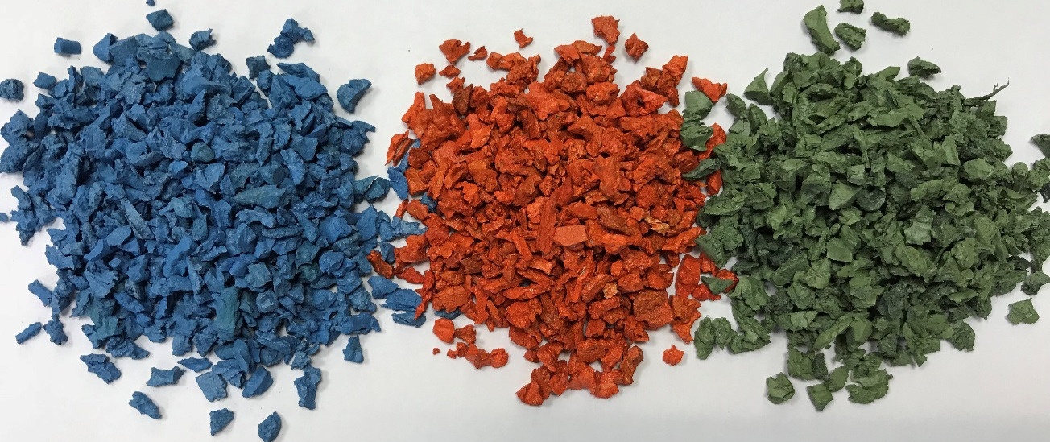
End of waste criteria: rubber from elt
Powder
Granulate
Coated

Slide 9
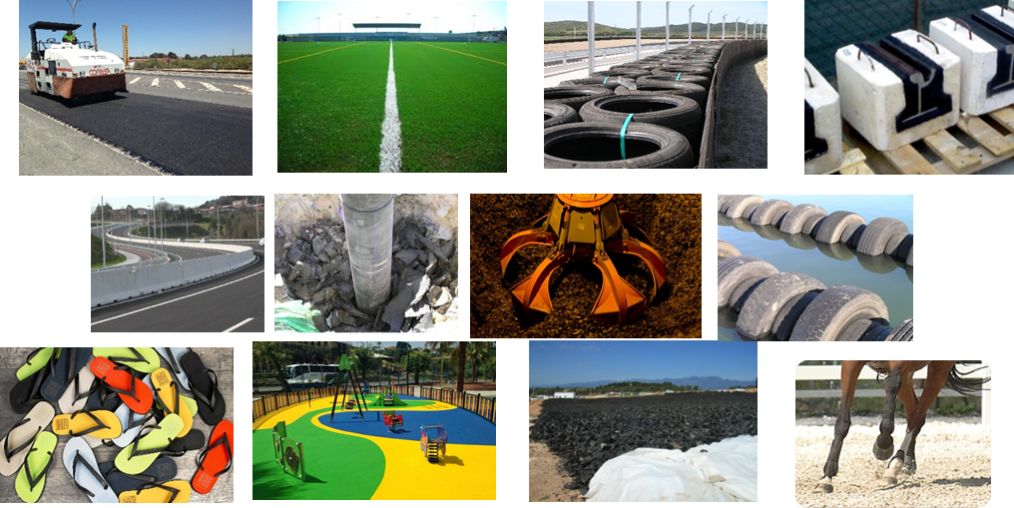
CONDITIONS ART. 6 DIRECTIVE 2008/98/EC on waste
a) the substance or object is commonly used for specific purposes
  Sport surfaces
  Playgrounds
  Asphalt mixtures
  Street furniture
  Moulded parts
  Etc.

Slide 10
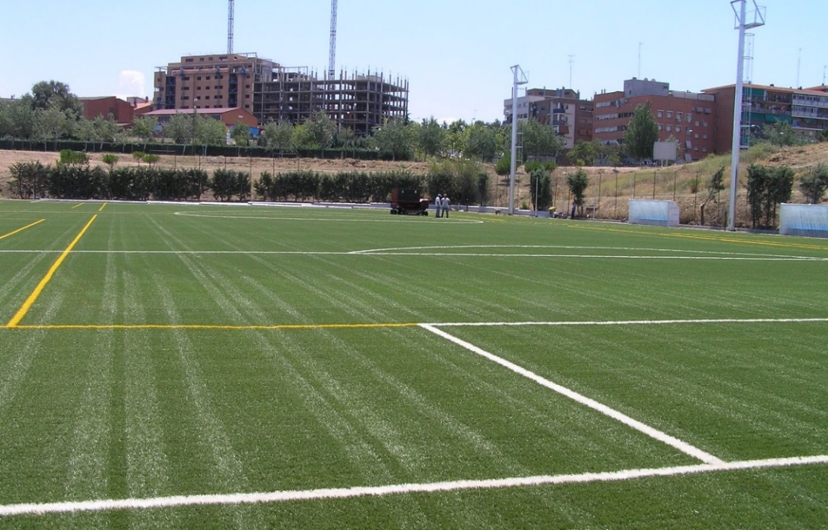
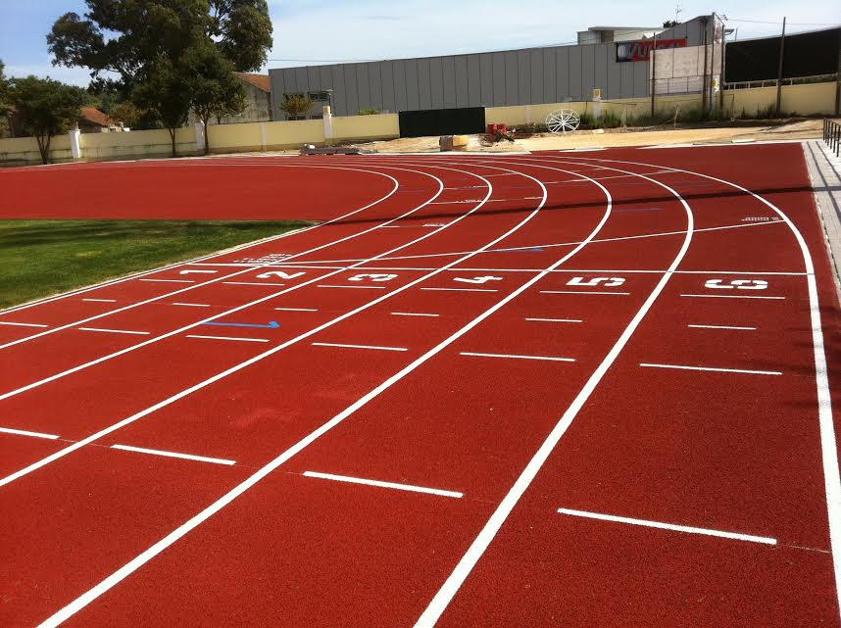
CONDITIONS ART. 6 DIRECTIVE 2008/98/EC on waste
a) the substance or object is commonly used for specific purposes
Synthetic turf and shock pad
Sport surfaces

Slide 11


CONDITIONS ART. 6 DIRECTIVE 2008/98/EC on waste
a) the substance or object is commonly used for specific purposes
Safety floors and playgrounds
Asphalt mixtures

Slide 12
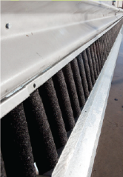
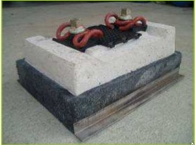
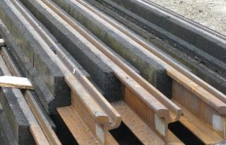
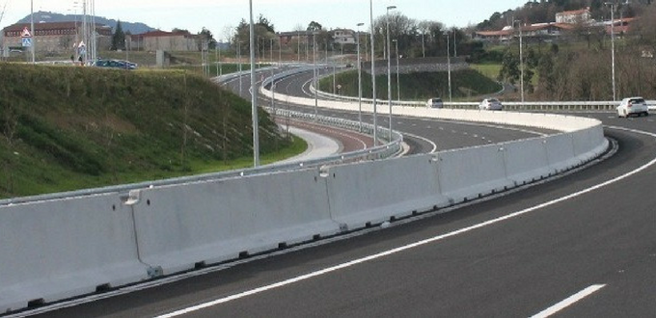
CONDITIONS ART. 6 DIRECTIVE 2008/98/EC on waste
a) the substance or object is commonly used for specific purposes
Vibration absorption
systems
(railway tracks)
Security barriers and motorcyclist protection systems

Slide 13
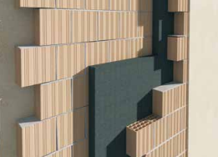

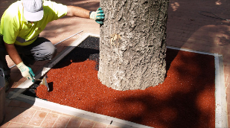
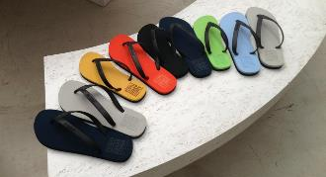
CONDITIONS ART. 6 DIRECTIVE 2008/98/EC on waste
a) the substance or object is commonly used for specific purposes
Ornamentation and moulded products
Thermal and acoustic insulation
Casters
Shoes soles

Slide 14
CONDITIONS ART. 6 DIRECTIVE 2008/98/EC on waste
b) a market or demand exists for such a substance or object
Spanish market niches rubber from ELT

Slide 15

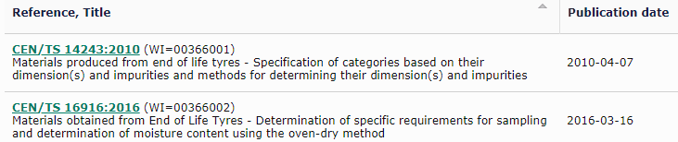
CONDITIONS ART. 6 DIRECTIVE 2008/98/EC on waste
c) the substance or object fulfils the technical requirements for the specific purposes and meets the existing legislation and standards applicable to products
For ELT materials
For products with ELT materials

Slide 16

CONDITIONS ART. 6 DIRECTIVE 2008/98/EC on waste
d) the use of the substance or object will not lead to overall adverse environmental or human health impacts
Health and environmental risks
PAH, metals, phthalates, VOC, SVOC
Risk assessment on artificial sport pitches
Health risk negligible (ECHA, RIVM, US Environmental Protection Agency,…)
New studies in progress (PAH leaching, toxicology, exposure,…)
Life cycle assessment
Reduction of CO₂ emissions

Slide 17
Circular economy
Design & Production
Raw Materials
End-of-life → Waste
New Applications
Turning waste into resources
Closing the loop
Recovery & Recycling
SECONDARY RAW MATERIALS

Slide 18

Thank you for your attention!
Roberto Pérez Aparicio
rperez@signus.es
Leticia Saiz Rodríguez
lsaiz@signus.es

