Slide 1
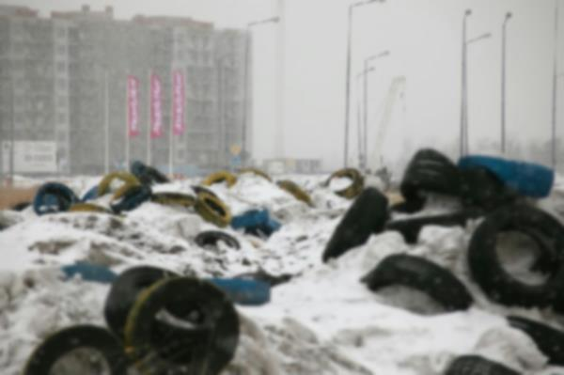
Tyre recycling trends in Russia
by Vladislav Vorotnikov

Slide 2
Key facts & figures
100 billion mt of waste stored at the dumps in Russia
Waste dumps occupy 4 million ha, growing every year
1 million used tyres Russia produces per year
Only 10% used tyres end up at recycling plants
The task is to recycle at least 30% used tyres from 2020

Slide 3
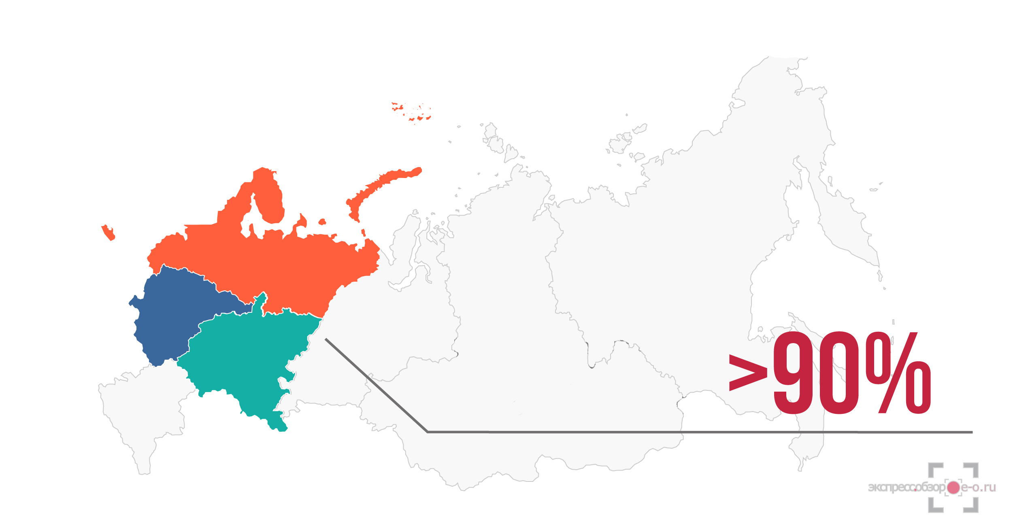
Russian tyre recycling industry is likely to be concentrated in the main production areas

Slide 4
Challenges
Imported equipment fails to recycle tyres with nylon cord
No nationwide tyre collecting system
Low demand for rubber crumb on the domestic market

Slide 5
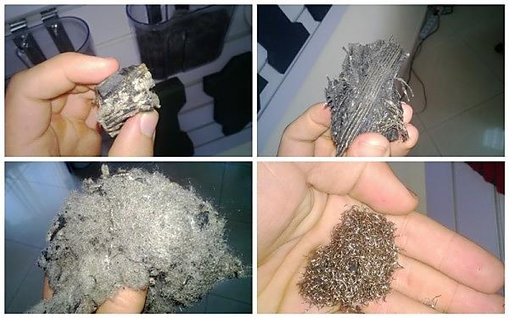
Mechanically recycled Russian nylon-cord tyres (1) and imported European tyres (2)
1. 2.

Slide 6
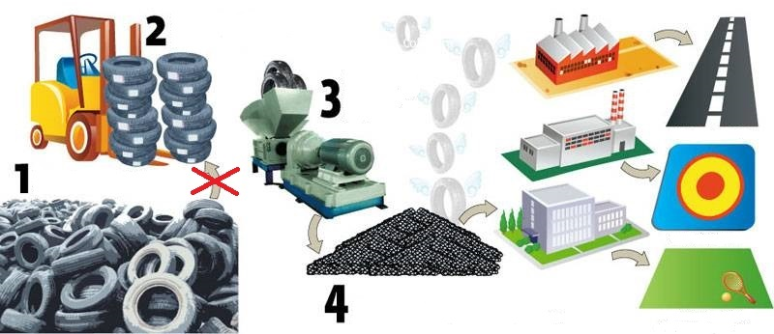
No nationwide tyre collecting system

Slide 7
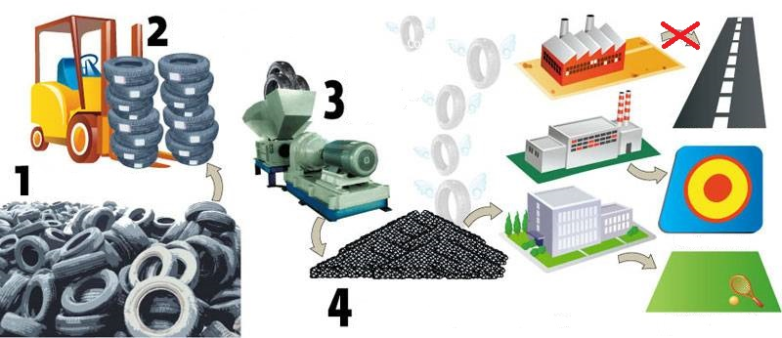
Low demand for rubber crumb on the domestic market

Slide 8
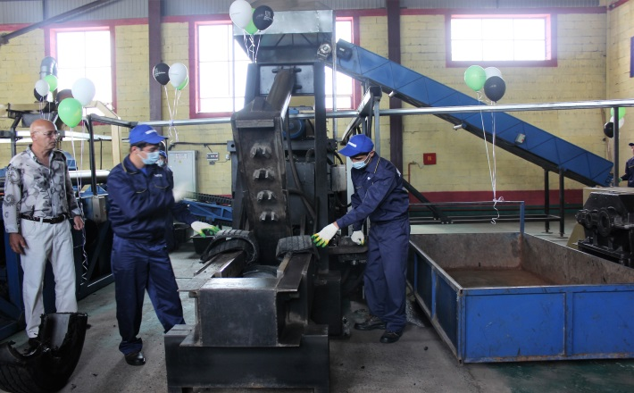
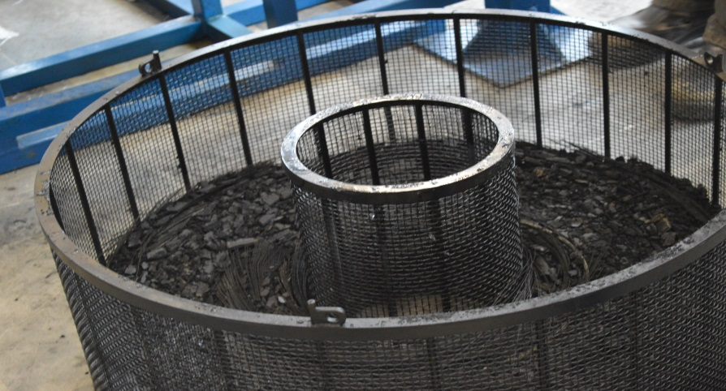
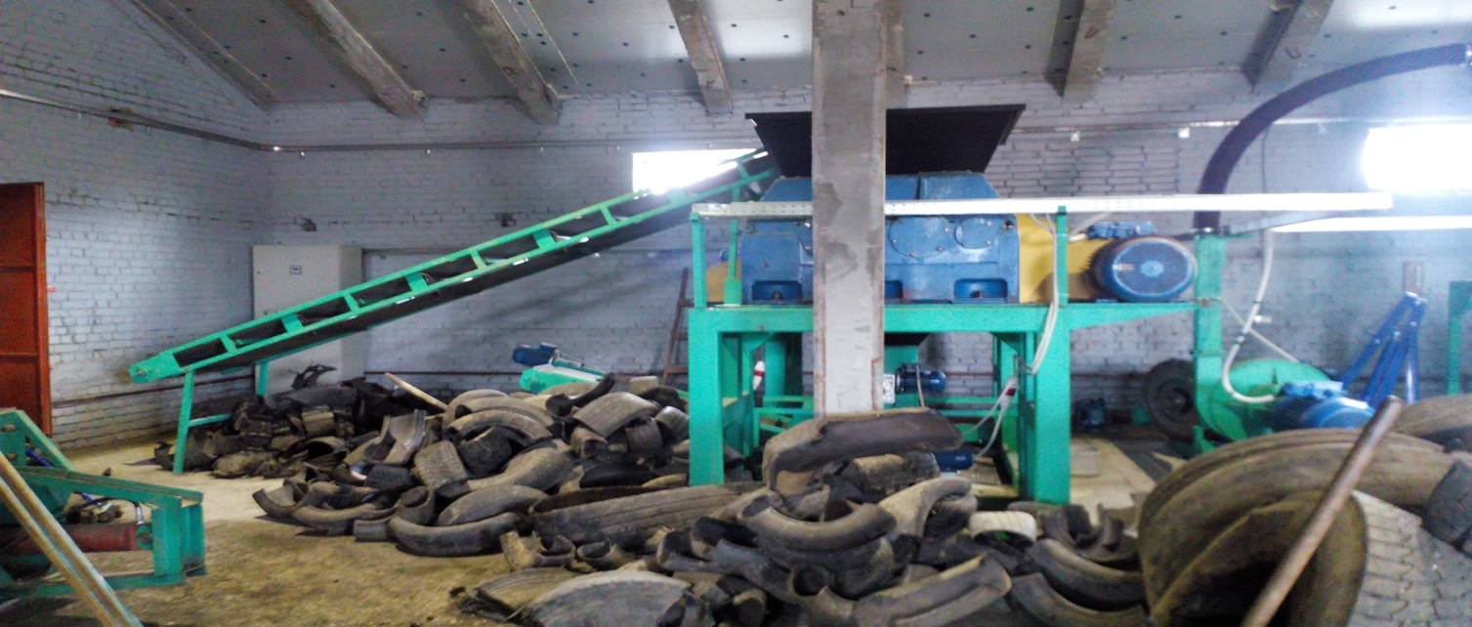
New tyre recycling plants are being launched in Russia

Slide 9
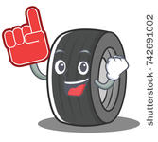
Thank you for your attention!

