Slide 1
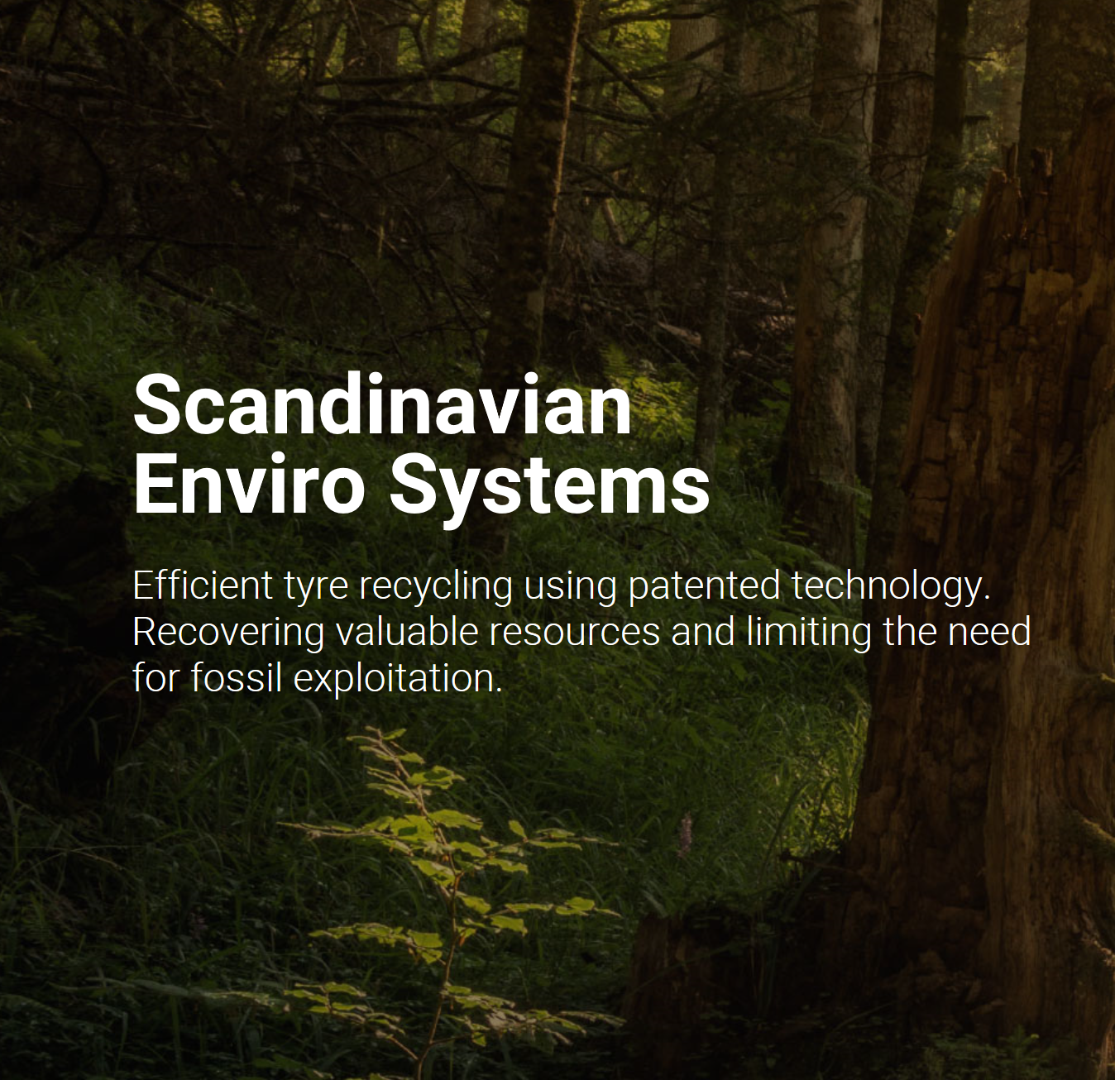
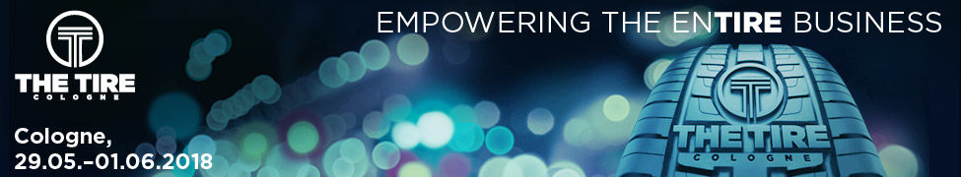
Disruptive technology in existing infrastructure
- bringing Circular Economy to the next level
The Tire Cologne
May 2018
Fredrik Olofsson
Sales manager

Slide 2
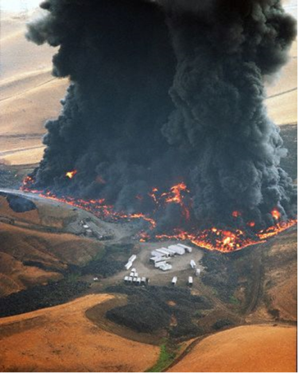
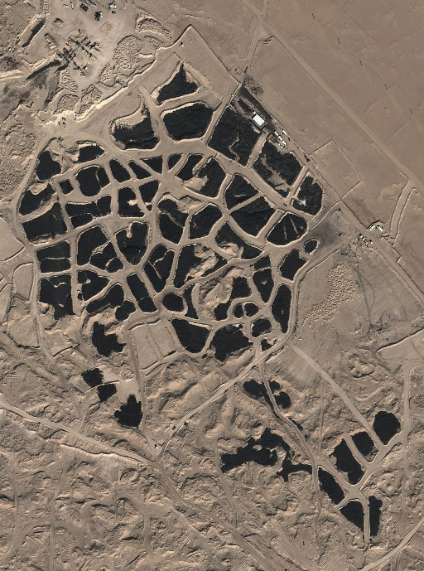
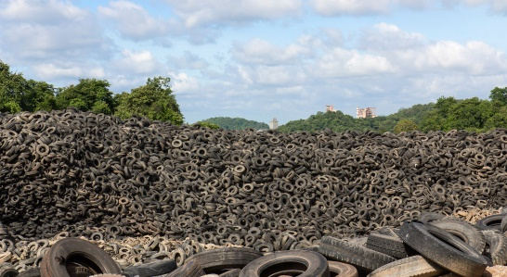
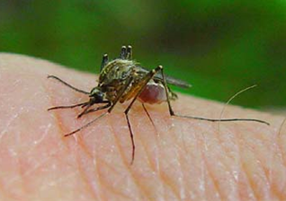
Solving a global problem
Carbon black shortage and significantly increased market prices.
----------------------------------------------
Demands in the rubber and plastic industry for CO² footprint reduction.
Notes:
1

Slide 3
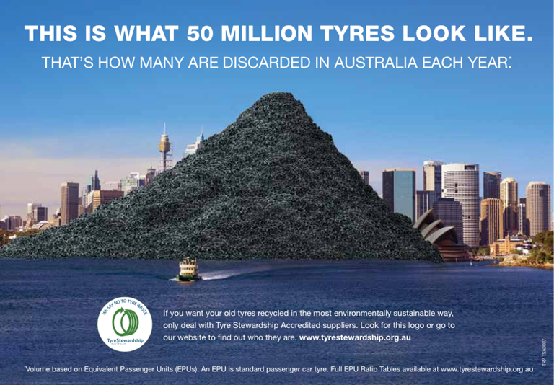
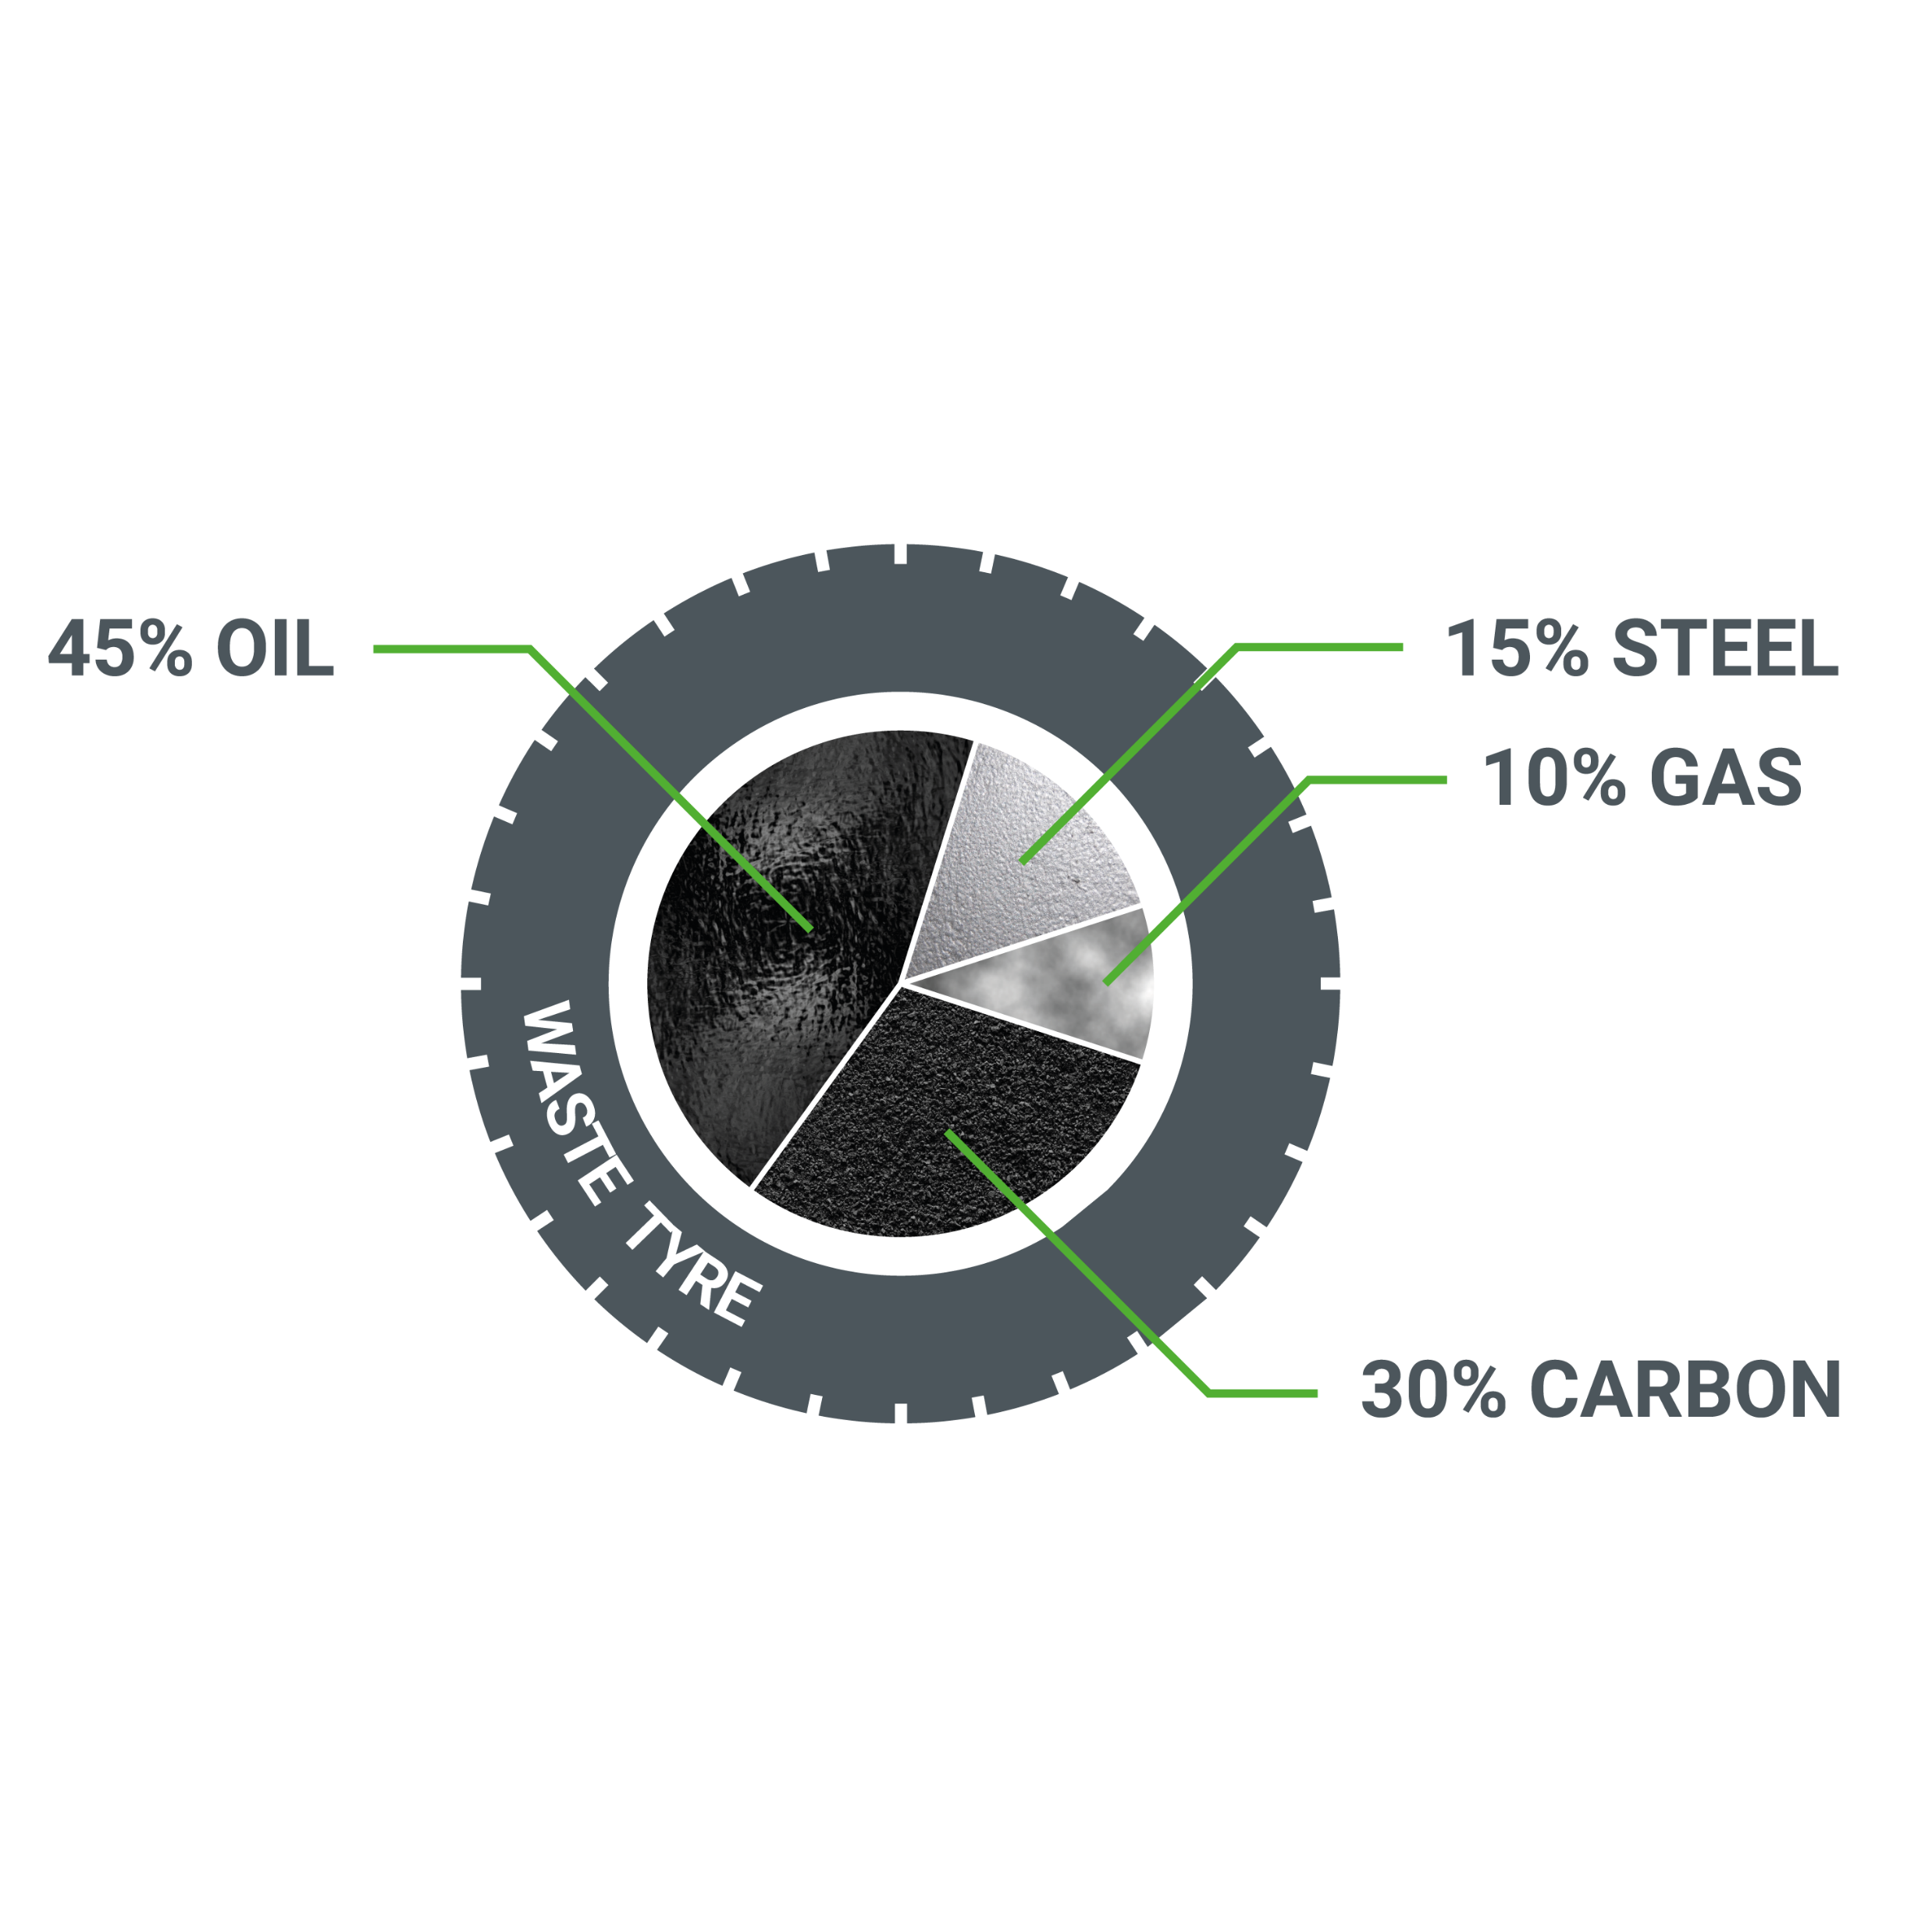
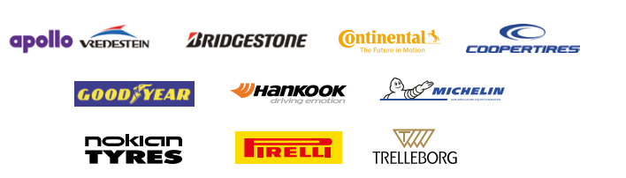
The Market and trends…..
The trend globally (especially Tire producers) is to focus on significant material upcycling so the recycled material can be used again in new rubber products.
Until recently the approach from the rubber industry was very sceptical and hard to persuade even to test our material.
Now we see attentive from many different segments in the rubber and plastic industry.
Impelling factors: proof of concept, market pricing, shortage of CB, vision/goal set by the industry and decision-makers……
Transparency of the rCB users pushes the sceptics in a very conservative line of business.

Slide 4
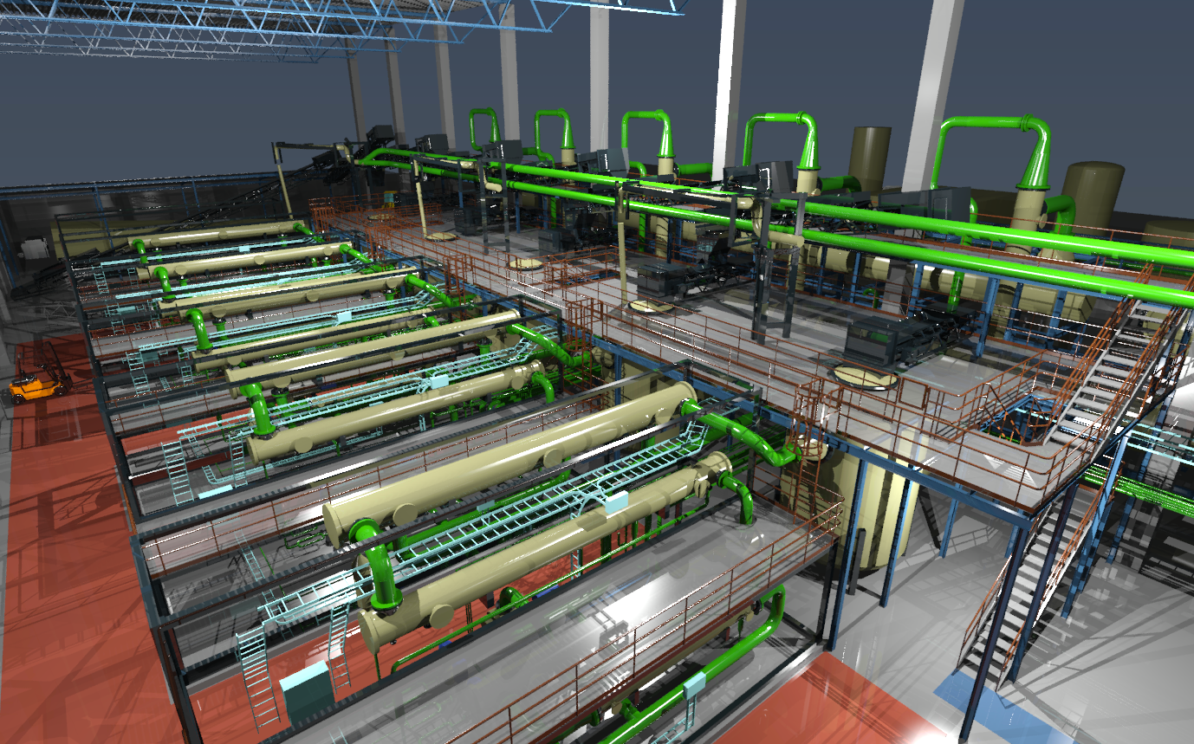
Trends in the rubber industry…..
In Continental´s sustainability report they state following:
” We will increase the recycled materials in new tire production to 10% before 2025.”
On Michelin´s homepage you can see the following statement:
Goals for 2020:
”Contribute to the development of the circular economy, with
30 % renewable or recycled materials, in the manufacture of tires”
Pirelli writes in the sustainability leaflet :
”from green sourcing and materials innovation to end-of-life tire management,
Pirelli takes an active leadership role”
Hankook, quotes from their CMS report:
”We have partially achived our goal to increase the use of recycled resources in product manufacturing.”
“Recycled carbon is one of the byproducts generated through the pyrolysis of end-of-life tires.
Using such recycled carbon for tires and other rubber products can help us reduce the depletion of resources
that occur as part of the raw materials production process. ​"​

Slide 5
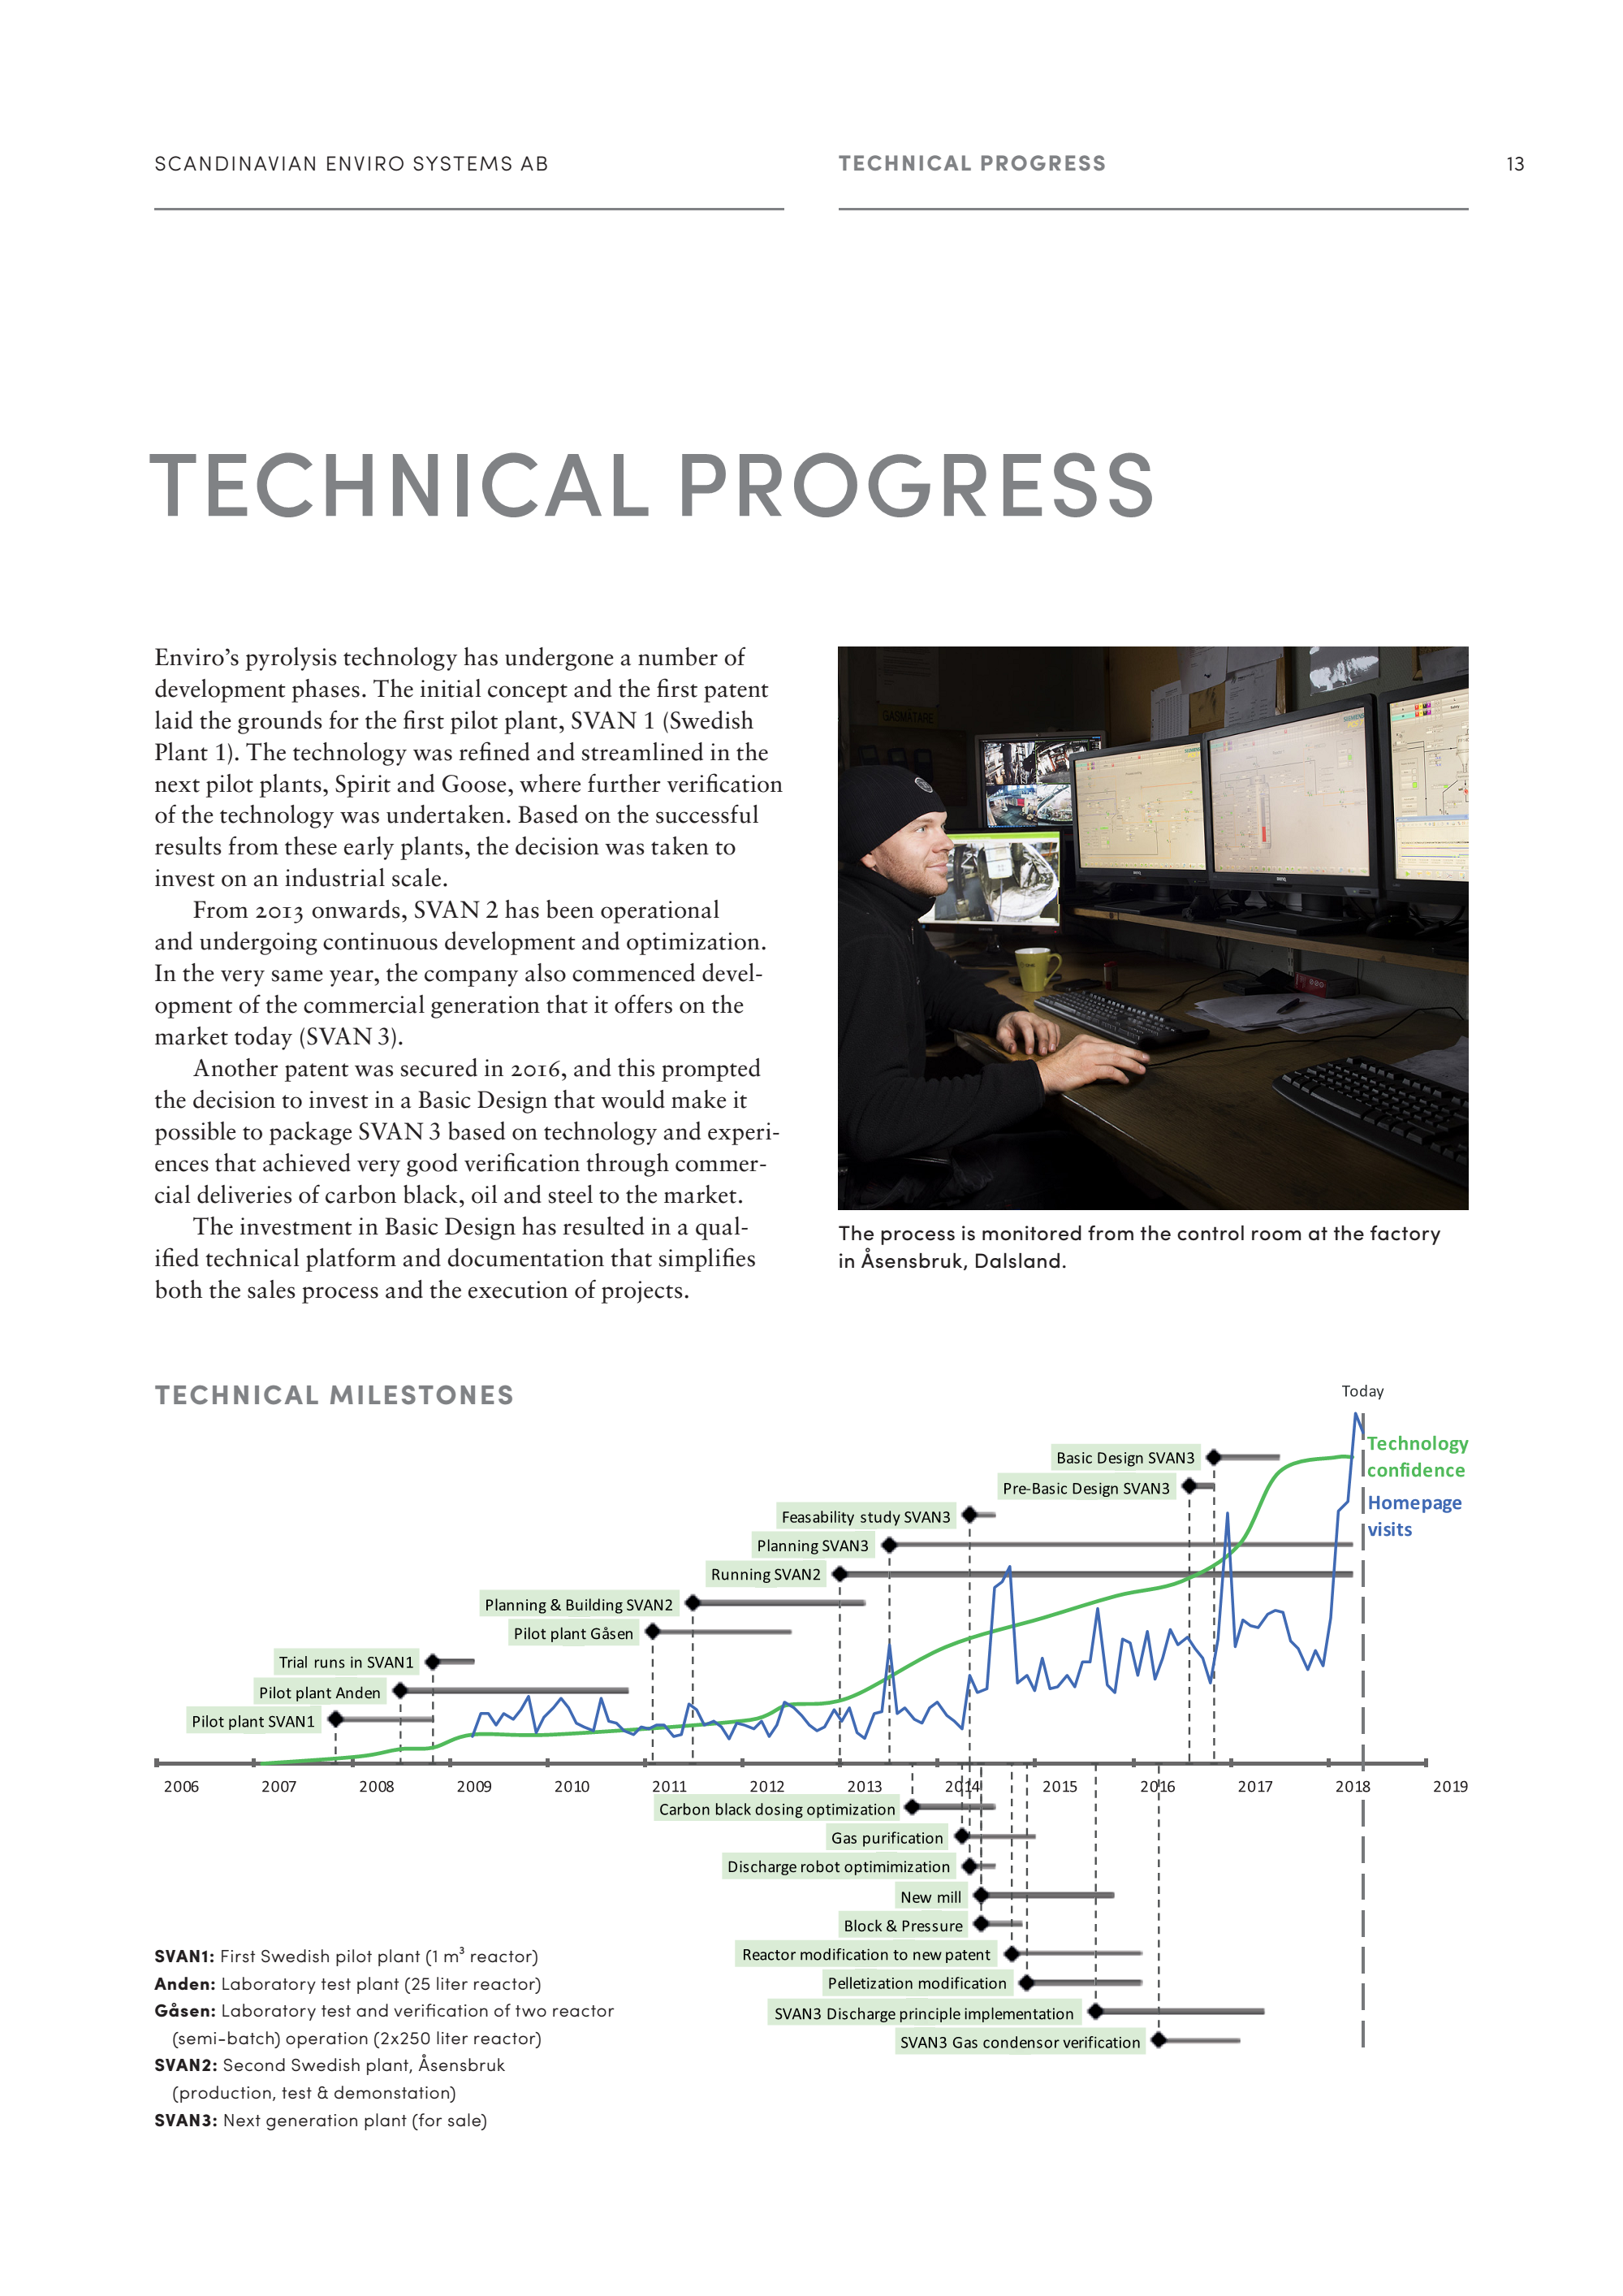
Scandinavian Enviro Systems
Enviro´s pyrolysis technology has undergone a number of development phases from 2007.
Commercial deliveries for more than 2 years.
Very stable and high quality, semi-batch system, Siemens platform, high degree of automation.
“Basic Design” completed 2017 – commercializing Enviro´s technology.
Huge globally interest in our rCB and plant offer.
First larger order of rCB related to tyres to happen 2018.
Ongoing trials with different types of feedstock – development of “new” grades of rCB.
Very promising results in the tire segment.

Slide 6
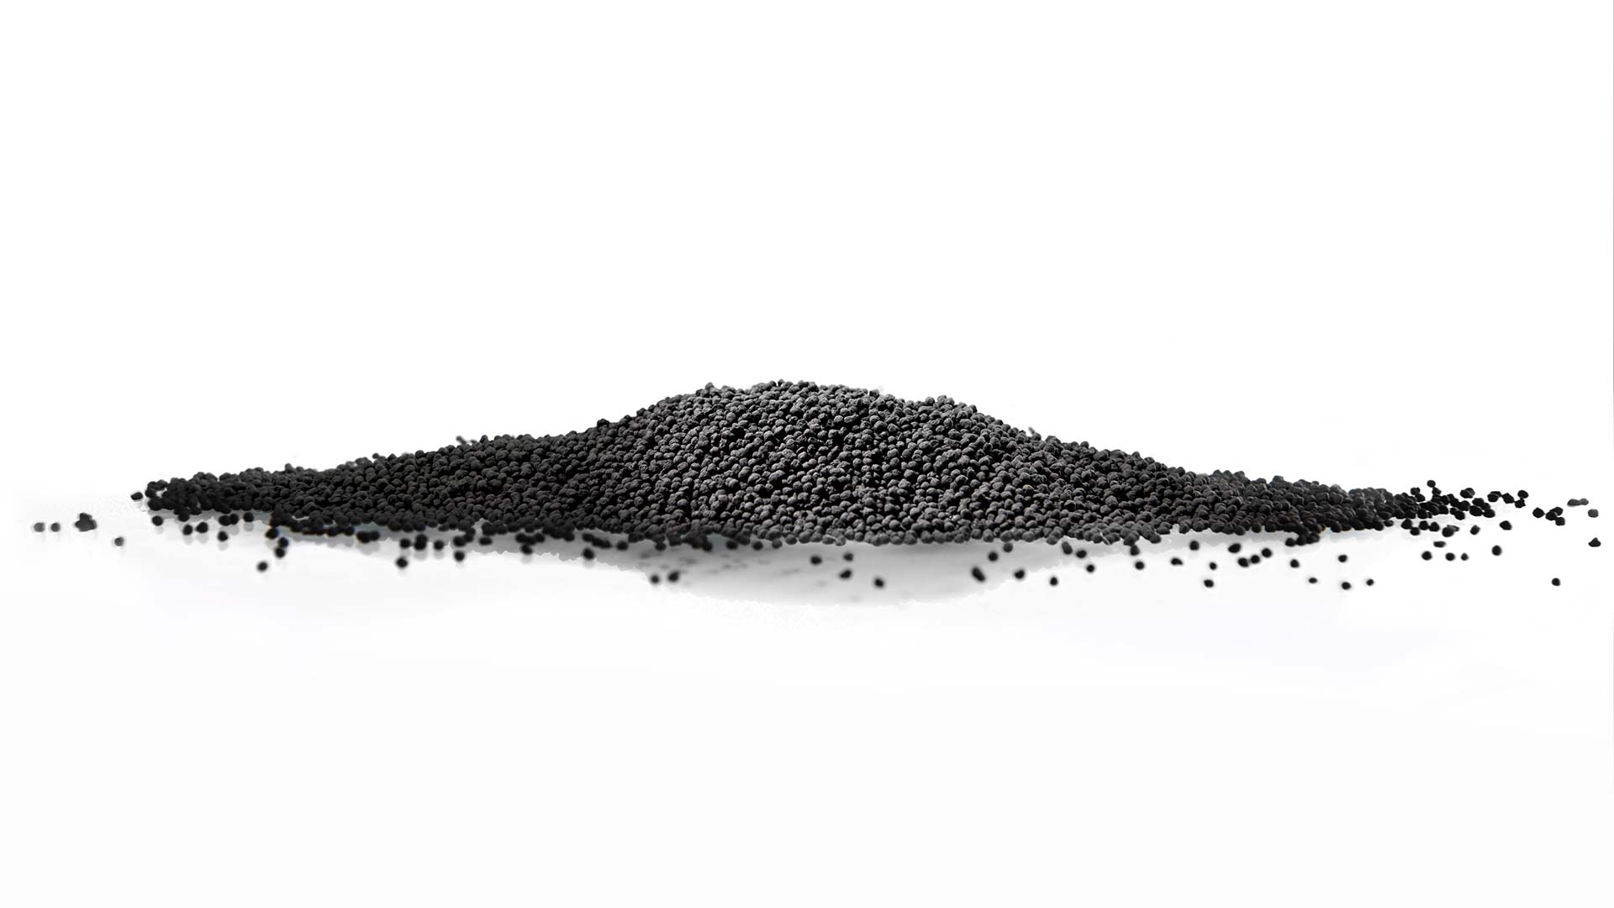
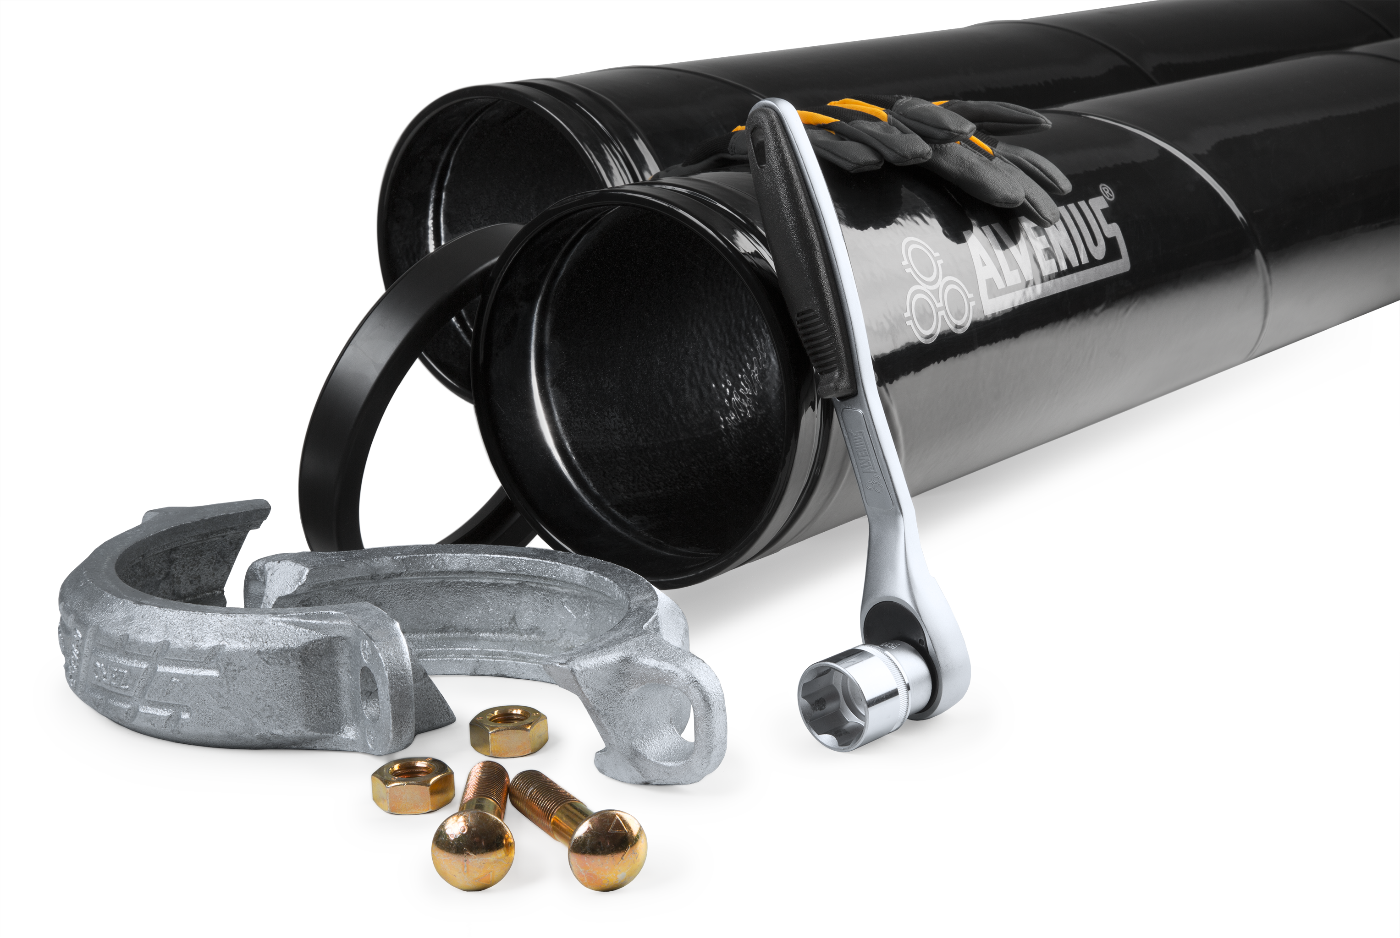
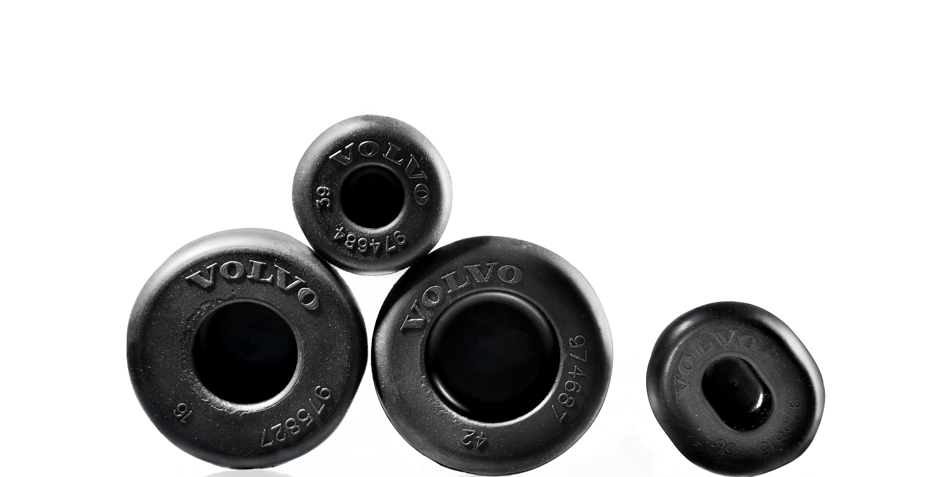
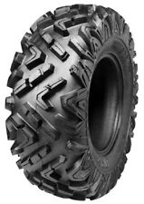
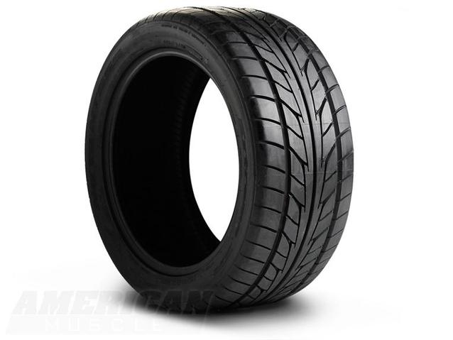
Progress so far – recovered carbon black
More than 40000000 products produced by AnVa to Volvo Cars. 100 % rCB used instead of vCB. More products with our rCB to be implemented during 2018.
3 sealings to Alvenius. 100 % rCB used instead of vCB.
Solid tires – huge interest from this segment. First larger order received 2018.
Huge interest from compound producers and the rubber industry (compression/injection).
Numerous trials completed by the tire industry. Promising results. We are convinced production trials will be performed in the near future.
Promising trial results by the masterbatch (plastic) industry.

Slide 7
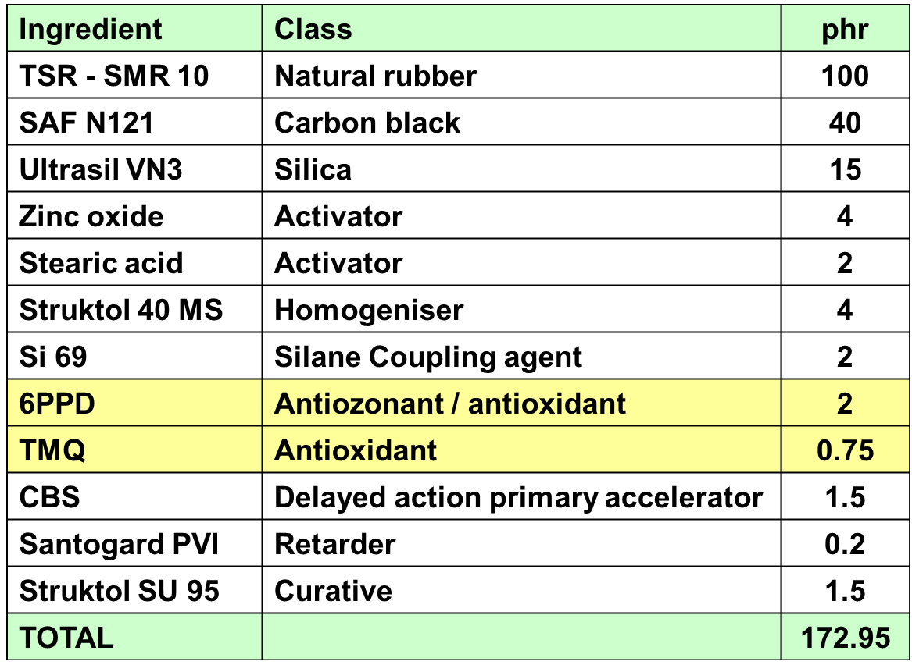

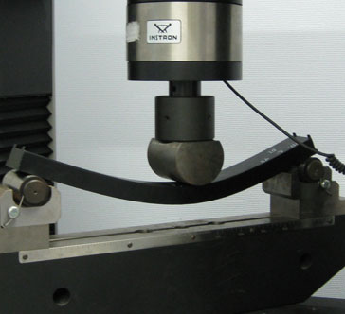
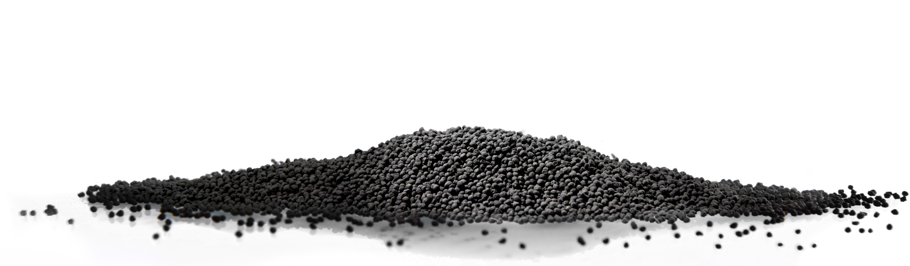
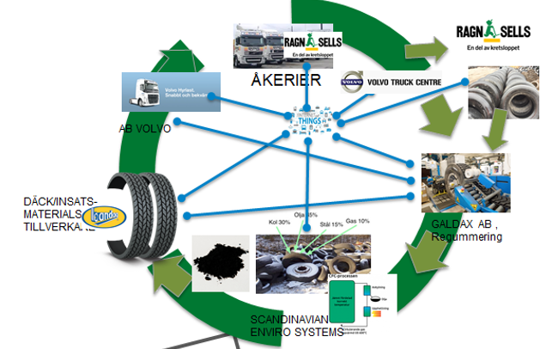
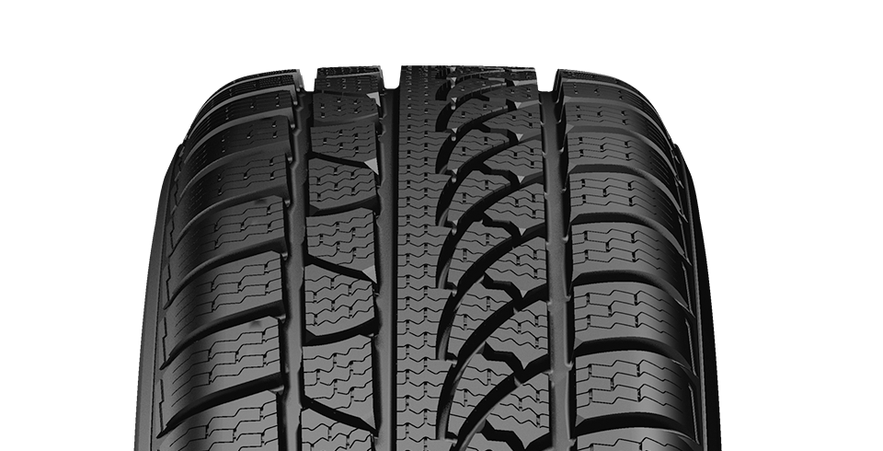
Re-treading and usage of rCB?
Notes:
1

Slide 8
In a near future
Existing plant in Åsensbruk, Sweden
New plant/-s in XXXXXX, XXXXXXX
We ARE ready for “plant” commercialization – proof of concept and Basic Design.
Capacity – volumes needs to be increased due to market demand.
Huge global interest in our company and technology.

Slide 9
What we now experiencing and see in the future
MoU with ArticCan, 30000T plant, Canada.
Ongoing discussions about plant establishment in Chile, Denmark, Mexico and South Africa.
Huge interest and ongoing discussions with operators in the waste management segment about plant establishment.
Carbon black shortage and price trend boosts interest in rCB with high and stable quality.
Development of new rCB grades based on different feedstock.
Usage of significant volumes of our rCB in the tire segment.

Slide 10

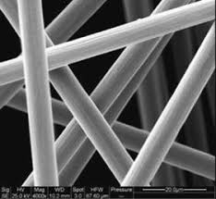
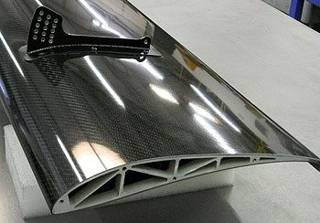
The new waste stream carbon fibre - rCF
Our patented technology seems to be appropriate for the new waste stream carbon fibres. Ongoing project with automotive and aircrafts industry.
rCF – possible to commercialize in the automotive segment?
rCF – can it be used in the rubber industry?
rCF – definitely in the plastic industry.

Slide 11
Thank you, please visit our web page for more valuable information.
www.envirosystems.se

