Slide 1
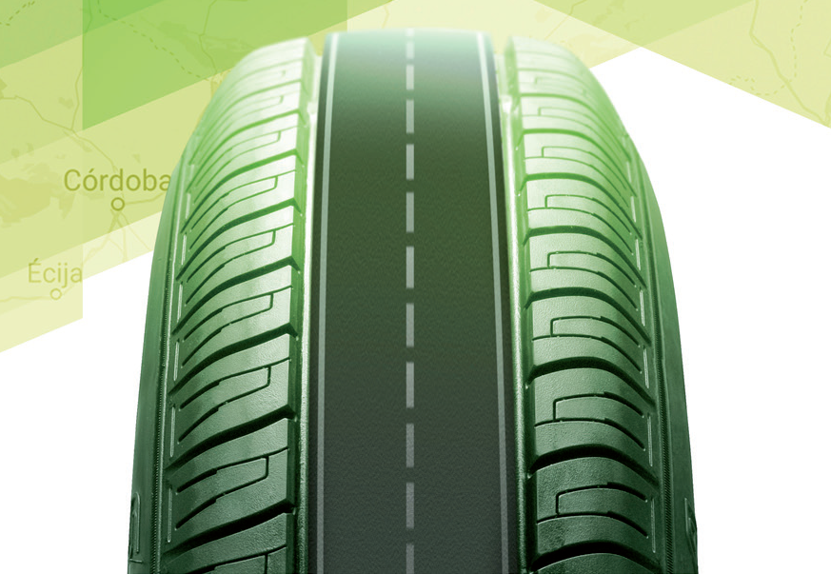
20 YEARS OF EXPERIENCE IN THE USE OF CRUMB RUBBER IN ASPHALT MIXES ON SPANISH ROADS
Luis Alfonso de León
Cologne, 30th may 2.018

Slide 2
INDEX
PRESENTATION
ASPHALT RUBBER MIXES: WAYS TO ADD CRUMB RUBBER FROM ELT´S
BENEFITS OF USING ASPHALT RUBBER
  TECHNICAL
  ECONOMICAL
  SOCIAL
  ENVIRONMENTAL
SPANISH EXPERIENCE WITH ASPHALT RUBBER
CONCLUSIONS
Cologne, 30th may 2.018

Slide 3
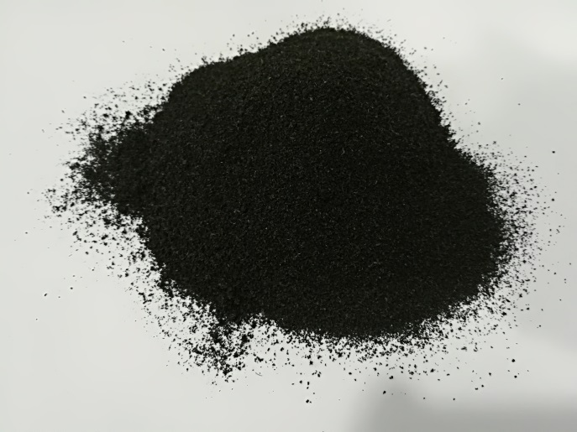
PRESENTATION
CRUMB RUBBER: finest part of products obtained after a crushing process of end life tyres (ELT´s).
Crumb rubber powder is usually defined by a gradation between a minimum and maximum size of particles.
In Spain, and usually worldwide, most
common size for crumb rubber to add
to an asphalt mix is between 0 and 0,8 mm.
(30 mesh approx.)
Technical and physical properties of crumb
rubber from ELT´s must meet some minimum criteria to be added into an
asphalt mix in order to enhance it´s properties
Cologne, 30th may 2.018

Slide 4
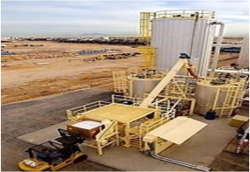
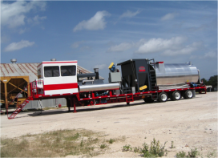
ASPHALT RUBBER MIXES: WAYS TO ADD CRUMB RUBBER FROM ELT´S
WET WAY
Crumb rubber mixed first with neat bitumen (or binder)
Digestion process of crumb rubber particles into neat bitumen changing this into a crumb rubber modified bitumen (CRMB): excellent technical results
Hot mix asphalt production mixing CRMB and aggregates in asphalt plant mixer
Two options to reach a CRMB through wet way:
  Terminal blenders, then transport to asphalt plant
  Mobile blenders producing CRMB in the asphalt plant
Cologne, 30th may 2.018

Slide 5
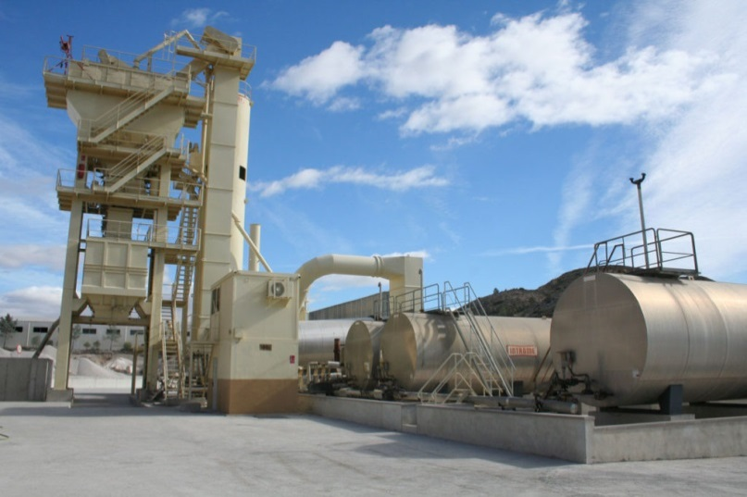
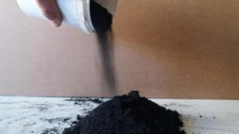
ASPHALT RUBBER MIXES: WAYS TO ADD CRUMB RUBBER FROM ELT´S
DRY WAY
Crumb rubber added as another small aggregate into asphalt mixer
Difficult to ensure digestion process of crumb rubber particles into neat bitumen
Easy to work with, no trouble or interference with usual asphalt plant process
Cologne, 30th may 2.018

Slide 6
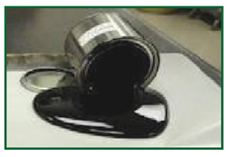
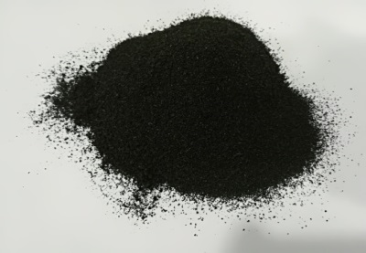
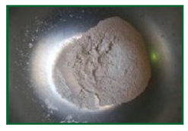
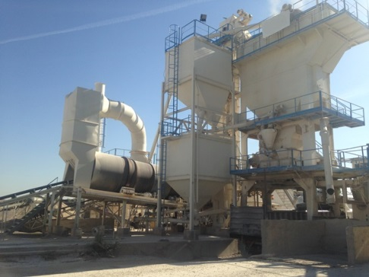
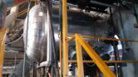
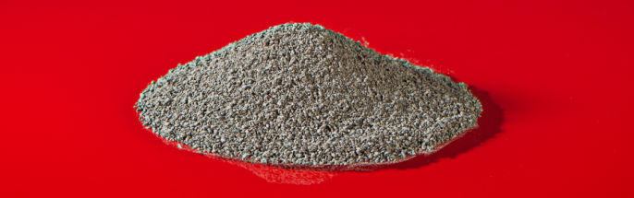
ASPHALT RUBBER MIXES: WAYS TO ADD CRUMB RUBBER FROM ELT´S
SEMI-WET WAY
Takes main advantages of both ways (wet and dry)
Crumb rubber is pre-digested in terminal with neat bitumen and other additives (wet way)
After this, predigested crumb rubber is delivered to asphalt plant to add it like other small aggregate (dry way)
Cologne, 30th may 2.018

Slide 7
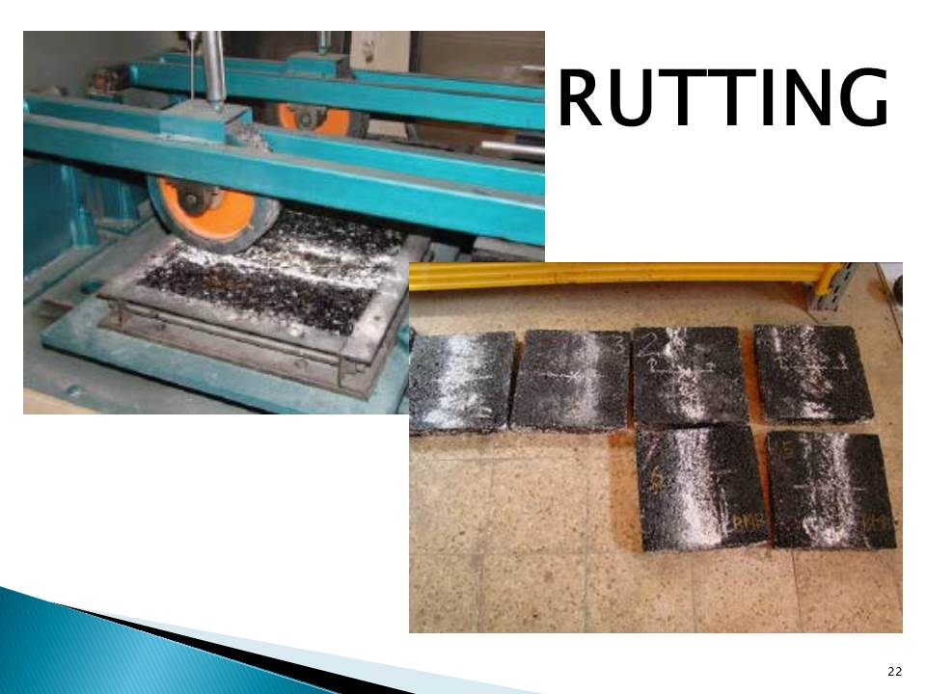
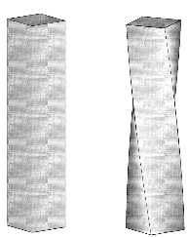
BENEFITS OF USING ASPHALT RUBBER
TECHNICAL
Asphalt mixes produced with crumb rubber enhance their properties:
Longer useful life of asphalt rubber layer, as a consequence of a great percentage of crumb rubber in the final asphalt mix
Better resistance against cracking
Better performance against rutting
Better fatigue life against conventional mixes
Improvement of torsional recovery without cracking
Cologne, 30th may 2.018

Slide 8
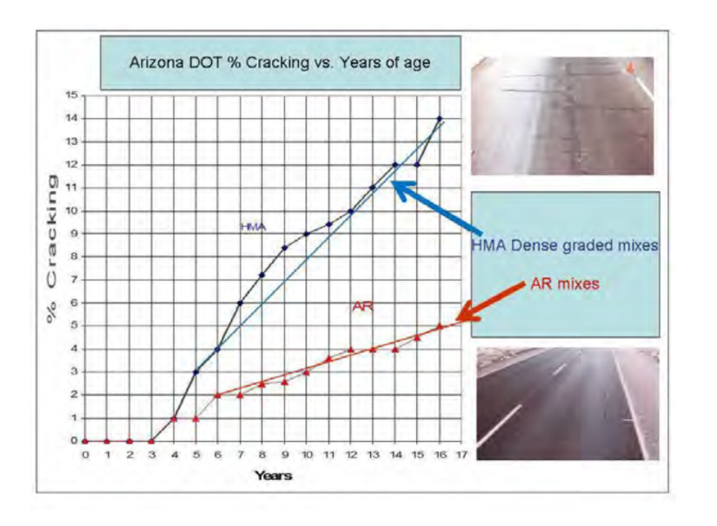
LONGER USEFUL LIFE
Cologne, 30th may 2.018

Slide 9
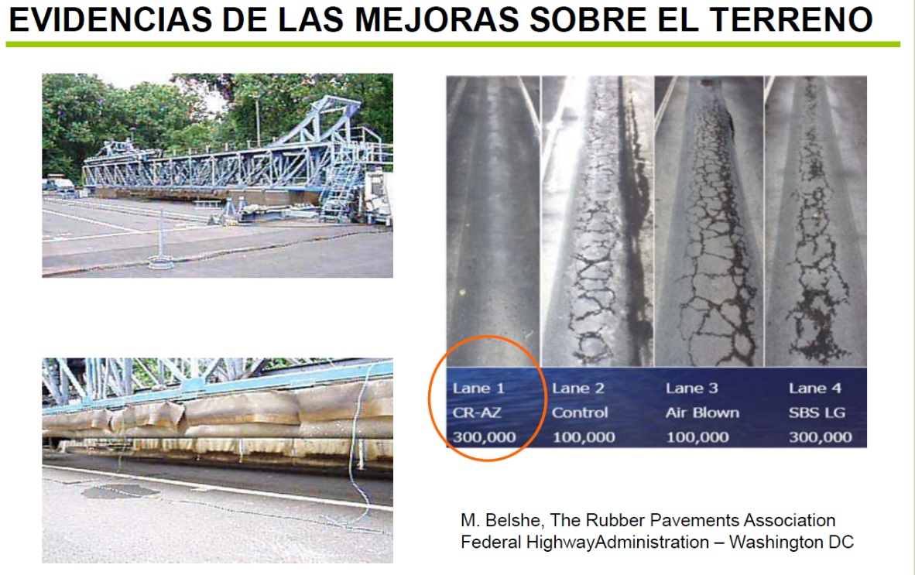
RESISTANCE AGAINST CRACKING AND RUTTING
Cologne, 30th may 2.018

Slide 10
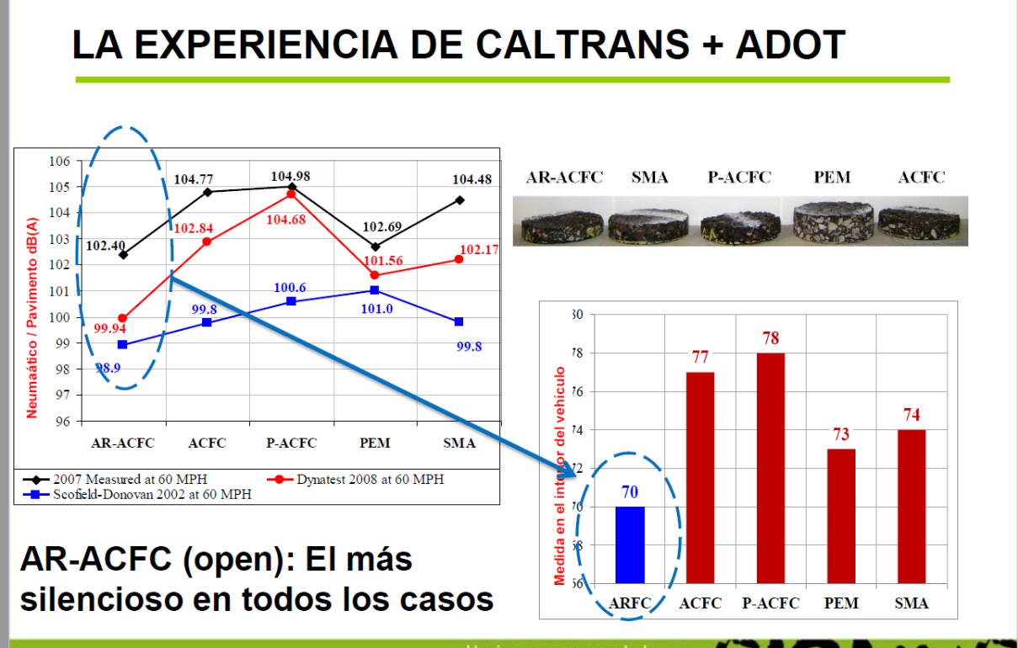
SOUNDLESS EFFECTIVENESS
CALTRANS + ADOT EXPERIENCE
ASPHALT RUBBER: most silent road of all mixes
Cologne, 30th may 2.018

Slide 11

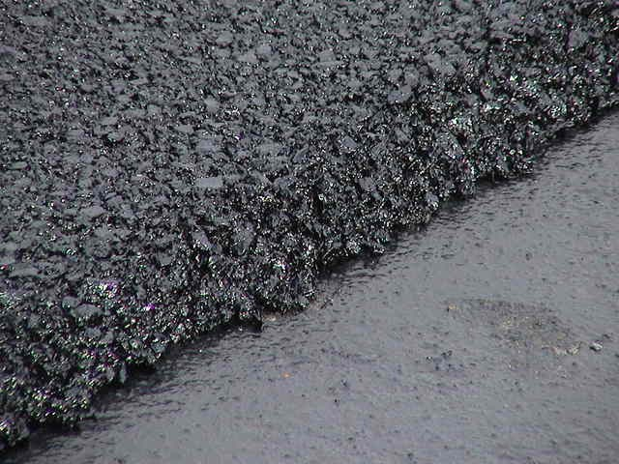
BENEFITS OF USING ASPHALT RUBBER
ECONOMICAL
Lower maintenance costs because of longer useful life of asphalt rubber mixes
Saving money due to reduced thickness of asphalt rubber layers against conventional ones
Crumb rubber is cheaper against other syntethic polymers used in modifying asphalt mix properties
Cologne, 30th may 2.018

Slide 12
BENEFITS OF USING ASPHALT RUBBER
SOCIAL
Due to longer useful life, time between two operations of reinforcement of a road surface is higher in mixes made with RARX against conventional, this supposes less inconvenience in time for road traffic, pedestrians and users in general
Asphalt rubber mixes are soundless effective, there´s a decrease of sound levels generated by vehicles in road-tyre contact surface, and therefore a lower noise pollution in neighborhood of the road which means a better quality life for all people living or working near the asphalt rubber road
No socio-economic degradation in surrounding environments of ELT´s stockpiles, as these don´t exist
Cologne, 30th may 2.018

Slide 13
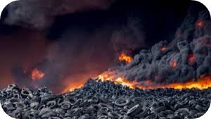
BENEFITS OF USING ASPHALT RUBBER
ENVIRONMENTAL
As a consequence of designing reduced thickness layers, smaller amounts of raw materials (aggregates, bitumen or binder and other additives) are required in the process of asphalt mix production, offering better technical performance than achieved with conventional asphalt mixes.
A high waste of ELT´s is guaranteed with usage of asphalt rubber, this supposes a real commitment with sustainability and environment preservation avoiding ELT´s stockpiles.
Cologne, 30th may 2.018

Slide 14
SPANISH EXPERIENCE WITH ASPHALT RUBBER
During the last twenty years a great number of road works with asphalt rubber have been done in Spain
First many were trial tests, in order to check all technical, economical, …, benefits mentioned before
Dry way was the technique firstly used, results weren´t always successful
Wet way started to be used with the 21st century, better results but some questions to solve
All these years both ways have improved, developed better processes to work with and now results are really great
Due to the growth of using crumb rubber for asphalt mixes, new ways (semi-wet) have appeared as an evolution of existing ways
Cologne, 30th may 2.018

Slide 15
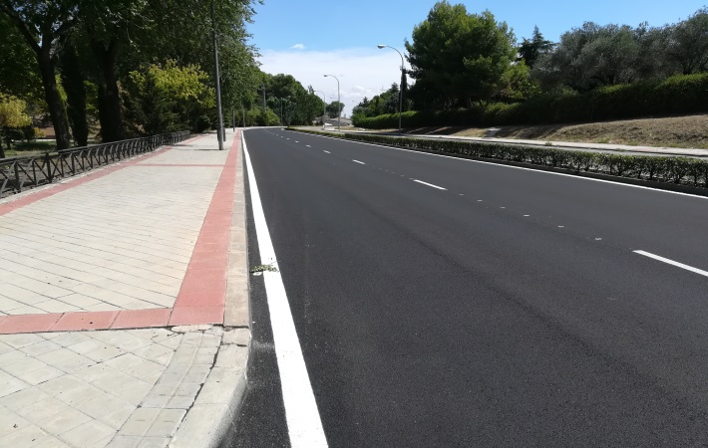
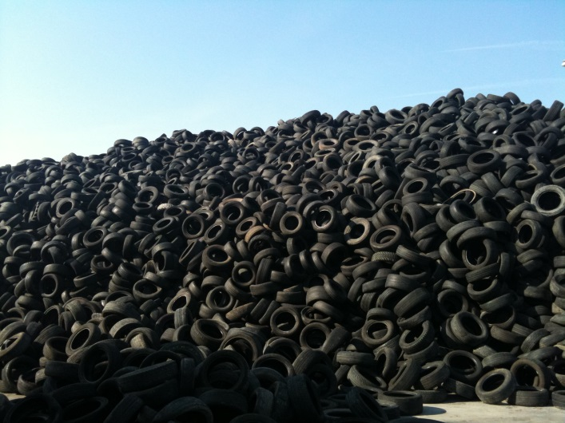
SPANISH EXPERIENCE WITH ASPHALT RUBBER
Some figures about this:
More than 1.600 kms. of roads, highways, streets, airports, … done with asphalt rubber mixes
More thas 1 M Tons. of asphalt rubber mixes produced
More than 60.000 Tons. of crumb rubber modified bitumen (CRMB) produced for former asphalt rubber mixes
Near 17.000 crumb rubber Tons. used, obtained from near 3,5 M ELT´s
Cologne, 30th may 2.018

Slide 16
SPANISH EXPERIENCE WITH ASPHALT RUBBER
And some graphics to illustrate…
Cologne, 30th may 2.018

Slide 17
SPANISH EXPERIENCE WITH ASPHALT RUBBER
Cologne, 30th may 2.018

Slide 18
SPANISH EXPERIENCE WITH ASPHALT RUBBER
Cologne, 30th may 2.018

Slide 19
SPANISH EXPERIENCE WITH ASPHALT RUBBER
Cologne, 30th may 2.018

Slide 20
SPANISH EXPERIENCE WITH ASPHALT RUBBER
Do really work asphalt rubber mixes and have a longer useful life? Let´s go for a walk...
Cologne, 30th may 2.018

Slide 21
SPANISH EXPERIENCE WITH ASPHALT RUBBER
Cologne, 30th may 2.018

Slide 22
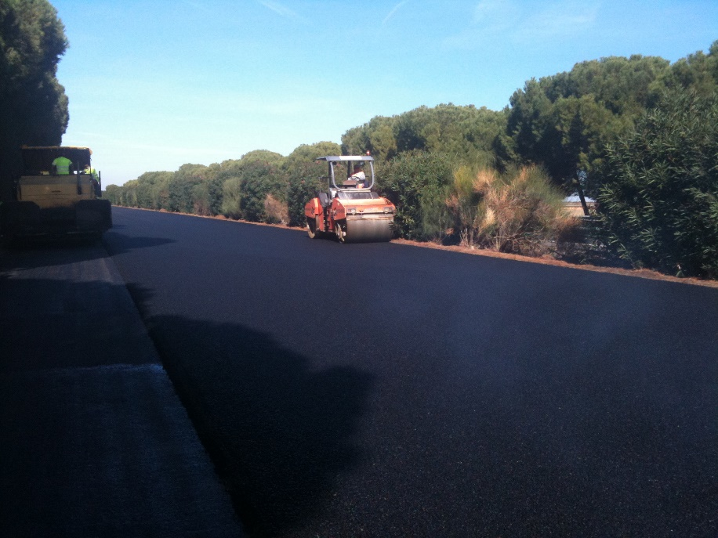
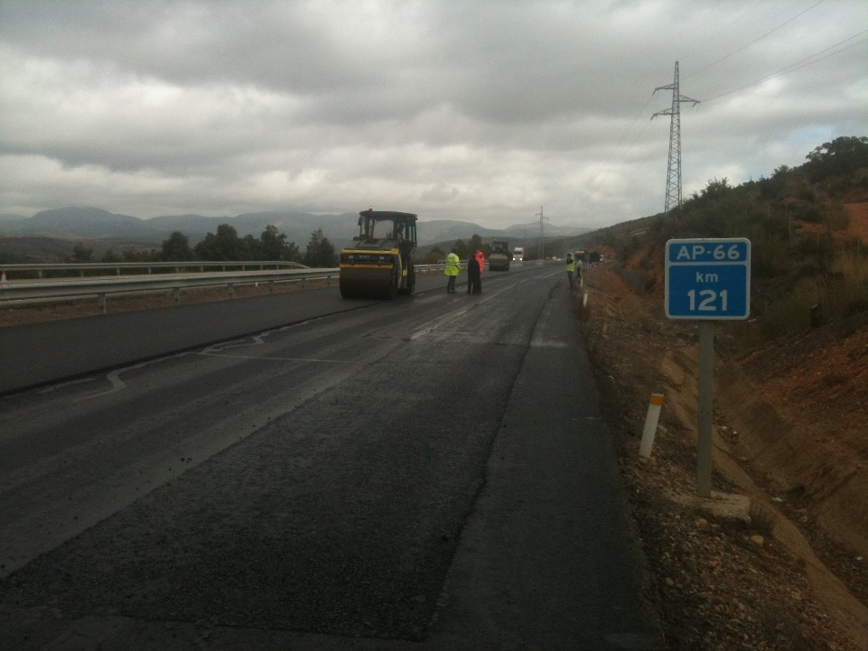
SPANISH EXPERIENCE WITH ASPHALT RUBBER
Working with asphalt rubber mixes
TOLL ROADS
Cologne, 30th may 2.018

Slide 23
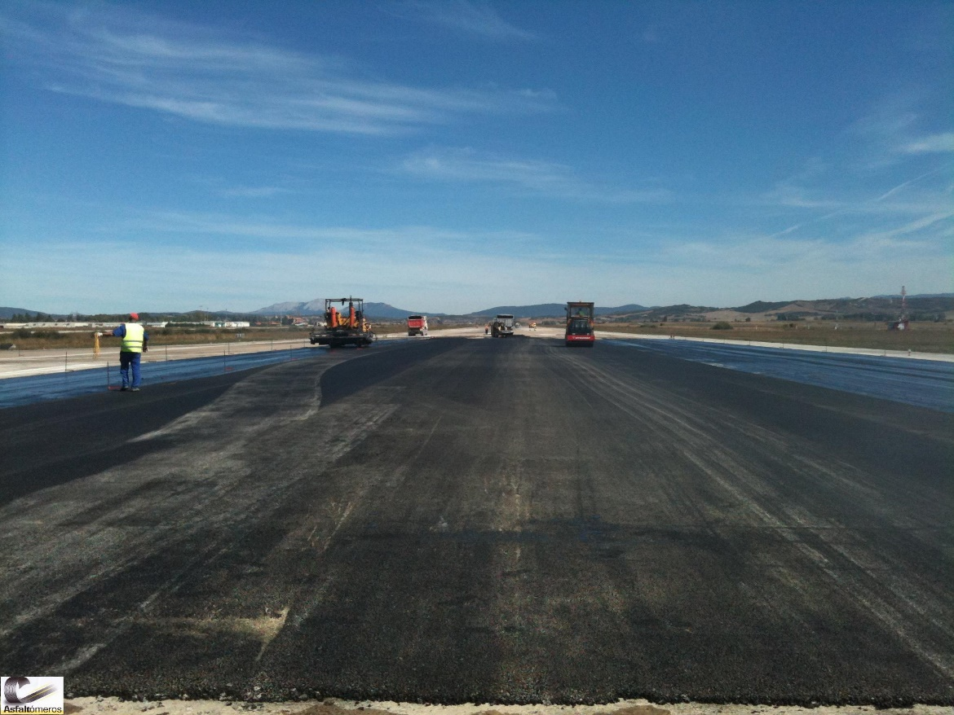
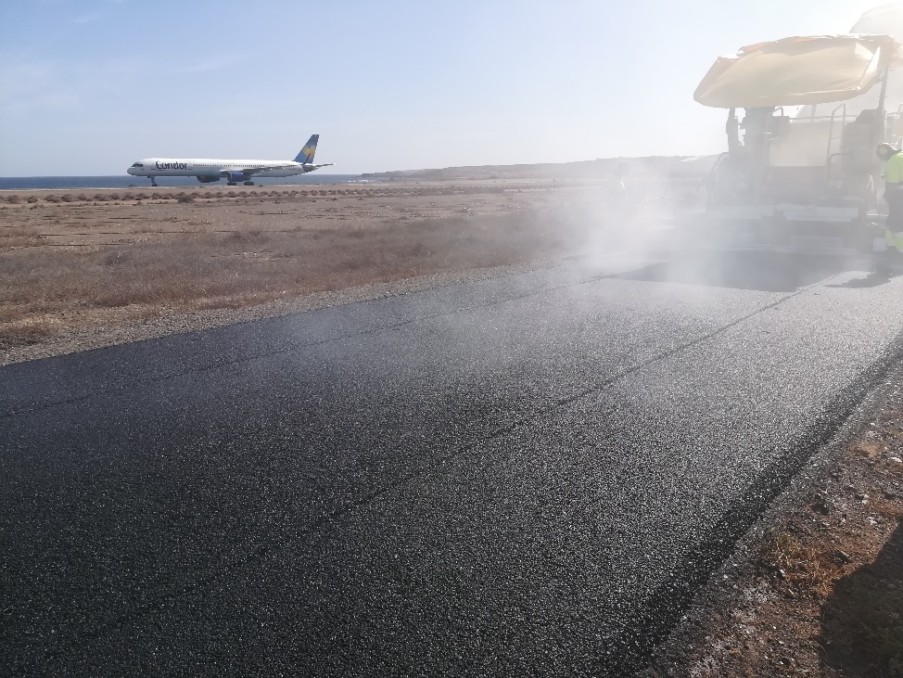
SPANISH EXPERIENCE WITH ASPHALT RUBBER
Working with asphalt rubber mixes
AIRPORTS
Cologne, 30th may 2.018

Slide 24
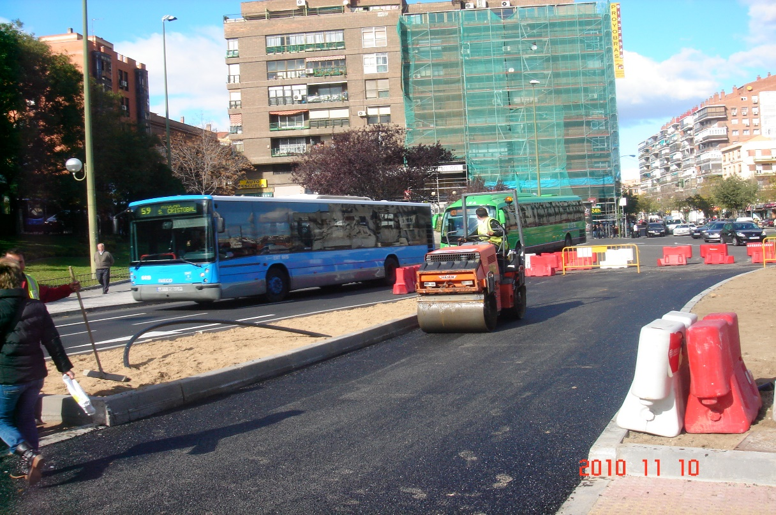
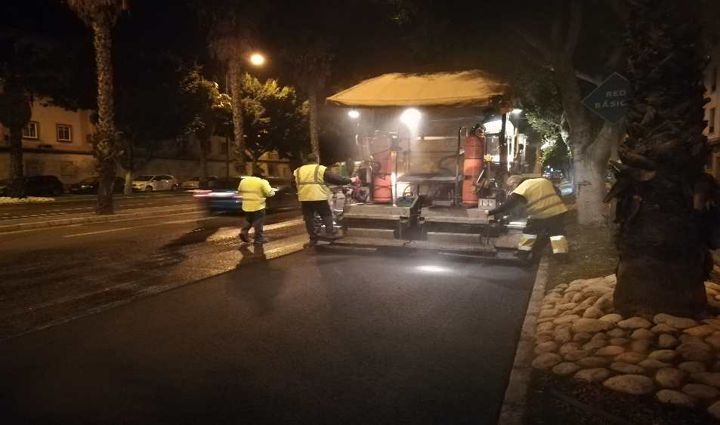
SPANISH EXPERIENCE WITH ASPHALT RUBBER
Working with asphalt rubber mixes
CITIES
Cologne, 30th may 2.018

Slide 25
CONCLUSIONS
Crumb rubber obtained from ELT´s is an excellent raw material for enhancing technical properties of asphalt mixes.
These better technical properties are today very considered, in order to decrease maintenance road costs and to ensure a longer useful life for asphalt mixes.
Besides technical advantages, asphalt rubber mixes have economical and social benefits against conventional and traditional asphalts.
Of course, we are talking about products environmentally sustainable, in order to reach the goal of circular economy in asphalt business too.
Hundreds of successful experiences and works are the best reason to continue using these technologies based on crumb rubber.
This is a no-return way, asphalt mixes will be sustainable and environmentally friendly in a near future even at 100%.
Cologne, 30th may 2.018

Slide 26

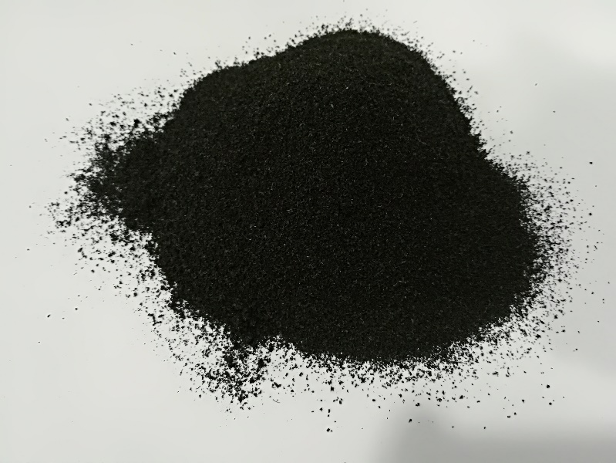
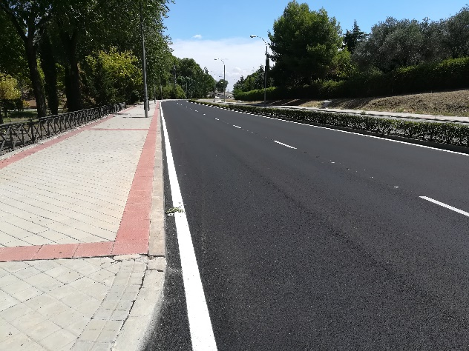
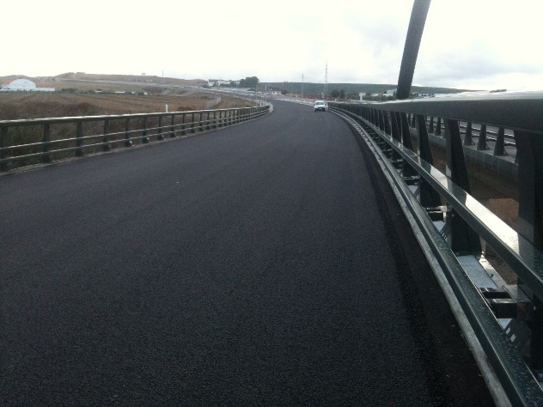
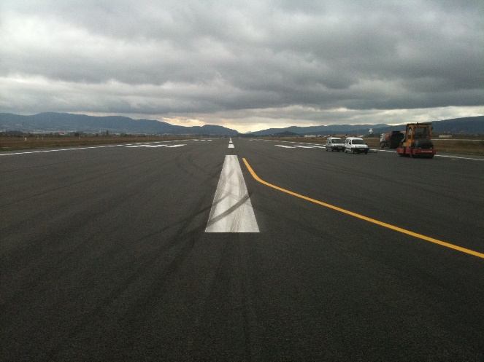
THANK YOU VERY MUCH

