Slide 1
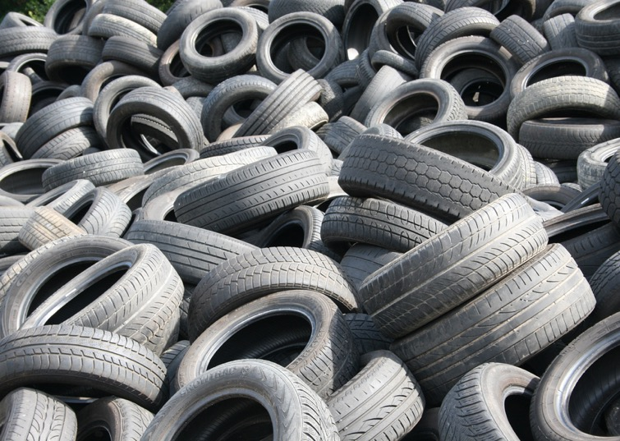

Slide 2



TIRE RECYCLING
CONSULTING
CEYES helps companies build succesful tire recycling and other relevant businesses
With the focus on the Circular Economy
Together with our great partners

Slide 3

CEYES is one of the world’s leading consultancy firms for research, products, design and management of tire recycling facilities through re-cycled and up-cycled rubber.
We offer specialized independent advice, knowledge and effective solutions for the production of re-cycled and up-cycled rubber for, inter alia, decision makers, starting entrepreneurs and companies.

Slide 4
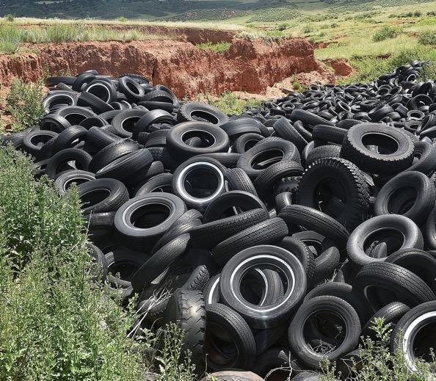
20 YEARS OF EXPERIENCE
After more than20 years of experience and know-how.
We started CEYES Circular Experts in 2016, and is enable to offer our customers, one the best tire recycling solutions.
WE BUILT
Over the last 13 years together with our partner MTB Recycling,
tire recycling facilities in Croatia, Romania, England, Israel, Tunisia, USA, Sweden, Kuwait etc etc.

Slide 5
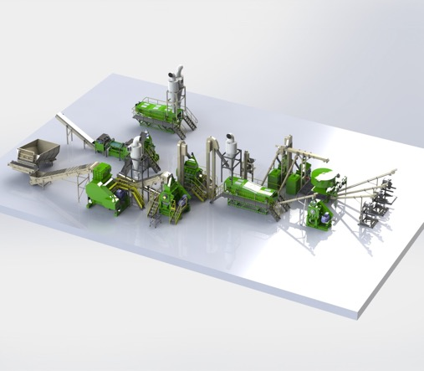

In cooperation with “MTB recycling” we offer the concept “Total tire recycling”
“Total tire recycling”
Pre-engineering on customers request
Productions and maintenance
Turnkey project
Techn. project leader and manufacturing machinery

Slide 6
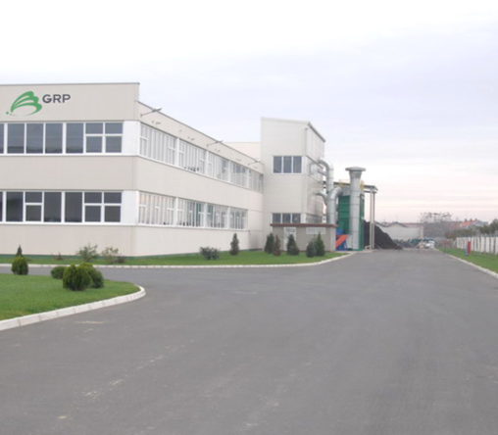

GUMIIMPEX GRP
2005 - CROATIA
MTB TRS3000 line incl. Clean Wire System
Capacity 3,5 tons input
50% Car tires
40% Truck tires
10% OTR tires
Output
Granules 0,0-0,5 0,5-2,0 2,0-3,5
97% Clean steel wire

Slide 7
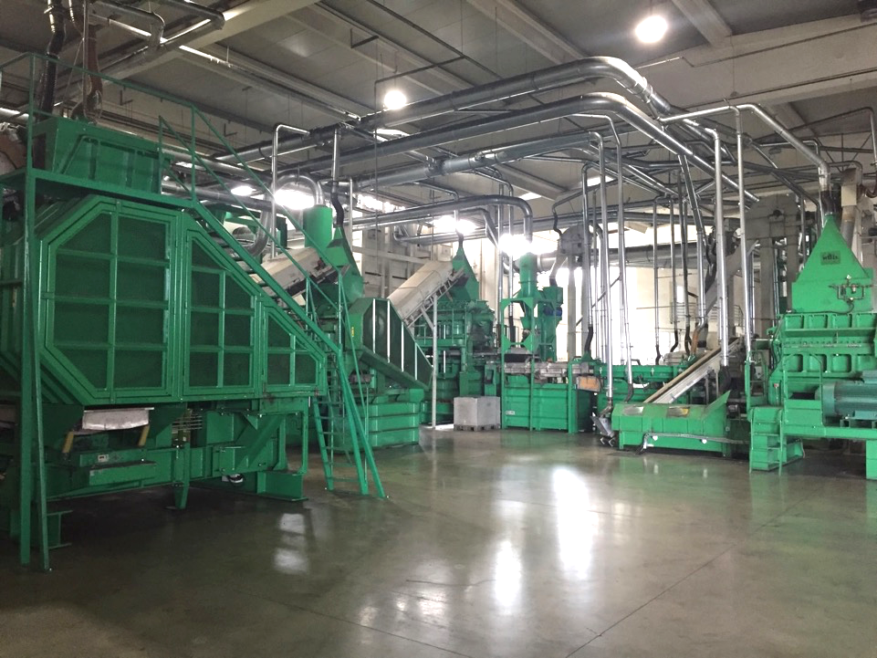
2005 - 2017

Slide 8
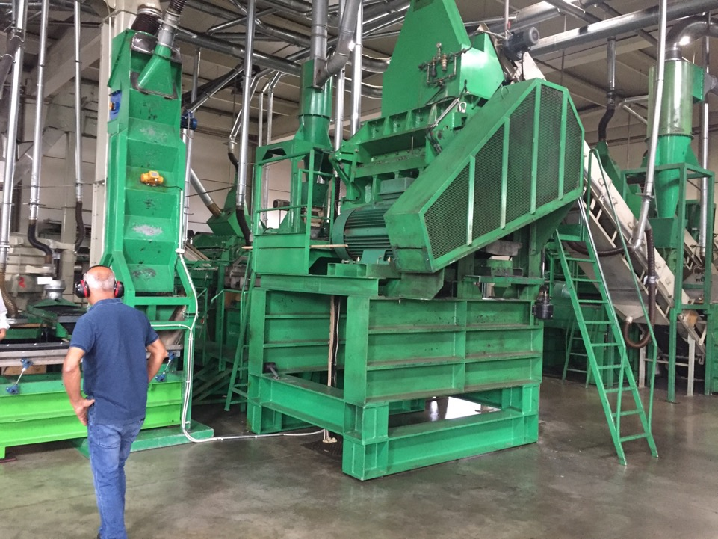
JUNE - 2017
2005 - 2017

Slide 9
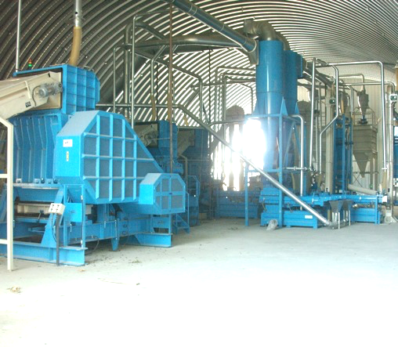

PROAUTO
2008 - Romania
MTB TRS2500 line
Capacity 2,5 tons input
50% Car tires
40% Truck tires
10% OTR tires
Output
Granules 0,0-0,5 0,5-2,0 2,0-4,0

Slide 10
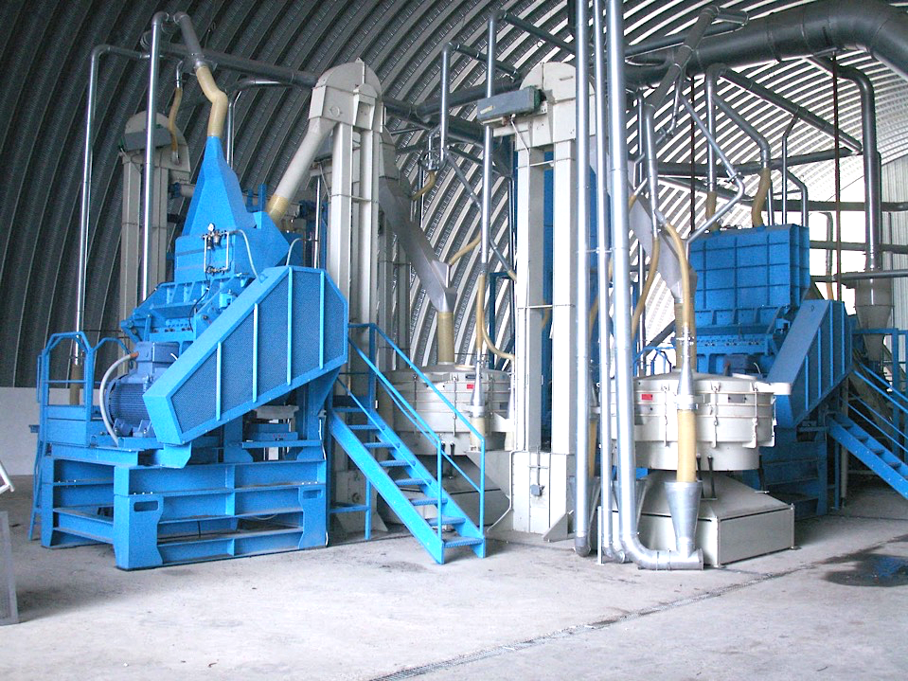

Slide 11
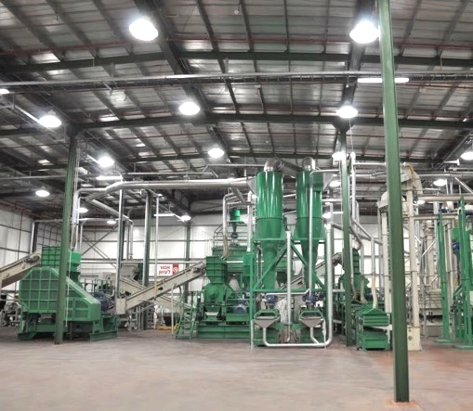

TYREC
2009 - Israël
MTB TRS3000 line
Capacity 3 tons input
50% Car tires
40% Truck tires
10% OTR tires
Output
Granules 0,0-0,5 0,5-2,0 2,0-4,0

Slide 12
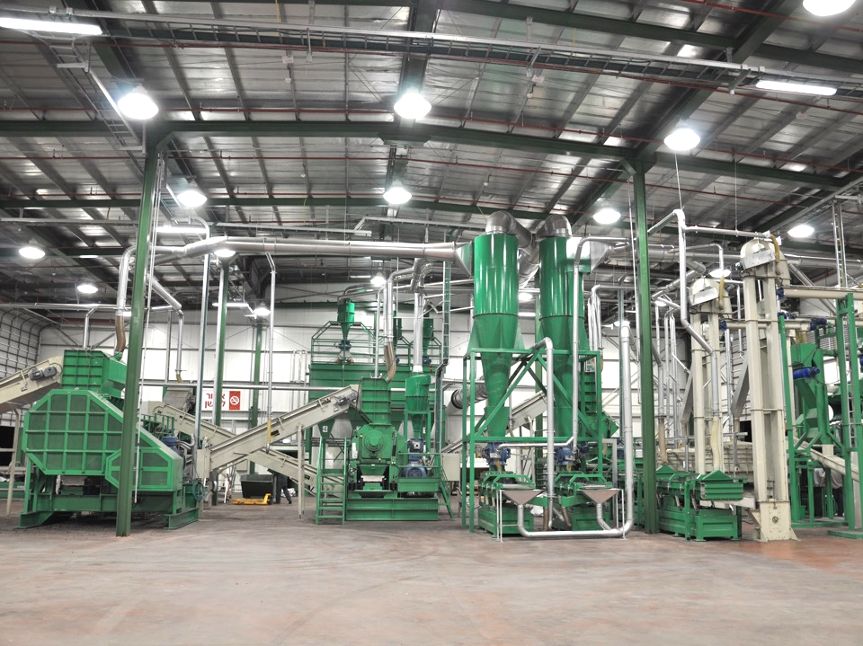

Slide 13
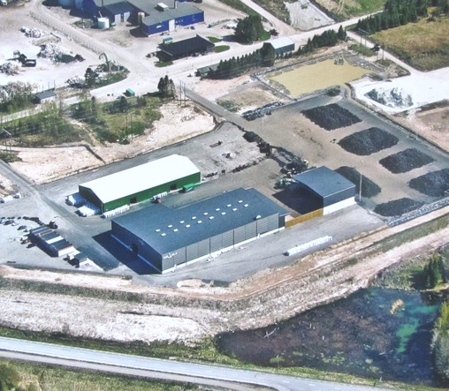

RAGN SELLS
2011 - Sweden
MTB TRS6000 line
Capacity 6 tons input
40% Car tires
10% Car tires with spikes
40% Truck tires
10% OTR tires
Output
Granules 0,0-0,5 0,5-2,0 2,0-4,0
97% Clean steel wire

Slide 14
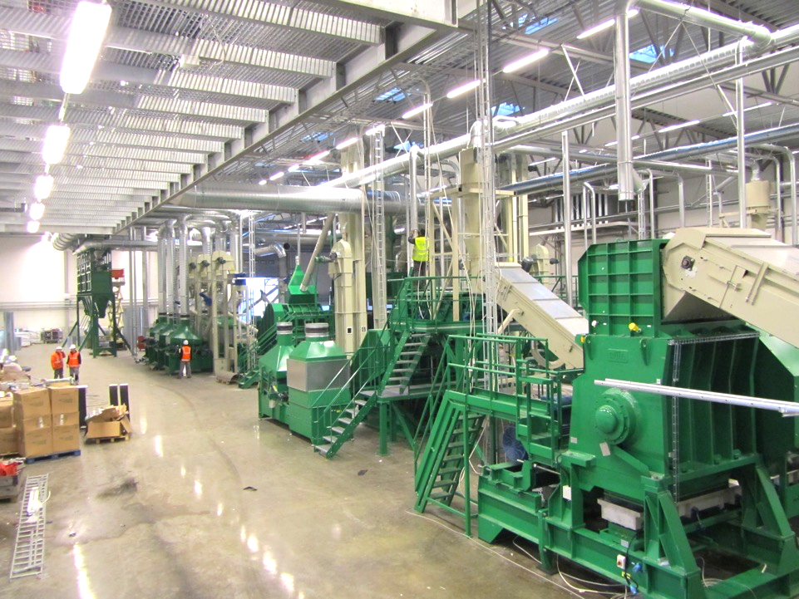

Slide 15
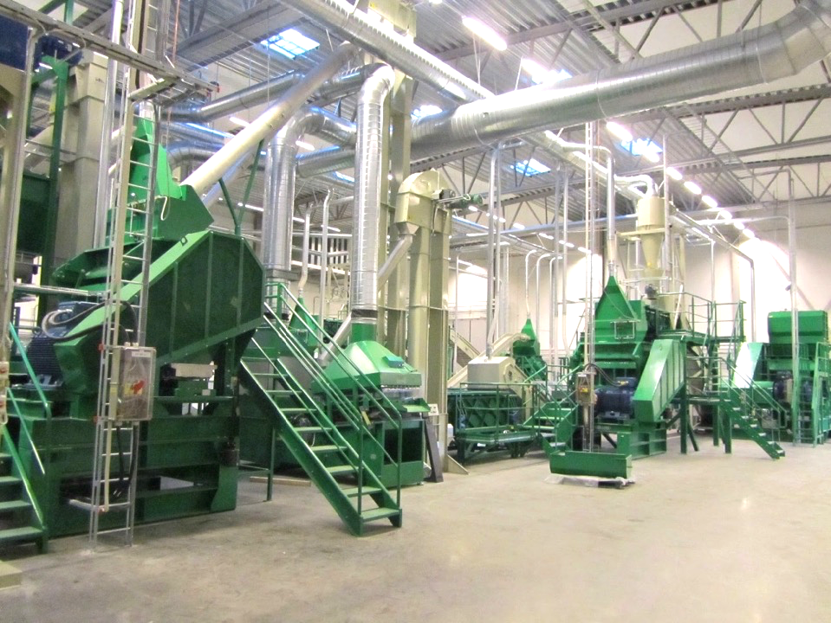

Slide 16
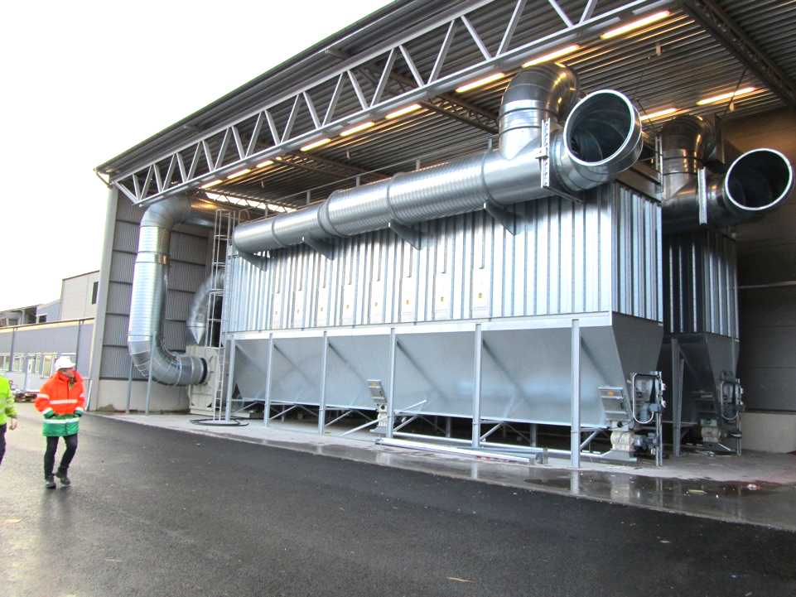

Slide 17
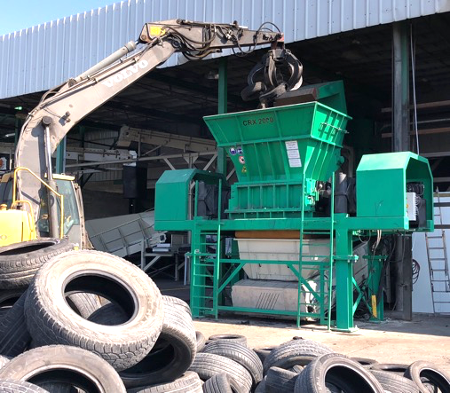
TYREC
2017 - Israël
Up-grade to MTB TRS10.000 line
Capacity 10 tons input
50% Car tires
40% Truck tires
10% OTR tires
Output
Granules 0,0-4,0 4,0-10,0

Slide 18
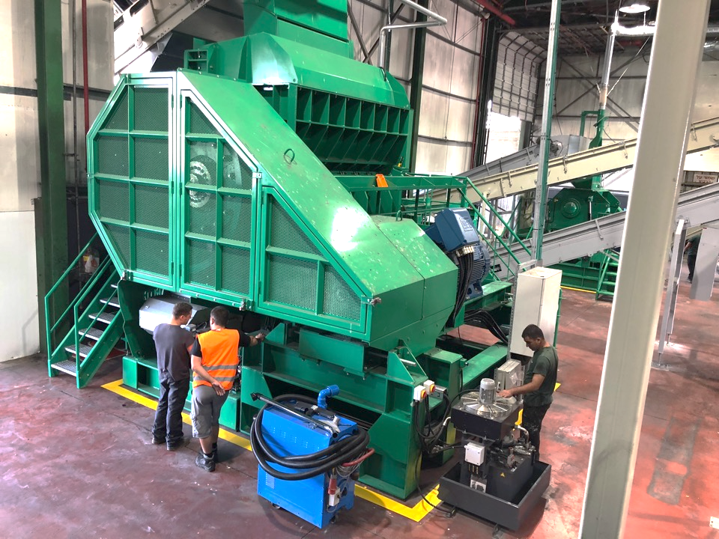
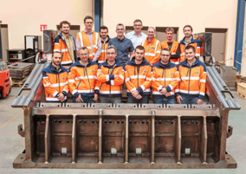
MAXI GRANULATOR SRP2800

Slide 19
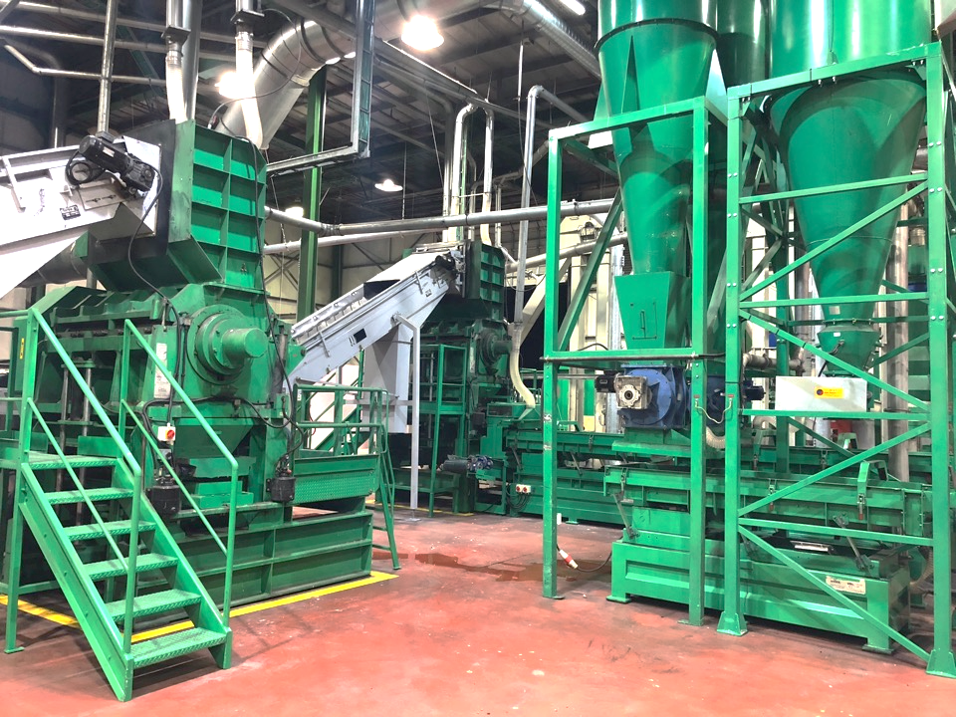

Slide 20
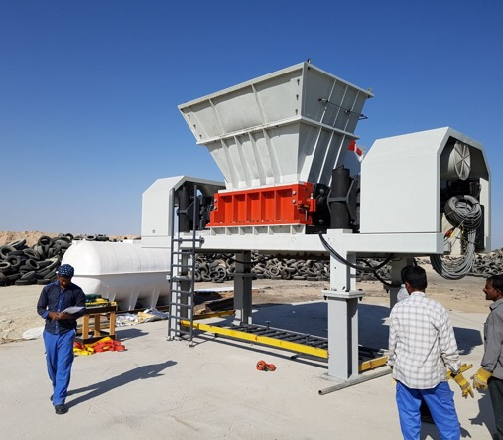
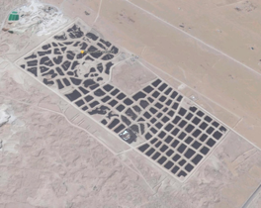
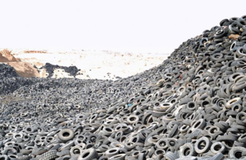

KUWAIT RECYCLE COMP.
2017 - Sula biya Tire graveyard Kuwait
CRX2000
Capacity 14 tons per hour
Biggest tire graveyard in the world

Slide 21
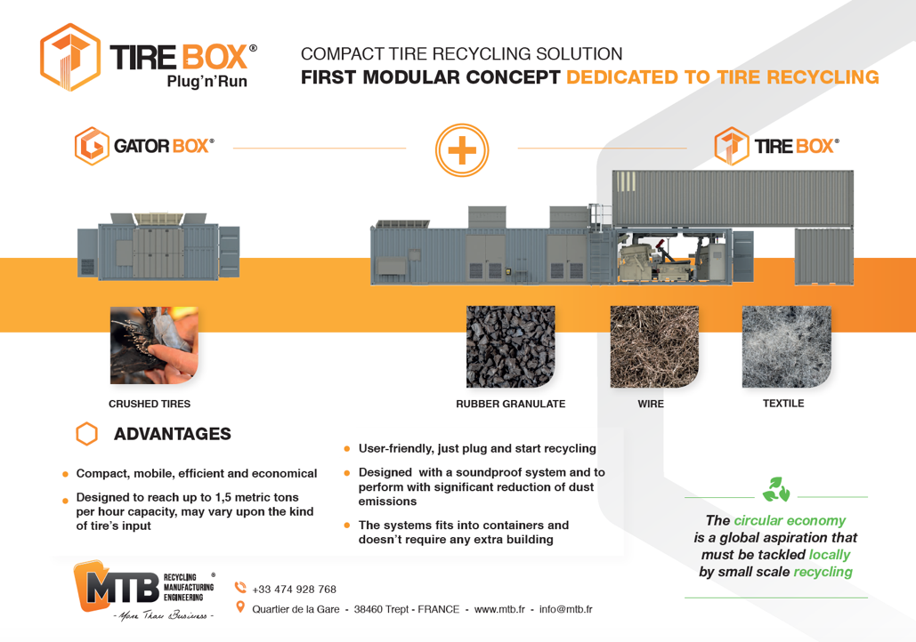

Slide 22
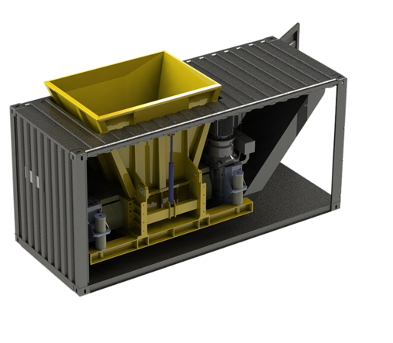

NEW DEVELOPMENT
2017 - SEMI MOBILE SHEAR
The Gator’Box, Compact & mobile shear and ripper
Gator’Box incorporates, in its 20-foot container, the RSX: a two-rotor grinder that can be used both as a rotary shear and a shredder.

Slide 23
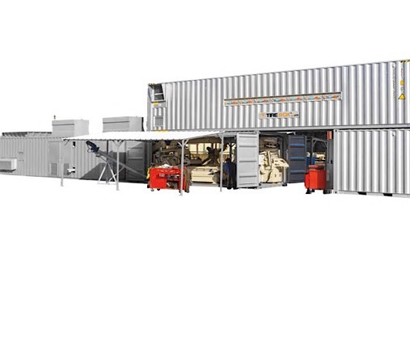
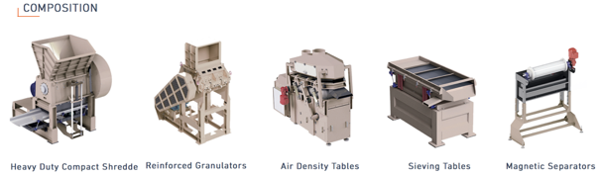


NEW DEVELOPMENT
2017 - SEMI MOBILE TOTAL CONCEPT
100% of MTB's expertise and performance in boxes.

Slide 24
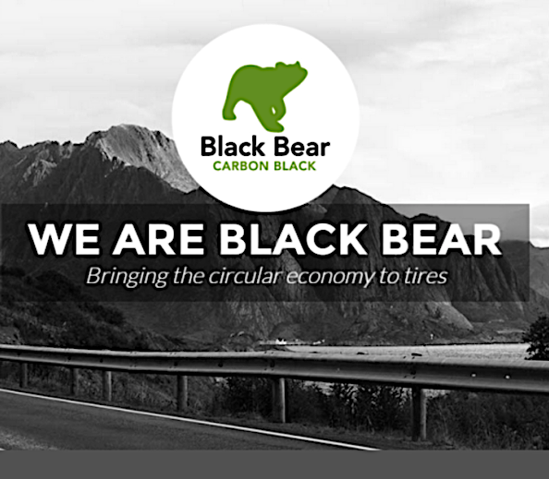
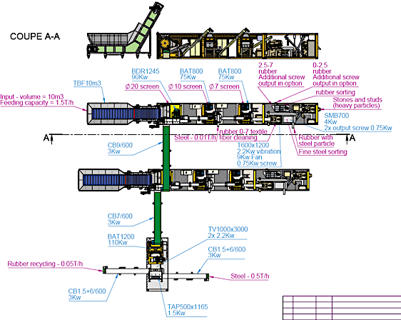

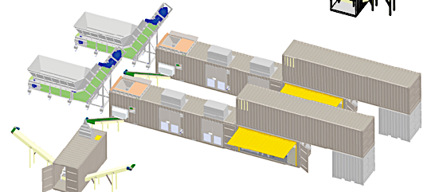
MODULAR PRE-TREATMENT SYSTEM
designed for BLACK BEAR CARBON process

Slide 25
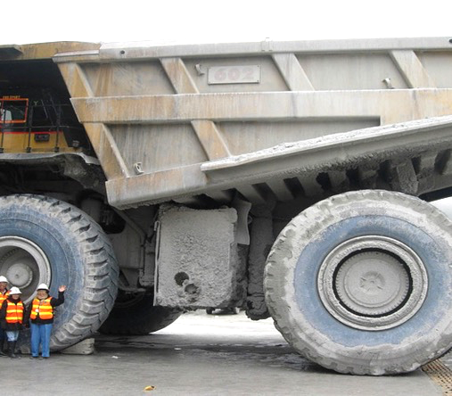
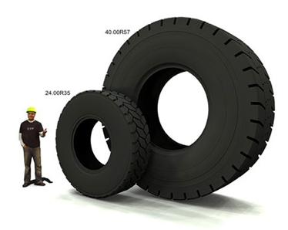
MINING TIRE RECYCLING
2017 - SEMI MOBILE TOTAL CONCEPT
CEYES and his partners can deliver a complete Mining Tire recycling solutions locally at the mining site.
Processing range from 33 to 63 inches
Max. outside diameter of 4.2 mtrs
Easily relocatable in a few units

Slide 26
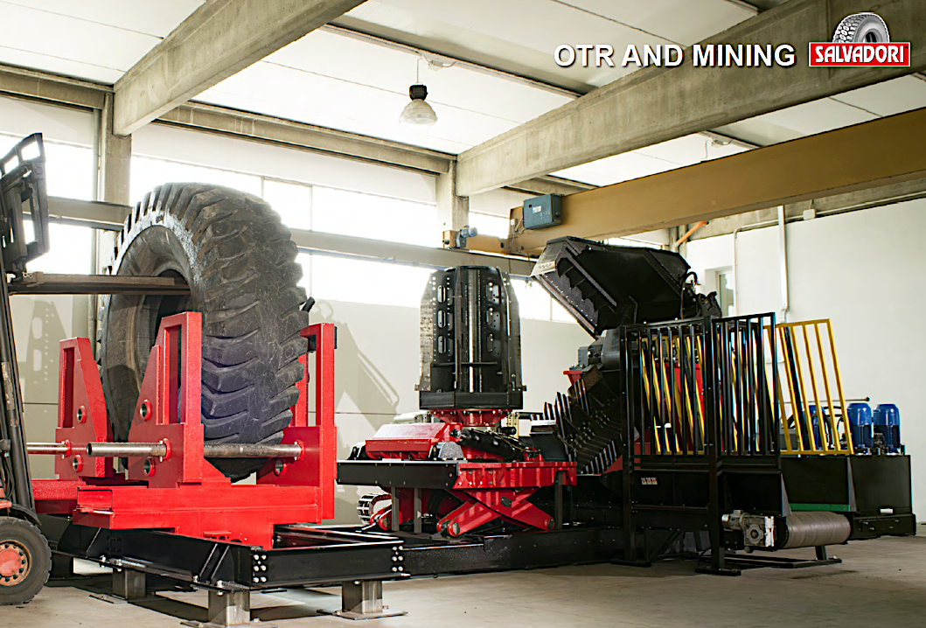

Slide 27
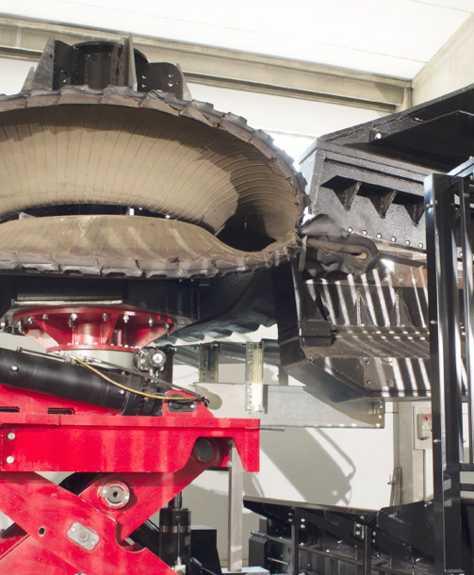
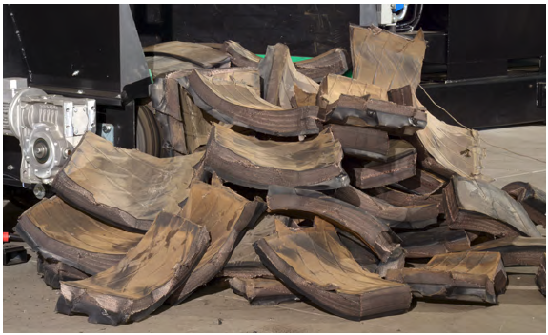
These rubber pieces can be perfectly processed on location by the MTB GATOR box

Slide 28
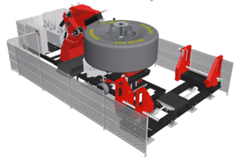
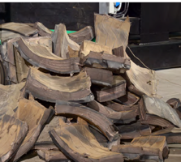

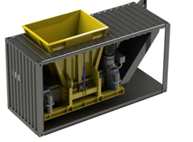
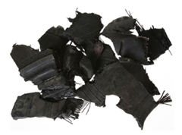
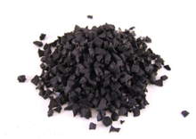
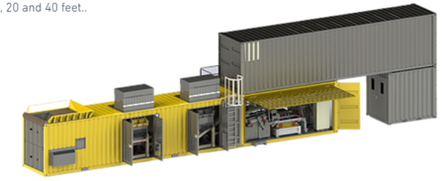
MT REX
STEP 1
4 Tons per hr.
Max. 63 inch. (inside dia)
Max. 410 cm (outside dia)
GATOR BOX
STEP 2
6 Tons per hr.
Output max. 56 - 300 mm
TIRE BOX
STEP 3
1.2 Tons per hr. input
Output 0,5 - 2,0 mm
Output 2,5 - 7,0 mm

Slide 29
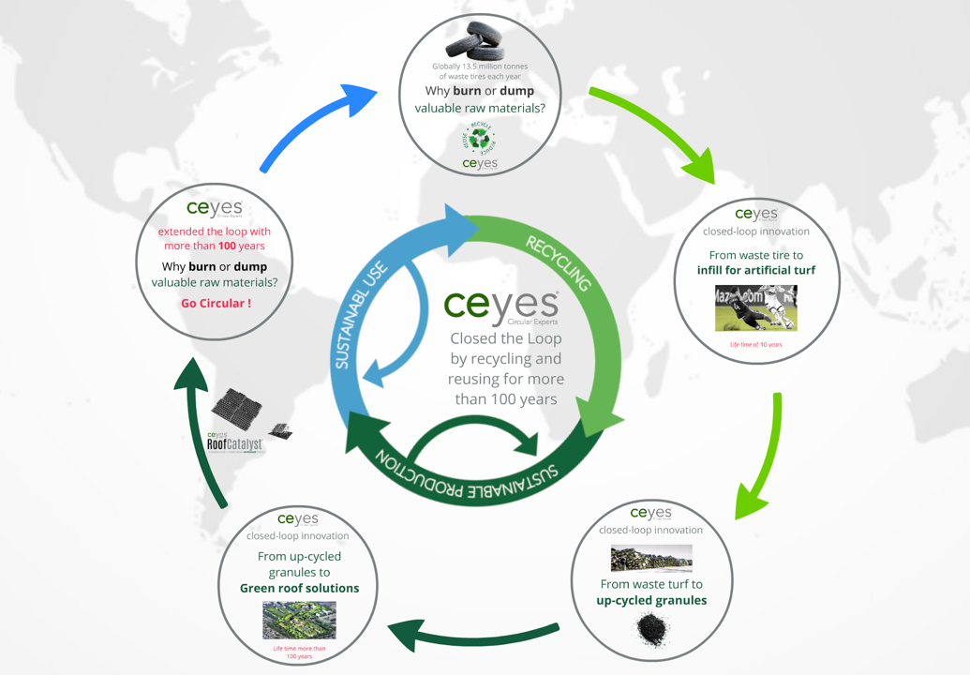

Slide 30
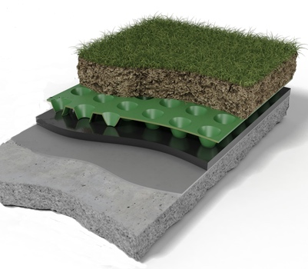
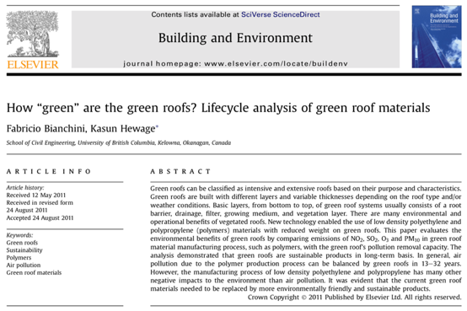
HOW GREEN ARE
GREEN ROOFS?

Slide 31

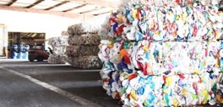
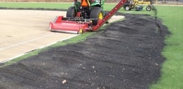



LIFECYCLE ANALYSIS OF GREEN ROOF
MATERIALS
Lifecycle analysis of green roof materials
School of Civil Engineering, University of British Columbia, Kelowna, Okanagan, Canada
Lifecycle analysis of granules by Dutch enthusiasts of the Circular Economy
(appropriate Canadian LCA needed)
excisting solution
Waste HPDE
polyethylene and polypropylene
the new Circular solution
Waste rubber granules
used in synthetic turf
4,50
0,10
kg CO2-eq / kg
kg CO2-eq / kg
1 kg HDPE-waste, provides
75% secundair HDPE granules
1 kg RUBBER provides
100% secundair RUBBER granules

Slide 32
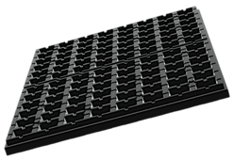
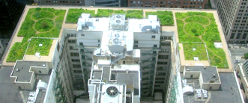
LIFECYCLE ANALYSIS OF GREEN ROOF
MATERIALS
3,5 kg
p/m2
27,5 kg
p/m2
60 mm (secundair HDPE)
60 mm CEYES RoofCatalyst ®
15,75
2,75
kg CO2-eq / m2
kg CO2-eq / m2
CO²
is balanced
13 to 32 years
CO²
is balanced
3 to 6
years
lifespan varies between 40 to 50 years
lifespan varies more than 100 years

Slide 33
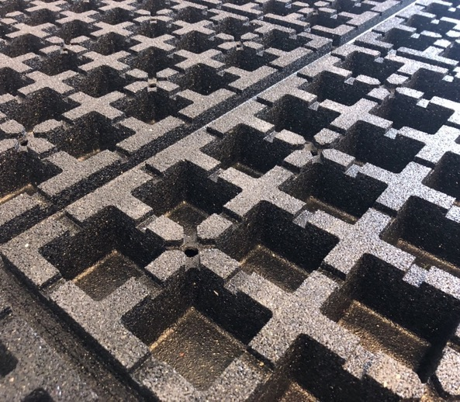

THE FIRST GREEN
ROOF SOLUTION
Up to 5x less CO2 footprint than the same product from recycled plastics.
A longer product life span is a pillar of the circular economy.
Designed and produced according to the Circular Principles.
Locally made from local waste.
Solution for rubber infill waste problem.
100% Recyclable.

Slide 34
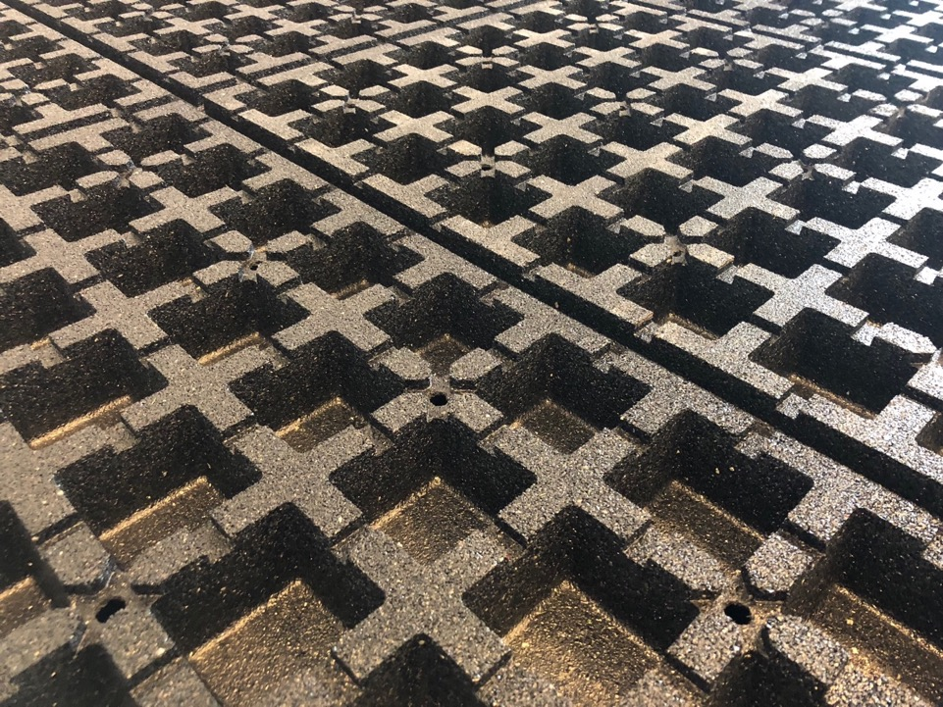
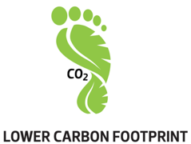


Slide 35
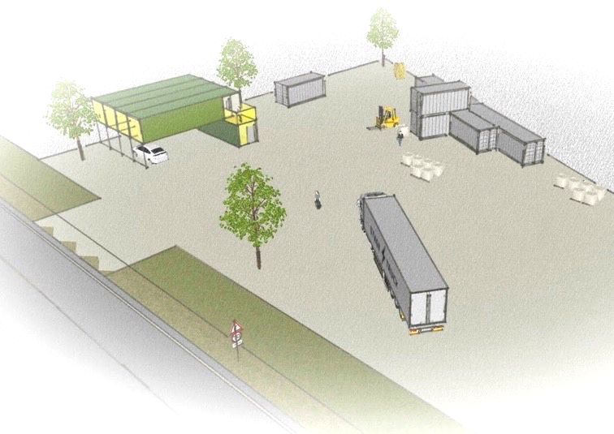
THE CIRCULAR ECONOMY
IS A GLOBAL ASPIRATION THAT MUST BE TACKLED LOCALLY

Slide 36






BY SMALL SCALE INDUSTRIES
This is a whole new approach, small-scale production in the Circular Economy. These boxes are circular, compact, mobile, efficient, effective, economical, 100% recyclable and create less CO2 emissions compared to a factory building.
These CEYES HUBS are ideal in regions and especially attractive in a radius of 400 km.
In this day and age, it is no longer justified to cover large distances, together with its forthcoming high CO2 emissions.

Slide 37



















evolutionary wooden buildings
Locatie CEYES HUB, development location landscape Klaver 14 (CeRu BV)
Plot size 1.750 m2

Slide 38




Slide 39

SMALL SCALE INDUSTRIES
Centralized vs De-centralized
The production of 80,000 m2 of retention panels requires 4000 transport movements of up to 200km for the supply of the rubber granulate and 4000 transport movements of max. 200km for the discharge of the rubber retention panels to the projects.
a competitor operating its production facilities in Germany have a minimum distance of 600km and it will save 800,000 liters of diesel per year.
20 million liters of diesel in 25 years
(€ 28 million) for every production line of 80,000m2

Slide 40

SMALL SCALE INDUSTRIES
Centralized vs De-centralized
Not only is there energy (saving fuel) but also the environment is spared. 1 liter of diesel is 2640 gr CO₂ / liter emissions.
In 25 years, therefore, 52.8 million kg CO₂ will be saved with 1 small scale unit.
In this day and age, it is no longer justified to cover large distances, together with its forthcoming high CO2 emissions.

Slide 41

ENERGY SAVINGS
RUBBER VS PLASTICS
Approximately 30 Kwh of electricity is required for the processing of 1m2 plastic drainage plates from recycled HDPE. The energy consumption in the production of rubber retention panels is only 5.2 Kwh or about 6 times lower.
On an annual basis this means an energy saving of 2,000,000 Kwh in the production process of 80,000m2 of panels and therefore 50 million Kwh for 25 years.

Slide 42



Slide 43


Slide 44

CONTACT US:
CEYES B.V.
Tappersweg 14 office 48
2031 EV Haarlem
The Netherlands
Tel: +31 23 205 2271
info@ceyes.eu
www.ceyes.eu

